Slide 1
Welcome to CS 150

Slide 2
Quick Introduction
Introduce yourself to the people around you
smaller rooms, we can do this for everyone
Name and Favorite Fruit or Vegetable
Online students – type this in the chat
Why the full introduction?
This help session is your cohort
You are in this class together
These are the people that will help you through!

Slide 3
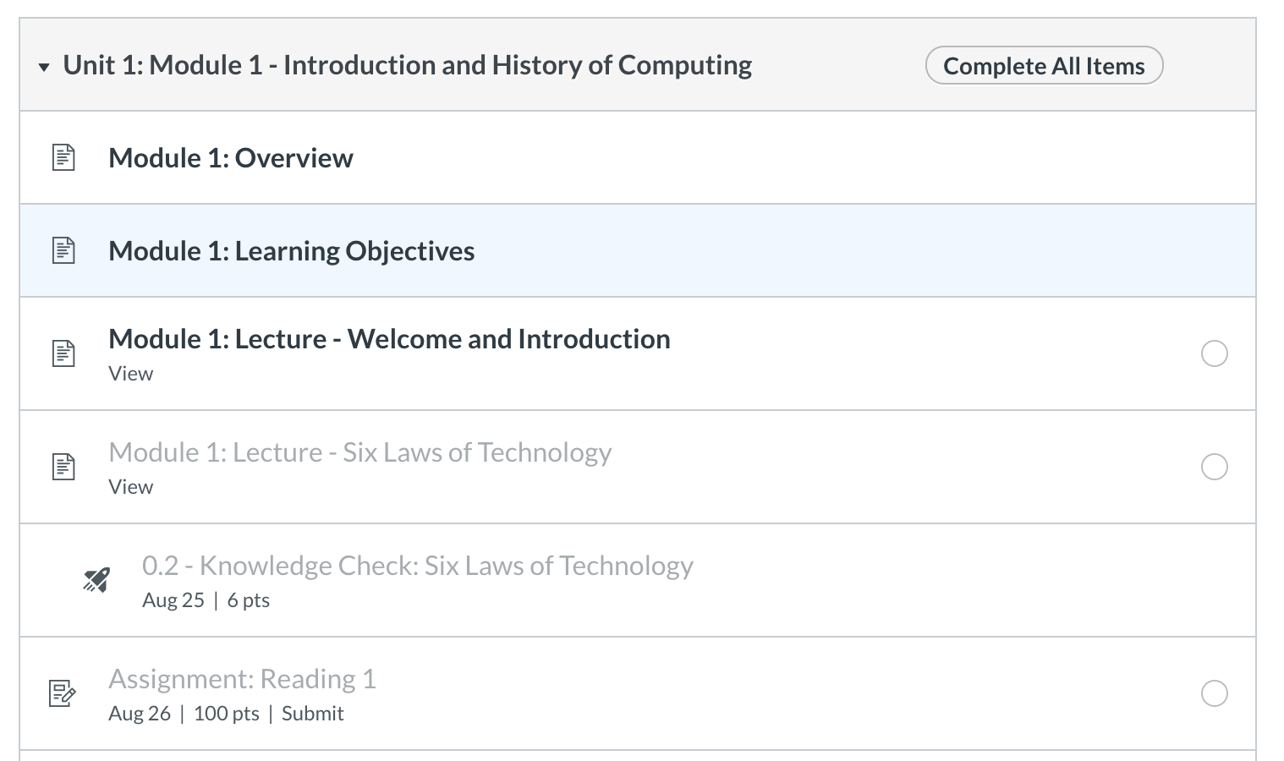
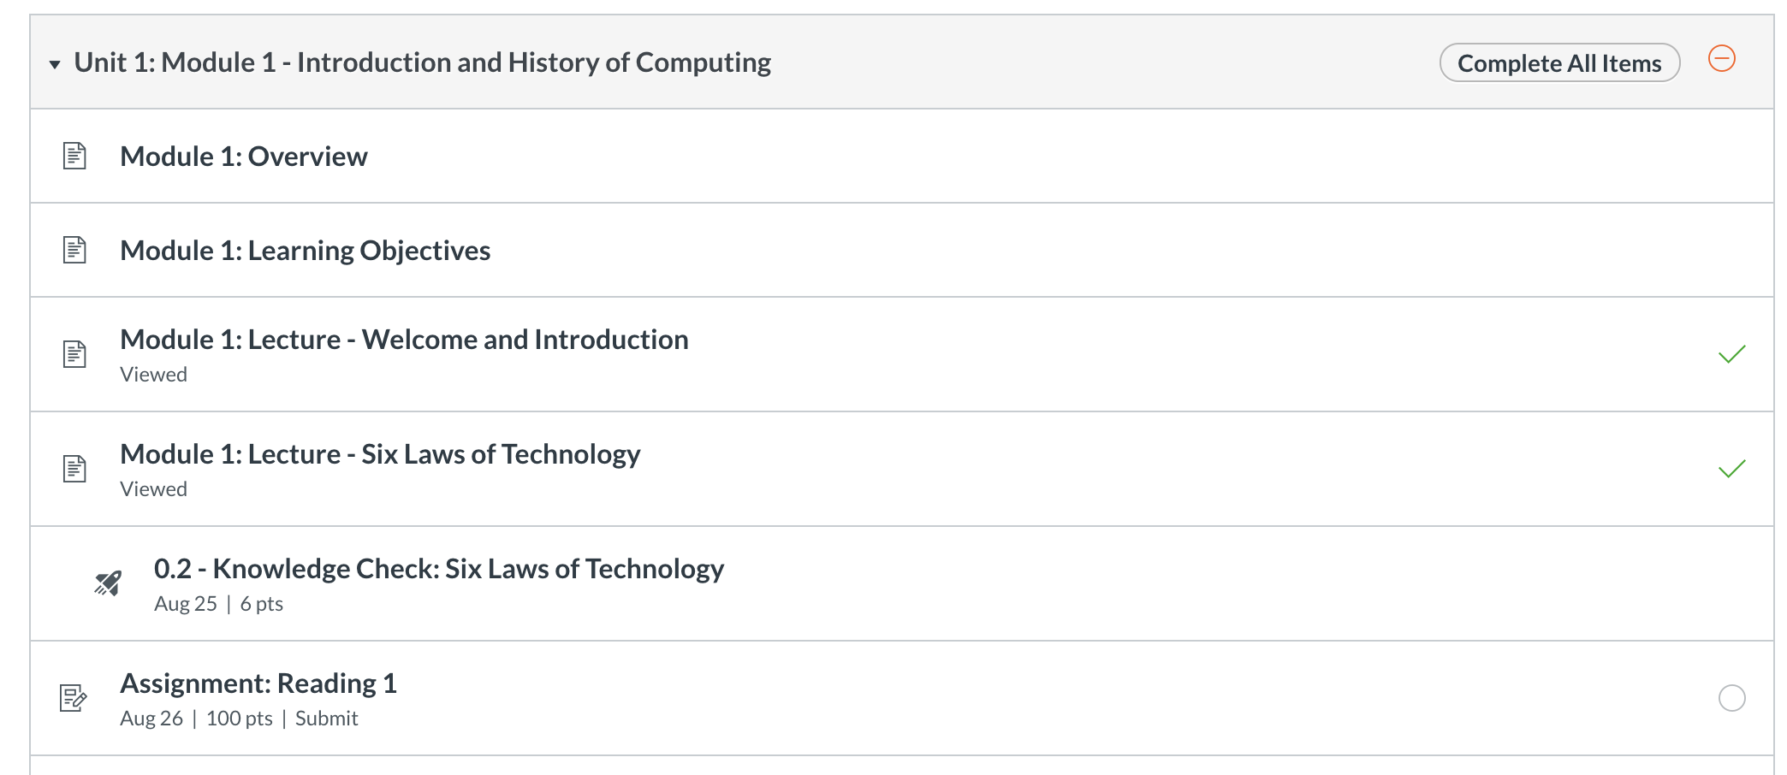
Course Layout
Modules
Follow them in order
General Order
Reading
Due Monday and Wed Nights
Lectures + Knowledge Checks
Due Tuesday and Thursday nights
Lab
Due Monday and Wed Nights
Written assignments / discussion posts
One per unit, Friday

Slide 4
Accommodations Window
Flexible Resubmission Windows with a *very hard* deadline
Knowledge Checks
Resubmit all semester (no reason to not get 100%)
Practice Exams
Resubmit all semester
Readings
Resubmit until the Unit Exam / End of the Unit
Labs
Resubmit up to a certain number of times until Unit Exam / End of The Unit
Written Assignments
Single submission
Note: This is enough flexibility to get you in trouble! – Don’t be that person.
Make sure by the end of each week, you have completed the module except for the last lab (that is due the next Monday)
Unit 1, Module 1 – Complete through everything but Lab 1 by Friday
Lab 1 + Unit 1, Module 2 – Complete through Lab 3 by Friday of Week 2. etc.

Slide 5
Readings and Labs
All in zybooks
To be successful
Do reading before lab!
First reading is the longest by far!
They focus on writing Code

Slide 6
Knowledge Checks
Focus on Reading Code
Also help with recall
Best thing to do – go back to them
Interleave – pick different orders to redo them from time to time
Spacing – do some every night!
Psychology of learning – this helps!
Best way to study for exams?
Every night – knowledge checks, practice exam
Retesting + spacing
You can do them 100 times, get different results every time!
Highest result is the one kept
 | ReStudy | ReTesting
Massed
Spaced
Most
Students
Ideal For
Recall

Slide 7
Written Assignments
AUCC – Requires 25% of the grade to be written
75 points – Do or don’t assignments ~7% of your grade
Discussion posts + reflection
Take your time. I read them all, and a single sentence will earn you a zero!
100 points – Midterm Essay –10% of your grade!
Graded by TAs
*major* component of your grade
Practical Project - 8% of your grade
End of term project – 100 points graded paper, 50 points code.

Slide 8
Exams
End of Unit 1, 3 and Final Exam
95 points – exam
5 points practice exam (yes, so you should get 100% on the practice exams)
All readings up to the exam must be completed
Or you won’t be able to take the exam!
You can complete them with a zero, but that is a bad idea
We use respondus
Which is why the syllabus quiz requires it – just to make sure you are ready for the exam in four weeks

Slide 9
Help Sessions / On-Campus
On-Campus Days
MW, your assigned lab
Tuesday or Thursday – 1 help session a week (like today)
Attendance Required?
No, but…
Really, really good idea.
We give extra credit per help session you attend
REPLACES the 2:00-2:50 T/TH time in ramweb
Goals of Help Sessions
Provide content related to lectures and labs (discussion and coding)
Answer questions
Build community
Your Responsibilities
Come with questions – mark certain knowledge checks, practice exam questions etc.
Pro Tip:
Send questions to your TA before the help session.
Ask them to cover them during the help session.

Slide 10
COVID – and being sick
If the symptom checker says “don’t come to campus”
Then don’t come to campus
Everything is performance based
Which means we only take attendance for extra credit.
As long as you get it done, you are fine.
If you are unable to work, please work with case management!
Extra Credit
You have enough for an entire letter grade (maxes at 100 points)
You should do it!

Slide 11
Coding is Like Music
To be successful in CS 150
Work ahead of the schedule
Go through the modules
Try the lab before going to the lab day!
Practice often (daily)
Get help when you are stuck
Keep practicing
Memorization
Won’t help you! (maybe on culture topics)
You can’t memorize problem solving
You have to practice Divide-Conquer-Glue

