Slide 1
Methods and Strings
Warm up question – what is your favorite board game? Start talking as soon as you sit down By the end, can you name the board games of the others around you?

Slide 2
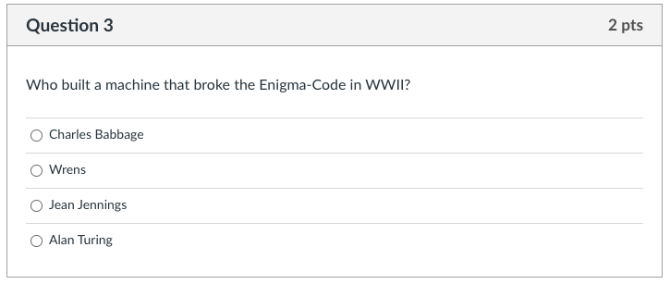
Knowledge Check: Discuss

Slide 3
Can Machines Think
Discussion:
What defines thinking?
How did Alan Turing address this question?
What are ways can we break the turing test?
Related Concept - John Searle’s Chinese Room
Counter to Alan Turing
Let’s watch a video on it!

Slide 4

Chinese Room – Discussion – Can machines think
Notes:
STOP before ‘Responses’

Slide 5
An Easier Question - Why Board Games?
Games are
A series of rules
These rules must be done in a specific pattern
Code is like board games
specific rules and patterns
Games were often the first tests of intelligence
Still very hard to solve for some games!
Not a board game – but Crossword Puzzles & Hangman
String is a collection of ordered characters
Your job - build a crossword puzzle – using terms in this class
or
Play hangman with terms in the class (using java syntax)
number the dashes for hangman – but start at 0 - - - - - - 0 1 2 3 4 5
i
n
S
y
s
t
e
m
t
r
i
n
g
Notes:
Hangman and Crossword puzzles are a great example of string

Slide 6
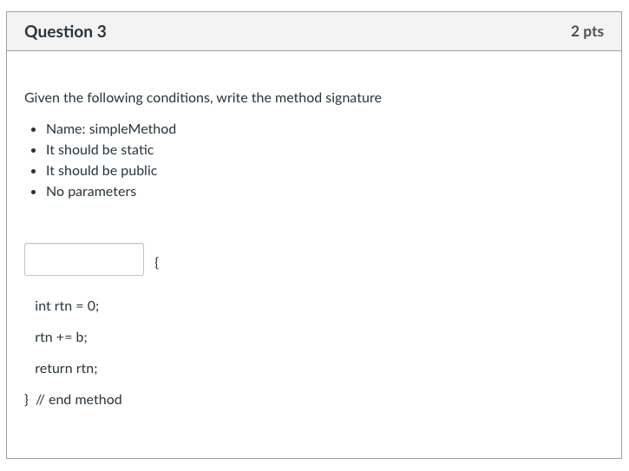
Knowledge Check: Work Together

Slide 7
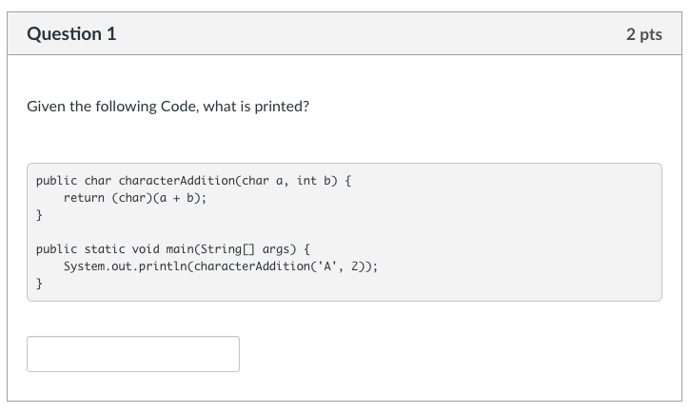
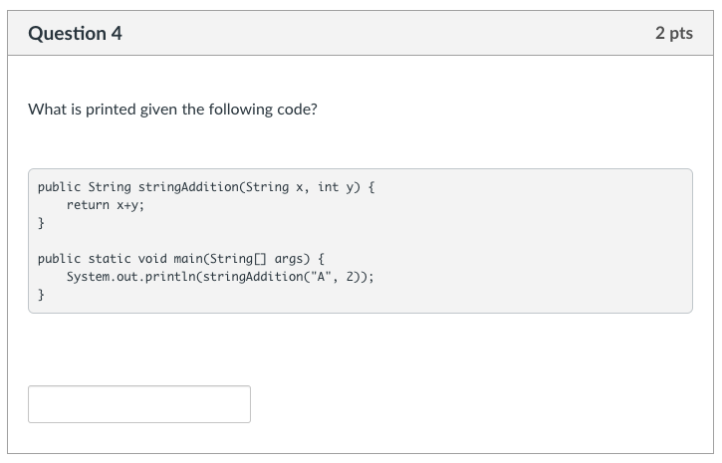
Knowledge Check: Work Together
How do these two differ?

Slide 8
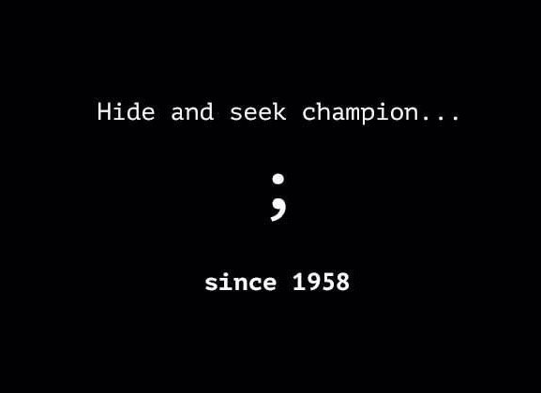
Debugging Code
Go to Zybooks – Code in there!
Compile Errors
bad syntax
missing semicolon (bane of all coders)
missing curly brackets
Runtime Errors
Crashes while running (you will get this!)
Logic Errors
Poor logic
Works, but not as intended
Solution
code only a few lines at a time
run after a few lines
even if running doesn’t do much!
Let’s look at some examples

