Slide 1
Welcome to CS 150

Slide 2
Quick Introduction
Introduce yourself
Popcorn style
Please have cameras on
Name and Favorite Fruit or Vegetable
Online students – type this in the chat
Why the full introduction?
This group (called help session) is your cohort
You are in this class together
These are the people that will help you through!

Slide 3
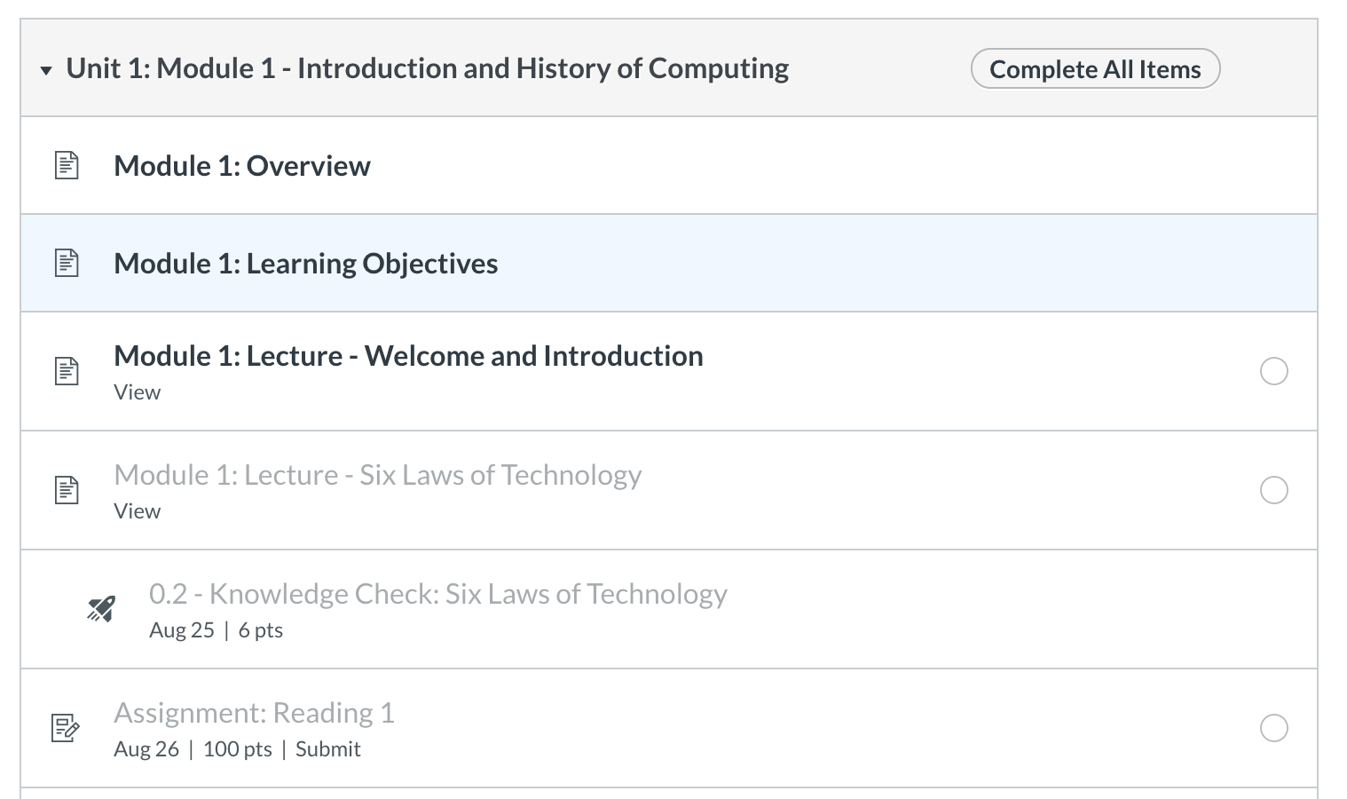
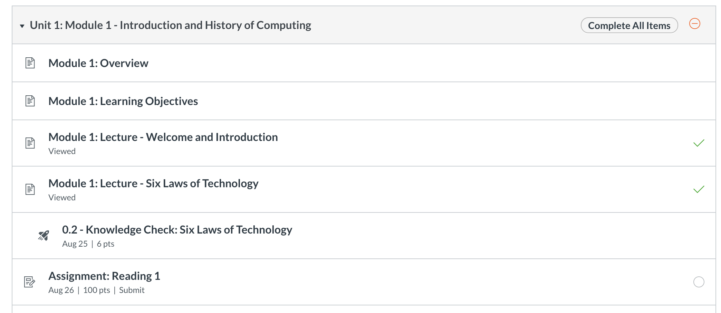
Course Layout
Modules
Follow them in order
General Order
Reading
Due Monday and Wed Nights
Lectures + Knowledge Checks
Due Tuesday and Thursday nights
Lab
Due Monday and Wed Nights
Written assignments / discussion posts
One per unit, thursday

Slide 4
Accommodations Window
Flexible Resubmission Windows with a *very hard* deadline
Knowledge Checks
Resubmit all semester (no reason to not get 100%)
Readings
Resubmit until the Unit Exam / End of the Unit
Labs
Resubmit up to a certain number of times until Unit Exam / End of The Unit
Written Assignments
Single submission, due Thursday nights with Sunday accommodation window
Take Home Exams
Single submission, due Thursday nights with Sunday accommodation window
Note: This is enough flexibility to get you in trouble! – Don’t be that person.
Make sure by the end of each week, you have completed the module except for the last lab (that is due the next Monday)
Unit 1, Module 1 – Complete through everything but Lab 1 by Friday
Lab 1 + Unit 1, Module 2 – Complete through Lab 3 by Friday of Week 2. etc.

Slide 5
Readings and Labs
All in zybooks
To be successful
Do reading before lab!
First reading is the longest by far!
Don’t Panic!
They focus on writing Code

Slide 6
Knowledge Checks & Exams
Focus on Reading Code
Also help with recall
Best thing to do – go back to them
Interleave – pick different orders to redo them from time to time
Spacing – do some every night!
Psychology of learning – this helps!
Best way to study?
Every night – knowledge checks
Retesting + spacing
You can do them 100 times, get different results every time!
Highest result is the one kept
Exams
Take Home! – One submission knowledge check essentially
 | ReStudy | ReTesting
Massed
Spaced
Most
Students
Ideal For
Recall

Slide 7
Written Assignments
Never miss a written assignment! They affect your grade the most
AUCC – Requires 25% of the grade to be written
Unit 1 and 3 shorter written assignments
50 points each
Graded by TAs
Due Thursday of week 3 of the unit.
Unit 4
Course reflection – easy 50 points, as long as you do it!
Midterm Essay (Unit 2)
100 points!
*major* component of your grade
Practical Project - 8% of your grade (Unit 4 major project)
End of term project – 100 points graded paper, 50 points code.
Note: Week 4,8,12 – No Lecture/Help Sessions – Limited Help Desk
Gives time for TAs to grade!

Slide 8
Help Sessions / On-Campus
On-Campus Days
MW, your assigned lab
Tuesday or Thursday – 1 help session a week (like today)
Attendance Required?
yes!!, why?
This is the discussion element of the course
If you are sick, that is fine
we only take a certain number of them, so flexible.
Goals of Help Sessions
Provide content related to lectures and labs (discussion and coding)
Answer questions
Build community
Your Responsibilities
Come with questions – mark certain knowledge checks, practice exam questions etc.
Pro Tip:
Send questions to your TA before the help session.
Ask them to cover them during the help session.

Slide 9
Help Desk
Starting Week 2
Via Microsoft Teams
TAs will “open” the helpdesk with an announcement
Meant for coding questions (labs / homework, readings)
More will be posted, but visit the website for times! http://www.cs.colostate.edu/~cs150
Make sure you follow the procedures.
General Chat
Great place to ask questions (after this week)
Questions should be theory or general, no code!
Your Private Group
Still no code – but use this for video chat with other members of your lecture group
Talk with each other
Help each other out!

Slide 10
Coding is Like Music
To be successful in CS 150
Work ahead of the schedule
Go through the modules
Try the lab before going to the lab day!
Practice often (daily)
Get help when you are stuck
Keep practicing
Memorization
Won’t help you! (maybe on culture topics)
You can’t memorize problem solving
You have to practice Divide-Conquer-Glue

