Slide 1
Amazing Grace & Strings

Slide 2
Announcements
Todo:
Lab projects start!
1st Essay Next Week!
Do you have your iClicker Cloud setup?
Now is good time!
We will use it today!
Reminder – readings are due before lecture
You don’t have to do all of it - challenge problems can be challenging…
You can return to them.
We start off each lecture with a quiz from your reading!
ACM-W this Week
Hike to Horsetooth Falls
Thursday, 5:30 PM Meet outside CSB front of building
Opening Question (talk with others in your group *before* class starts)
What is your favorite poem or song? Why does it have meaning?
Does that meaning have context?

Slide 3
Automatic Coding vs. Programming?
Coding
Syntax
How you do something
What you are doing in this class
It follows specific rules
Can be self-taught
Programming
Design
Theory
Specification
It requires the creative component
A good programmer has to be more than a coder. She has to be an problem solver, a designer, an artist and engineering.
Divide
Remember
Conquer
Conquer
Conquer
Glue

Slide 4
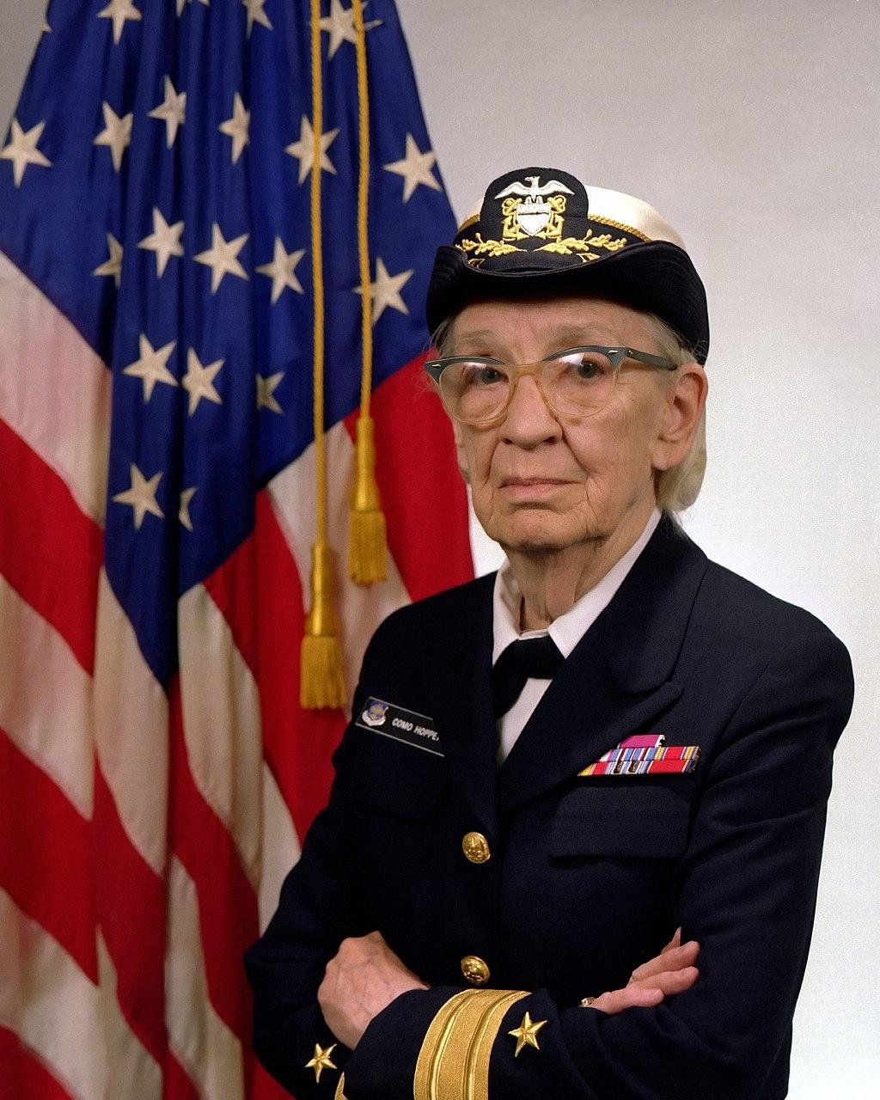
Pioneer of Compiled Code
Admiral Grace Murray Hopper
Nicknames, Amazing Grace, Grandma COBOL
Mark I computer
Built by Howard Aiken,
Programming by Grace Murray Hopper (and others).
Believed programing languages could be
Machine independent
Compiled from English to machine code
Same program, multiple machines
Invented the COBOL language
Also believed in Automatic Coding:
Code that writes itself - eventually A.I. that writes code for you
Pointed out later in life that “coding” is different than “programming”
Believed the programmer was greater than the engineer
By James S. Davis [Public domain], via Wikimedia Commons. Source

Slide 5
Today Most Code is Compiled
main.py
You write in English
The ‘compiler’ converts it to machine readable code
Why?
We don’t want to write in numbers
Machines want numbers and hardware instructions
This idea was a MAJOR breakthrough (1952)
General purpose computing
Reusable code across machines
Compiled languages (java is an exception), must be:
compiled to specific machine architecture / operating system
more structure, but faster
Interpreted Languages (Python, Javascript, LISP, etc)
require another program on the machine
reads the code, converts to machine at “runtime”
speed cost, but greater flexibility
Steve Russell wrote the first interpreter for LISP (1958)
print(“hello world”)
python interpreter - “loads” main.py, runs it on the machine
0001100001010101010101010101001010101010101010100101010101010101010101010100101010101010101010100101010101010101010101010010101010101001001010001

Slide 6
A Word is a Word
Technology is a human activity
Humans construct words to derive meaning
Computers should be able to handle human readable strings and characters - not just numbers 0s and 1s.
Not originally part of most languages
Even some modern languages are only used to single characters (letters or digits) without Strings built in
To understand Strings:
Let’s Play Hangman!
Go ahead and play a game or two!
Put numbers under the dashes starting at 0
Try with more than one word / a saying for the challenge.

Slide 7
Hang-them: Who Created Python?
Strings are ordered lists of characters!
Characters – visible and hidden
\n, \t – most common
Locations of characters
Called indices / index – start at 0
Have functionality attached to them (methods and operations)
G
u u
o o
s s
a
G u i d o v a n R o s s u m
_ _ _ _ _ _ _ _ _ _ _ _ _ _ _ _
0 1 2 3 4 5 6 7 8 9 10 11 12 13 14 15
t
e

Slide 8
iClicker Question
Given the following code, what is printed?
coding = "Compiling is Automatic Coding" short = coding[11:11] print(len(short))
0
And the following code?
coding = "Compiling is Automatic Coding" print(coding[:9])
Compiling
Write it out!

Slide 9
String Functionality
+ means String concatenation
Adding two strings together
returns new string (don’t forget to store!)
string[start:end] means substring
returns a smaller string based on values
start location (inclusive)
end location (exclusive)
both are optional.
If start is left out, starts at 0
If end is left out, goes to len(string) - 1
fname = "Howard" mname = "Phillips" longname = "of the Lovecraft" length = len(fname) # sets 6 to length! finitial = fname[0] # returns H, sets it to finitial minitial = mname[0] # returns P, sets it to minitial lname = longname[7:] # returns Lovecraft print(finitial + minitial + lname) print(len(lname))
error!
print(finitial + "." + minitial + ". " + lname + len(lname))
Typing to the rescue
print(finitial + "." + minitial + ". " + lname + str(len(lname)))
len(string) – is a function that returns the total characters in a String
str(int or float) – converts an int or float to a String

Slide 10
String Formatting
print(finitial + "." + minitial + ". " + lname + str(len(lname)))
The above code is messy!
String has built in formatting options (very extensive)
{} – means fill in this location with a variable
{0} – take the first variable in the list, and use that
{name} – uses the variable name
combined = "{}.{}. {}".format(finitial, minitial, lname) message = "{name} is {length} long".format(length=len(combined), name=combined) print(message)

Slide 11
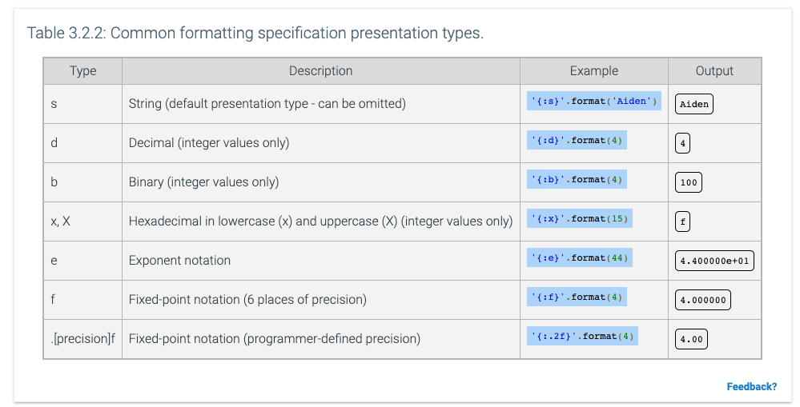
Formatting Numbers?
:d and :.nf are most common
especially for precents!
thirty_three = 1/3 * 100 print(str(thirty_three) + "%") print("{:.2f}%".format(thirty_three))
33.33333333333333%
33.33%
also, common <N
“pads” with spacing, so always length N
print("|{:<30}|".format(combined))
|H.P. Lovecraft |

Slide 12
String Formatting – Group Coding Activity
Group Coding Activity
one person codes, others direct
write a function that
takes in a number < 1 as one parameter
takes in a String as another parameter
returns a formatted String of
stringValue,percent%
where the % is to two decimal points
Test the function to make sure it works!
Post your solutions to the MS team
Examples: student_scores("Amy", 0.985) => “Amy,98.50%”
student_scores("Rory", 0.7132) => “Rory,71.32%”
student_scores("DrW", 0.80687) => “DrW,80.69%”

Slide 13
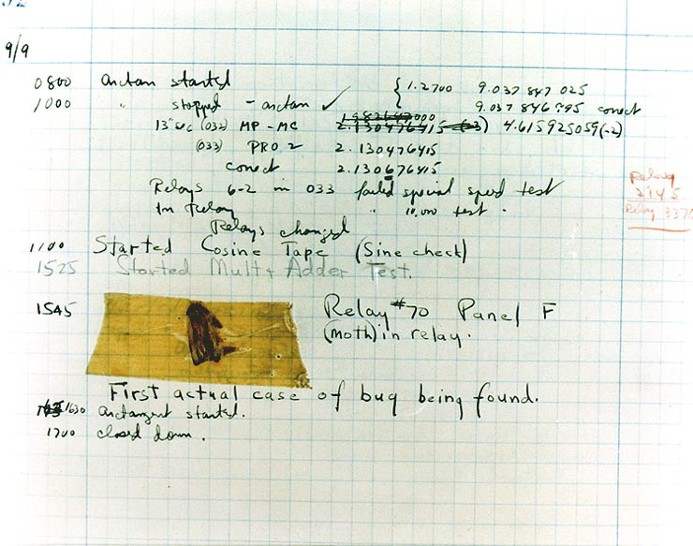
The first computer bug?
Actual bug in a computer relay, found by Grace
Good story, but….
Did not invent the term ‘debugging’
Was used in engineering for many years before
Debugging is used in programming
It often takes patience, practice and repetition.
Coding bugs (not actual bugs) were common
wanted to remove the human error by automation
By Courtesy of the Naval Surface Warfare Center, Dahlgren, VA., 1988. [Public domain], via Wikimedia Commons

