Slide 1
Poor Logic and Conditionals

Slide 2
Announcements
Your Paper is DUE Thursday (Today)
Late window until Sunday (hard cutoff)
Opening Question
Do you have a favorite board game?
ACM-W Ice-cream Social
When: Thursday September 9th at 5:30pm
Where: CSB third floor lounge
RSVP: https://forms.gle/diegr3b9MR1VadUX6
ACM-W Diversity in Computing Dinner
When: Thursday September 16th at 5:30pm
Where: LSC room 382
RSVP: https://forms.gle/LdDiVAPaui5Ctgw38

Slide 3
It’s Logic

Slide 4
Poorly Defined Logic of the 50/60s
Industry was used to building products
Machines are products
But Code was not
For the first time, the value shifted from the product to the person
You are a company’s most valuable commodity!
Especially true with computer science
This created a dichotomy
In some cases, still exists today
Automatic Programming / Coding
At the heart of this!
If you can replace coders with machines..
Enter Cobol and Univac
Additional Reading: Techs Ultimate Success

Slide 5
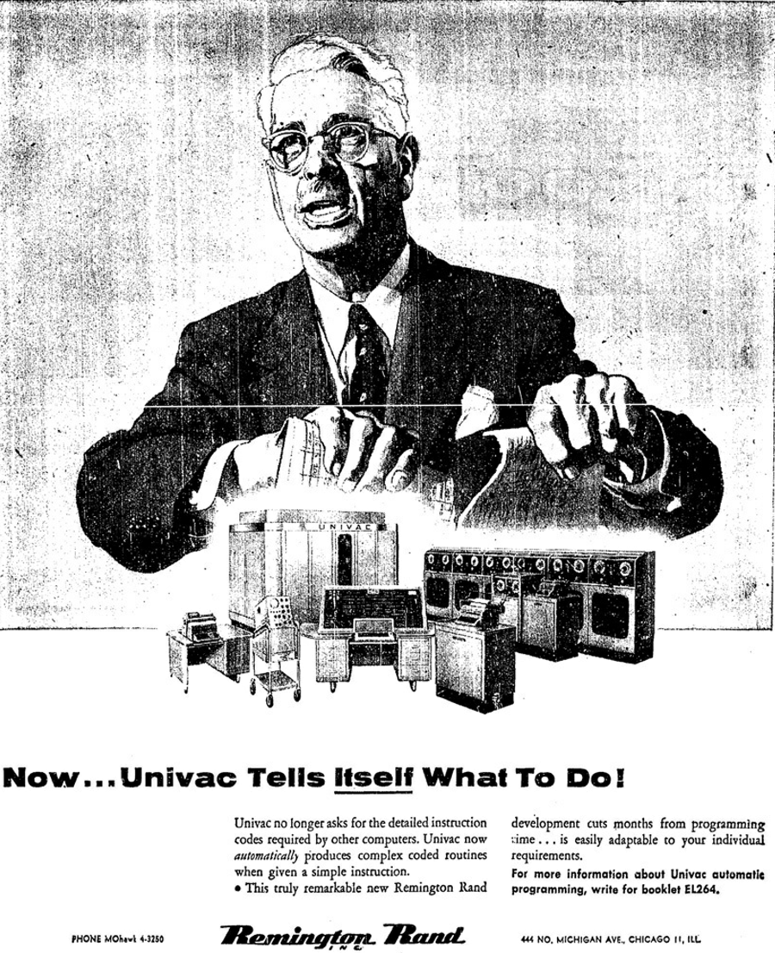
No more coders?
Actual ad. for the Univac after the creation of Cobol
Let’s think about it…
The industry didn’t know what to do with programmers
Some wanted to get rid of them
Others wanted to hire more
Truth
Everyone was tied to this new thing called a computer
Programmers were becoming even more important
Second law: Invention is the mother of necessity.

Slide 6
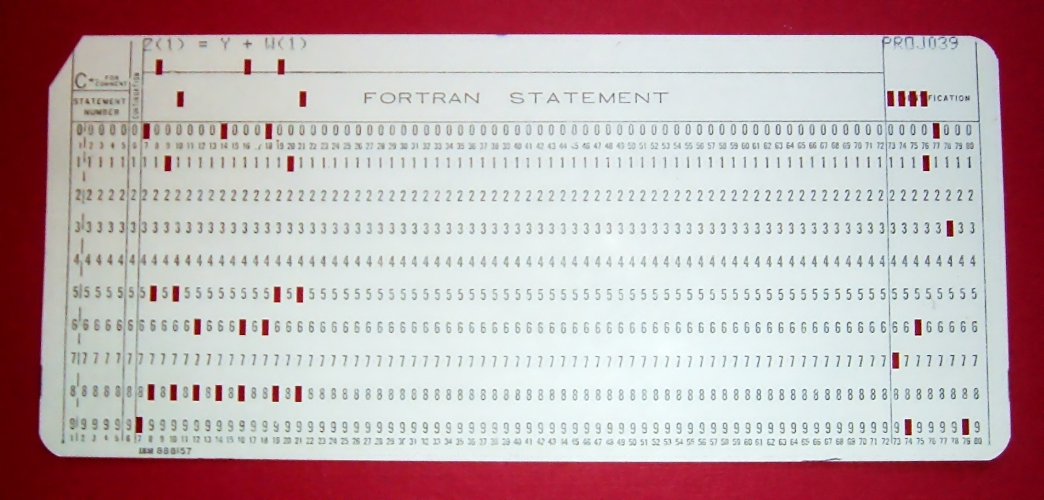
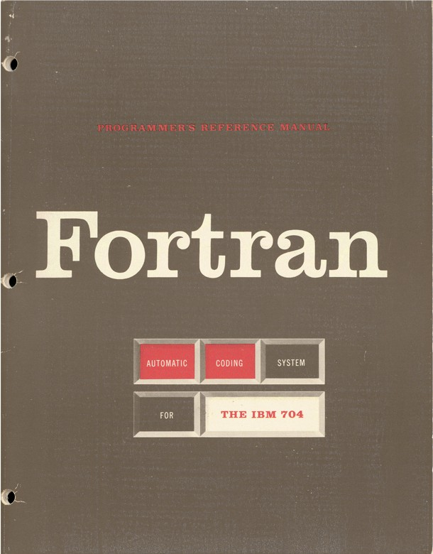
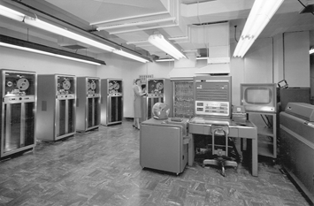
Fortran
Designed by John Backus
first optimizing compiler
Very important or wouldn’t work
1957 (10 years after WW II)
Punch Cards
Machine time limited
Designed programs on paper
Shared times
English -> punch cards -> machines
Designed for business use
Accounting
Math calculations
All text based
Hidden Figures <- Go watch it!

Slide 7
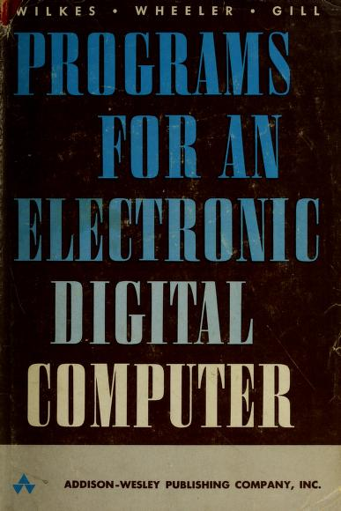
Secrets from the past?
Rare for a program to work right the first time
“The Preparation of Programs for an Electronic Digital Computer” (1951)
Considered the world's first programming book
Still true!
Imagine compilers:
Only generate code once a day
Even then, there would be bugs
Lone ranger mentality
Coming in fixing code, not sharing how it is done
This started to push women out of the industry
Would be specialized to certain fields
Wouldn’t usually get along with management
Management wanted to break free of their programmers

Slide 8
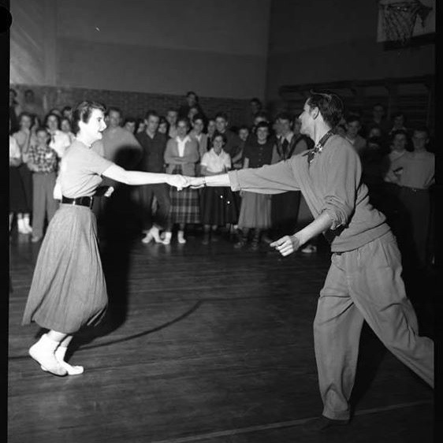
What does it take to be a good programmer - 1950s/60s edition?
IBM Programming Aptitude Test
number series
figure analogies
arithmetical reasoning
Cooking?
“Your Career in Computing” - 1968
If you can read a cookbook, you can be a programmer!
Worry about details while keeping big picture in mind
Books even said females could be better programmers
In truth
Wanted cheaper labor
Trying to fulfill a shortage - with women that others were pushing away
There has almost always been a shortage of programmers - we have one now.

Slide 9
Logic Problem Time
Three Boxes
ALL of them are mislabeled
We can pick one item from one box
We can see that one item.
We must relabel all boxes, based on the one item we see
Apples
Oranges
Apples and Oranges

Slide 10
Solution
Apple box - possible correct answers: Oranges OR Apples and Oranges
Orange Box - possible correct answers: Apples OR Apples and Oranges
If I pick from both boxes, I could end up with either apple or orange - no definitive answer
Apples and Orange Box - possible correct answers: Apples OR Oranges
This seems like a definitive answer - as we know if we pick one, the other is not in there
Let’s assume we pick an orange from the “Apples and Oranges: box
Apples
Apples & Oranges
Oranges
Apples
Apples and Oranges
Oranges

Slide 11
Basic Conditionals
Logic that evaluates as
Yes or No
True or False (called a Boolean)
Essential in all programming languages
You mentally do this all the time
100 pennies greater than $1?
Common logic operators
== Equals
< Less than (is left less than right)
> Greater than
<= Less than OR equal
>= Greater than OR equal
!= not equal ( ! is your NOT character)

Slide 12
Structure of if statements
if without else
if with else
def get_happy(puppies): happy = False if puppies >= 100: happy = True return happy
def get_happy2(puppies): if puppies >= 100: happy = True else: happy = False return happy
# conditions are operations, so you can return the result def get_happy3(puppies): return puppies >= 100

Slide 13
Group Practice
Complete the following code
def age_check(age): #TODO - add a line of code here, you do not print here! print(age_check(21)) # prints True print(age_check(20)) # prints False print(age_check(22)) # prints True

Slide 14
Elif?
elif – used for chaining if statements
def broken_rogue(dice_roll): if dice_roll >= 10: if dice_roll > 15: print("Trap Disarmed!") else: print("Get the 10-foot pole...") elif dice_roll >= 5: print("As far as I am aware, no traps.") else: print("Found the trap!")
broken_rogue(10) # prints Get the 10-foot pole...
broken_rogue(16) # Trap Disarmed!
broken_rogue(5) # As far as I am aware, no traps. broken_rogue(1) # Found the trap!

Slide 15

Secret Ninja Logic Trick
Work it out!
Draw it out - flow chart!
Really - just that
Often we over think it
if puppyCounter > 100:
true
false
Group Project
Can you code based on the tree?
Scream - So many puppies!
Sad panda, need more puppies

Slide 16
Group Practice 2
def age_check_by_region(age, region): #TODO - add multiple lines of code here age_check_by_region(21, "USA") # prints "OK to buy" age_check_by_region(20, "USA") # prints Not OK age_check_by_region(20, "EURO") # prints OK to buy age_check_by_region(18, "EURO") # prints OK to buy age_check_by_region(17, "EURO") # prints Not OK ### The following is true for anything else you put in besides USA or EURO age_check_by_region(25, "YOLO") # prints Not OK

Slide 17
Let’s Code!
def check_for_traps(dice_roll, difficulty, contains_trap): if dice_roll >= difficulty: return contains_trap elif dice_roll >= 5: return False else: return not contains_trap def disarm_trap(dice_roll, difficulty): return dice_roll >= difficulty

