Slide 1
First Paper Overview

Slide 2
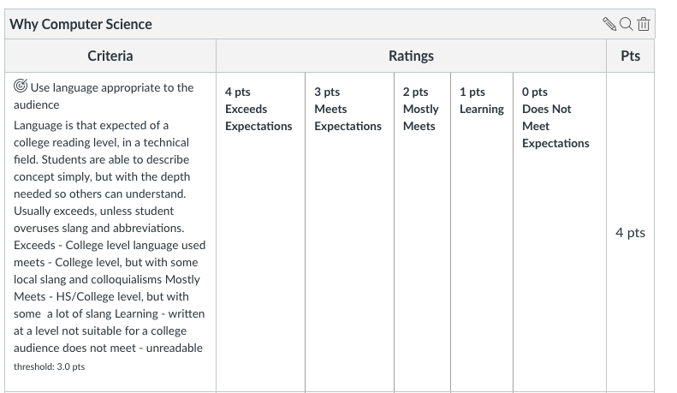
A Couple Reminders
Your first paper, “Why Computer Science” is due this module!
Hopefully, you already started!
Three parts:
Your Interview
Why you are interested in CS
One area of CS that interests you
with at least one citation to a source (yes, training you for citing sources)
Follow the Rubric: (in canvas)

Slide 3
Grading
Every Learning Outcome In Rubric
Scored between 1-4
0 if you skip that learning outcome completely
Final grade for paper 1-4
Based on most scores you have (rounded up)
For example
4, 4, 3, 3 = 4 for the paper
4, 3, 3, 2 = 3 for the paper
Exception:
If you score a 1 or 2 in any category, you may not score a 4 for the total!
Submitting a blank page, will grant you a 0
But allowed, if you want to ‘skip’ the paper
Don’t skip it! (Will seriously damage your grade)

Slide 4
Resubmitting?
You must meet with the instructor or TA – first
They will then regrade your new submission
If you score a 1 or 2 on the final paper score (not just a single category)
you will automatically be asked to re-submit
The goal is for you to do it correctly, more than just doing it!

Slide 5
FAQ
What type of format?
You can follow any style you want
but you must follow a style
Recommended Style: (highly recommended)
ACM/IEEE Style Guidelines
IEEE Overview - Purdue Online Writing Lab
Includes simple intext and biographical citations
Very commonly used in tech industries
Minimum number of pages?
We don’t have a minimum, only a maximum / stop reading page
Most people it will take a couple pages
Accommodations Window
Max of 3 days. We have to be strict, or won’t have time to grade them all

Slide 6
Paper Feedback
We *try* to grade as they come in
Looking forward to reading them!
Help Desk hours may be reduced on paper grading weeks!

