Slide 1
1s and 0s add up

Slide 2
Binary - Why does it matter?
Computers are large sets of memory
Each memory location has a state of ‘on’ (1) or off (0).
These states are how everything is stored
And the focus of Computer Engineering majors
They are also called ‘finite state machines’
Finite number of states (one or zero - yes or no, on or off)
A machine full of them
Not magic but science
Having tons of tiny states allows us to represent all the things computers do!
This is a much deeper topic for a 200 level class.
Knowing binary
Will help us understand how much memory is being taken up for primitive and objects
As every thing created takes up a portion of the finite states in the machine. (over simplified)

Slide 3
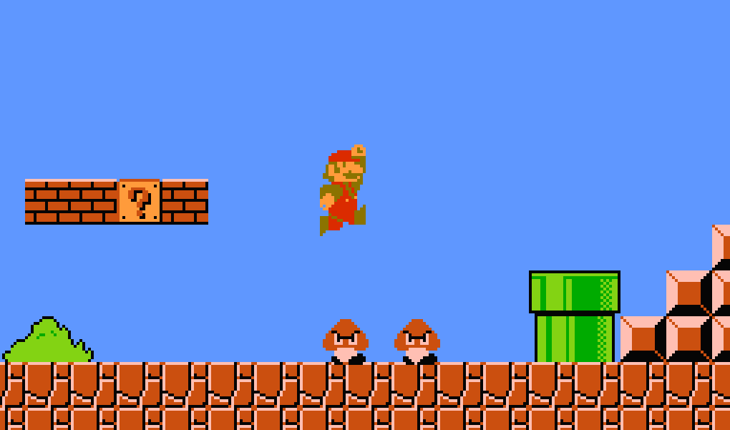
Let’s go back to memory allocation
Byte has 8 Bits
Computer represent data in bits
But we need to allocate the room
1 or 0
1
1 or 0
1
1 or 0
1
1 or 0
1
1 or 0
1
1 or 0
1
1 or 0
1
1 or 0
1

Slide 4
Binary Tests
00001111 =
10001000 =
00010001 =
15
00001111
64 32 16 8 4 2 1 .
8+4+2+1 = 15
136
17

Slide 5
Python Types?
val = bin(15) print(val) # 0b1111 val = bin(136) print(val) # 0b10001000
print(val[2:]) # 10001000
print(int(val, 2)) # 135
val = 0b111 print(int(val)) # 7
numeric
int
You can change the ‘base’ with a second argument
float
bin
not in the book, coverts number to binary
also, you can set a value as binary by leading with 0b
sequential
string
list
tuple
set (list, with unique values only)
dict
We will come back to dict - maps indices to names!

Slide 6
Go Practice
No codealong for this set of slides
Go practice!
Most stuff you have done, and try applying it in different ways!

