Slide 1
Data Privacy, Loops and Lists
Colorado State University
Computer Science Department
Slides Originally Created by Albert Lionelle (Albert.Lionelle@colostate.edu)

Slide 2
Announcements
Opening Question:
Do you use social media? If so, how much is your data worth to them?
Reminder – readings are due before lecture
You don’t have to do all of it - challenge problems can be challenging…
You can return to them.
We start off each lecture with a quiz from your reading!
Make sure to review knowledge checks and spread out their use!
Todo:
Start Practical
Catch up on labs
CS 164 – Next Course In Sequence, also consider CS 220 (math and stats especially)
CO Jobs Report 2021 – 77% of *all* new jobs in Colorado require programming
60% of all STEM jobs requires *advanced* (200-300 level)
31% of all Bachelor of Arts degree titled jobs also required coding skills
2016 Report found on average jobs that require coding skills paid $22,000 more

Slide 3
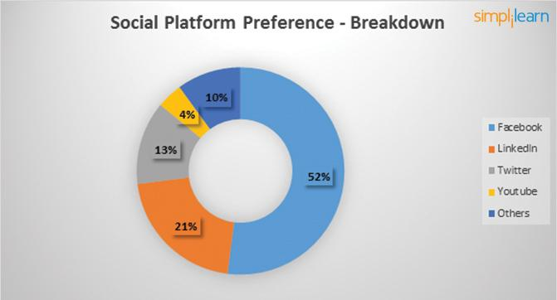
Data Mining and You
Further Reading: https://www.simplilearn.com/how-facebook-is-using-big-data-article https://zephoria.com/top-15-valuable-facebook-statistics/
https://medium.com/wibson/how-much-is-your-data-worth-at-least-240-per-year-likely-much-more-984e250c2ffa
Facebook
2.45 billion monthly active users
1.62 billion people on average log onto Facebook daily
Every 60 seconds on Facebook: 510,000 comments are posted, 293,000 statuses are updated, and 136,000 photos are uploaded.
300 petabyte data analysis warehouse (to start)
What do they track! (everything)
Likes
Faces / Images
Cookies, tagging, etc
“Your” Data Worth $240 a year, per person…

Slide 4
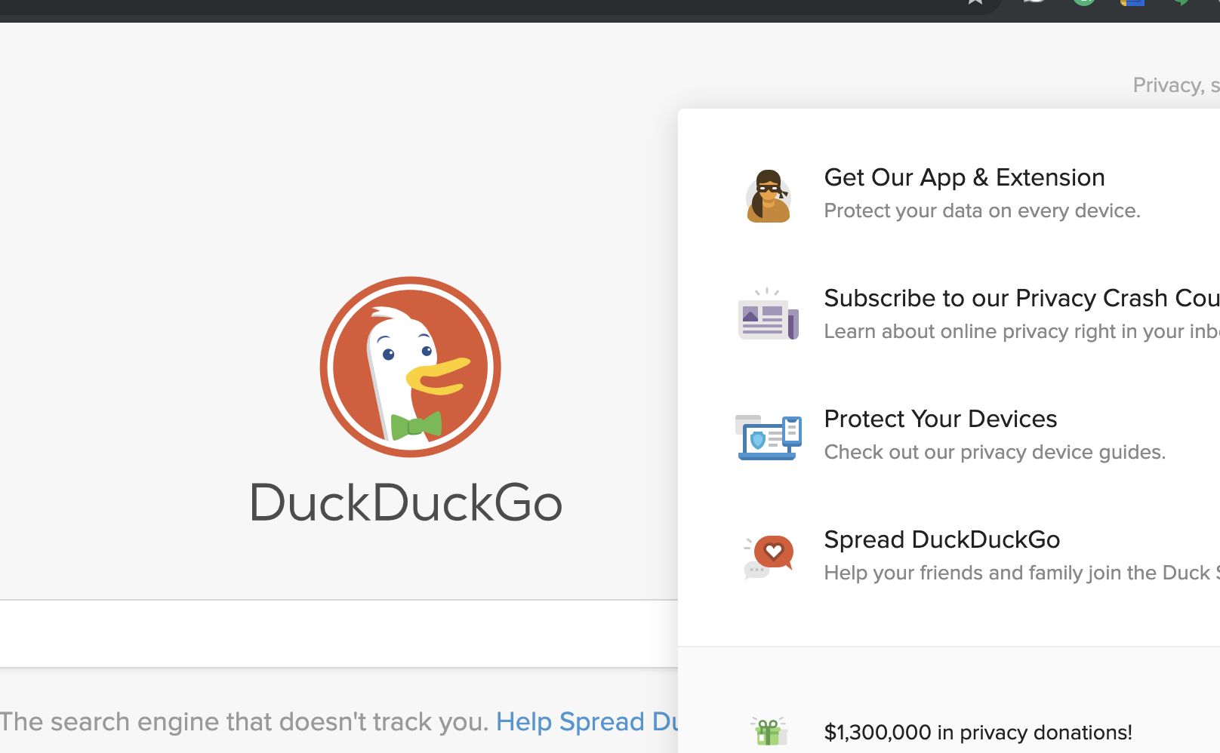

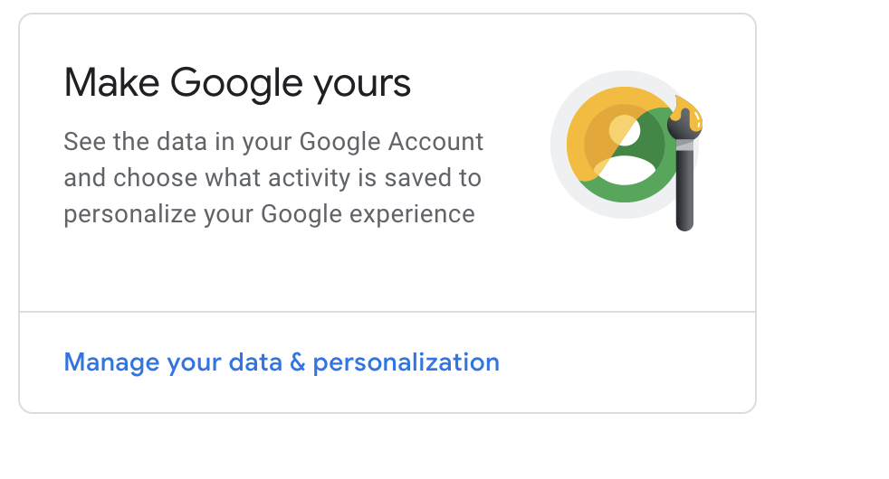
Tracking?
No one knows who owns data!
Do you own your data?
Google, Facebook and others - beg to differ
Simpler Case
Do you own your grades?
Does the school own your grade information?
Same argument!
Look at sites that don’t track your info
But - what tools do we lose?
What is the balance?
With that said, your data is only as secure as you make it.
We are our own worst security

Slide 5
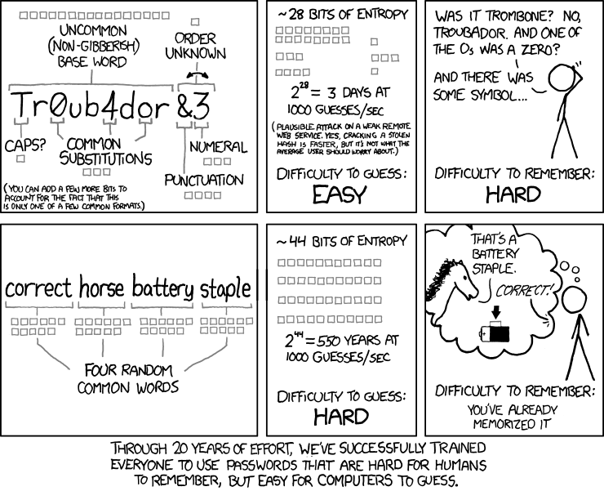
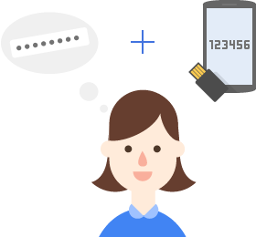
2-Step Authentication
For signin - not encryption!
Step 1
Enter your password
Step 2
You get a security code (often six digits)
Via an app or text message
Enter in the code
Really better than just a password
Admittedly, passwords should die
But how to balance user experience with security?

Slide 6
Homework (ok your choice)
https://myaccount.google.com/
Go there, and secure the information that is shared out!
https://www.facebook.com/help/325807937506242
Read up on facebook privacy options
https://www.facebook.com/settings (link to facebook’s privacy settings)
https://help.instagram.com/196883487377501
Read up on instagram privacy setting - and fix what you want
Set up Two-Factor Authentication!
https://www.google.com/landing/2step/
https://www.facebook.com/help/148233965247823
https://www.acns.colostate.edu/duo/ (yes, CSU - but more to this)
https://www.acns.colostate.edu/security/
It is worth the 30 minutes you spend on it!

Slide 7

Sending Data Online
How do you prevent someone from reading that data?
The quick brown fox jumps over the lazy dog.
Send File
The quick brown fox jumps over the lazy dog.
The quick brown fox jumps over the lazy dog.

Slide 8
Some more useful coding tools

Slide 9
Warm Up
Write a loop that takes in a list of numbers
Builds a list with only even numbers from that list
Remember about if statement, and remember about mod
For example:
lst = [12, 22, 13, 12, 15, 42, 21, 19] new_list = []
for val in lst:
# Student code here
print(new_list)

Slide 10
List Comprehensions
Cool shorthand “magic”
a way to have a loop that generates a list in one line!
numbers = [random.randint(1,6) for i in range(1,10)] print(numbers) # [6, 5, 2, 4, 2, 6, 1, 3, 4]
Also, conditionally add something!
common for filtering lists
odds = [i*-1 for i in numbers if i % 2 == 1] print(odds)# [-5, -1, -3]

Slide 11
Practice 2
odds = [i*-1 for i in numbers if i % 2 == 1] print(odds)# [-5, -1, -3]
Take a list of items,
Return only the items that have “a” in the word
Use a list comprehension!
The *in* keyword will help with the if statement
if “a” in val:
Example list
[“hello”, “alice”, “jade”, “zypher”, “ariel”]
The new list would be
[“alice”, “jade”, “ariel”]

Slide 12
Follow Along
Code with me!
Going to step us through a more complex example

Slide 13


Break/Continue
Very commonly used
break
Forces an early exit from a loop!
continue
Forces a next iteration for a loop
Be careful with while loops
very common in for loops
odds = [] for val in [23, 12, 13, 16, 18, 2, 23, 17, 20, 191]: if val in odds: break if val % 2 == 1: odds.append(val) print(odds) # [23, 13]
odds = [] for val in [23, 12, 13, 16, 18, 2, 23, 0, 17, 20, 191]: if val in odds: continue if val % 2 == 1: odds.append(val) print(odds) # [23, 13, 17, 191]

Slide 14

Loop Else
odds = [] for val in [23, 12, 13, 16, 18, 2, 23, 0, 17, 20, 191, 10]: if val in odds: break if val % 2 == 1: odds.append(val) else: print("Found no duplicates!") # NOT printed!
Remember If Statements?
if True: else:
True means execute block
Else means execute block if first isn’t true
Loops – Execute block while true
but if not true?
run block of code, *once* after expression is false!
Guarantees one run after loop
As long as False happens
Matters for break!
Reasons?
Good for closing files, closing internet connections, security checkups, etc

Slide 15
Let’s Code!
def reader(filename): with open(filename) as csvreader: lines = csv.reader(csvreader) plant_list = [line for line in lines] header = {} for i, col in enumerate(plant_list[0]): # first line is header header[col] = i return header, tuple(plant_list[1:]) def categorize(plant_list, named_indices, *args): by_category = {} lower_args = [arg.lower() for arg in args] for arg in lower_args: by_category[arg] = [plant for plant in plant_list if plant[named_indices["Category"]].lower() == arg] else: by_category["other"] = [plant for plant in plant_list if plant[named_indices["Category"]].lower() not in lower_args] return by_category def build_data(filename, *args): headers, lines = reader(filename) grouped_plants = categorize(lines, headers, *args) for arg in args: grouped_plants[arg] = {"average": (len(grouped_plants[arg]) / len(lines)), "plants": grouped_plants[arg] } else: grouped_plants["other"] = dict(average=(len(grouped_plants["other"]) / len(lines)), plants=grouped_plants["other"]) return grouped_plants,headers

