Slide 1
Research, Logic, Conditionals

Slide 2
Announcements
Opening Question
Try to explain a coding concept to someone else at the table.
Your Paper is DUE Thursday
Late window until Sunday (hard cutoff)
ACM – Caldera Talk
When: Wednesday, September 8 at 6:00pm
Where: Computer Science Building room 130
RSVP: https://forms.gle/oV272NkPVFp8eN2P8
ACM-W Diversity in Computing Dinner
When: Thursday September 16th at 5:30pm
Where: LSC room 382
RSVP: https://forms.gle/LdDiVAPaui5Ctgw38
ACM-W Ice-cream Social
When: Thursday September 9th at 5:30pm
Where: CSB third floor lounge
RSVP: https://forms.gle/diegr3b9MR1VadUX6

Slide 3
Discussion
Who did you interview for the paper?
What did you learn?
What are some commonalities between the interviews at your table?

Slide 4
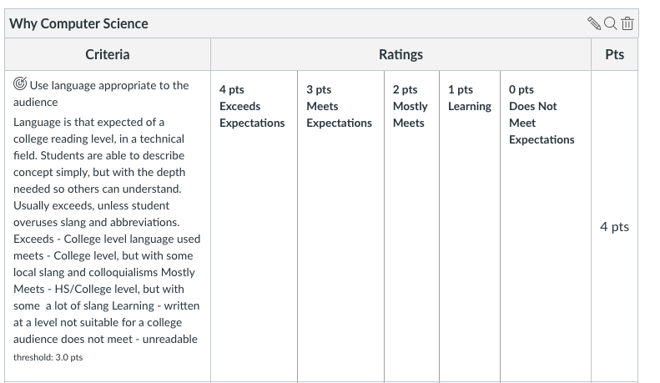
A Couple Reminders
Your first paper, “Why Computer Science” is due this module!
Hopefully, you already started!
Three parts:
Your Interview
Why you are interested in CS
One area of CS that interests you
with at least one citation to a source (yes, training you for citing sources)
Follow the Rubric: (in canvas)

Slide 5
Grading
Every Learning Outcome In Rubric
Scored between 1-4
0 if you skip that learning outcome completely
Final grade for paper 1-4
Based on most scores you have (rounded up)
For example
4, 4, 3, 3 = 4 for the paper
4, 3, 3, 2 = 3 for the paper
Exception:
If you score a 1 or 2 in any category, you may not score a 4 for the total!
Submitting a blank page, will grant you a 0
But allowed, if you want to ‘skip’ the paper
Don’t skip it! (Will seriously damage your grade)

Slide 6
Resubmitting?
You must meet with the instructor or TA – first
They will then regrade your new submission
If you score a 1 or 2 on the final paper score (not just a single category)
you will automatically be asked to re-submit
The goal is for you to do it correctly, more than just doing it!

Slide 7
FAQ
What type of format?
You can follow any style you want
but you must follow a style
Recommended Style: (highly recommended)
ACM/IEEE Style Guidelines
IEEE Overview - Purdue Online Writing Lab
Includes simple intext and biographical citations
Very commonly used in tech industries
Minimum number of pages?
We don’t have a minimum, only a maximum / stop reading page
Most people it will take a couple pages
Accommodations Window
Max of 3 days. We have to be strict, or won’t have time to grade them all

Slide 8
Practice Problems

Slide 9
Coding Practice
In your zybooks coding window
One person codes, the others direct
Write a code that
takes two parameters from the client
a name, and then number
It then prints out the name and number separated by a comma
The number should only have at most two decimal places.
Example Output
Amy Pond,12.2
Rory Williams,14.22
Clara Osborn,100.12

Slide 10
Practice Two
Take the same code, and break it up into two functions
One function just handles the formatting of the name number
hint: it should take in two parameters and return a string
The second function handles the client input, and printing to the screen
Hint: it will call your first function

Slide 11
Lab Practice Time
Work on a lab at your table.
You may discuss with others
but you may not share code
Feel free to ask questions
I will go over parts as asked

