Slide 1
Data Privacy
Colorado State University
Computer Science Department
Slides Originally Created by Albert Lionelle (Albert.Lionelle@colostate.edu)

Slide 2
Announcements
Opening Question:
Do you know the difference between http and https?
Reminder – readings are due before lecture
You don’t have to do all of it - challenge problems can be challenging…
You can return to them.
We start off each lecture with a quiz from your reading!
Make sure to review knowledge checks and spread out their use!
HELP DESK CLOSED – during break. Opens again Sunday the 29th.
Todo:
Start Practical
Catch up on labs
CS 164 – Next Course In Sequence, also consider CS 220 (math and stats especially)
CO Jobs Report 2021 – 77% of *all* new jobs in Colorado require programming
60% of all STEM jobs requires *advanced* (200-300 level)
31% of all Bachelor of Arts degree titled jobs also required coding skills
2016 Report found on average jobs that require coding skills paid $22,000 more

Slide 3

Sending Data Online
How do you prevent someone from reading that data?
The quick brown fox jumps over the lazy dog.
Send File
The quick brown fox jumps over the lazy dog.
The quick brown fox jumps over the lazy dog.

Slide 4
Encryption and Encrypting Files
Symmetric Encryption
We use this almost daily
HTTPS - or TLS
Public Key Encryption (asymmetric)
We should use this more

Slide 5
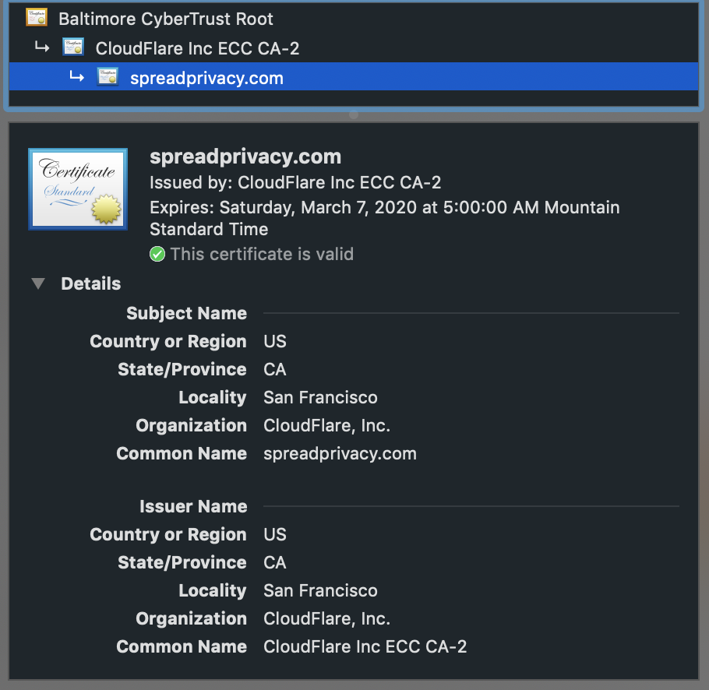
Transport Layer Security
Protocol
Used on top of the web protocols (www, IP, etc)
Stages:
Handshake
Double check certificate
Figure out encryption key
Connection is now encrypted for a limited time
We see it as: HTTPS
Also used in Virtual Private Networks (VPNs)
Side comment: it is possible to spoof certificates or root them. CS 356 and the CS 456 are great classes to learn how (and ways against). Open to minors and majors in CS.
Further Reading: https://en.wikipedia.org/wiki/Transport_Layer_Security https://spreadprivacy.com/what-do-security-certificates-do/

Slide 6


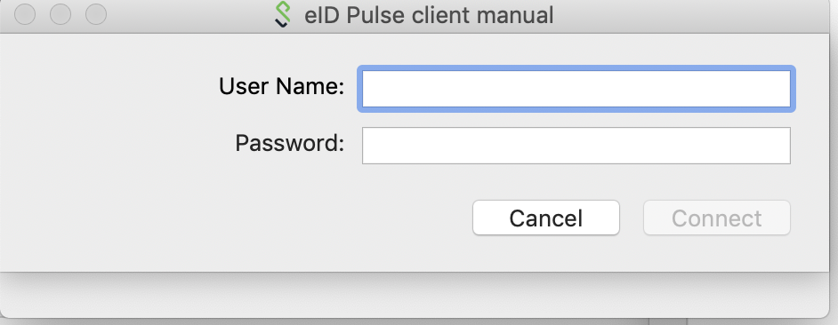

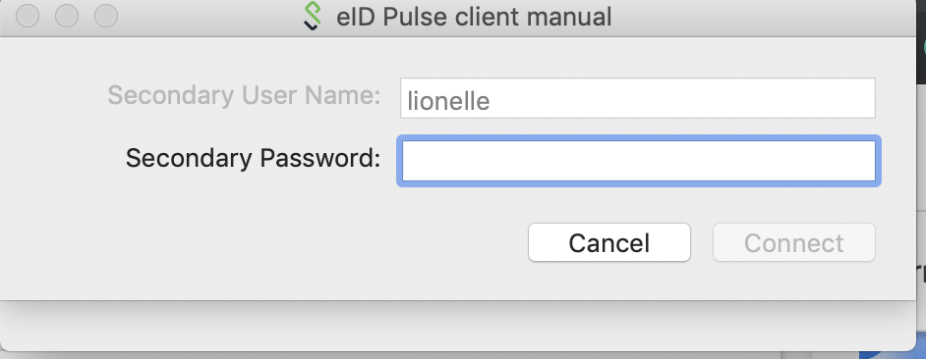
Virtual Private Networks (VPNs)
Your computer
You First Connect to a VPN Server
Tunnel all information through that server
Encrypted tunnel
Server then relays info to websites and to you
CSU Uses one
Pulse Secure
Uses 2 Factor Authentication
Encrypts all traffic
Pros
You ‘appear’ from CSU
Great for articles, etc
Cons
CSU becomes point of failure
But they are experts at doing this
Really - Go set it up
Encrypted Connection
VPN
Internet

Slide 7
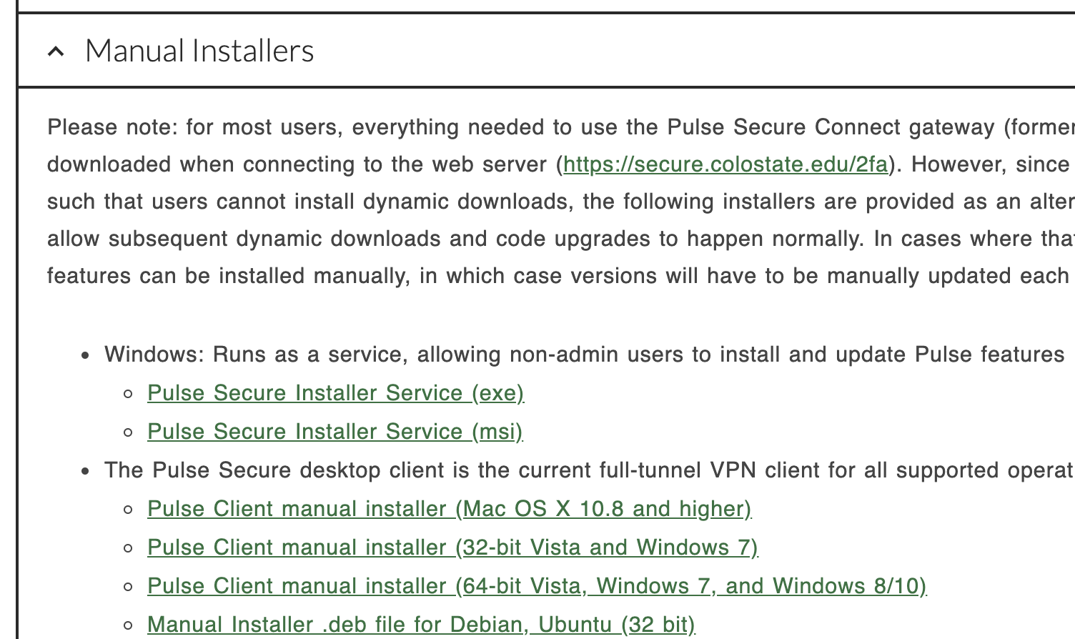
VPN Setup hints
Go Here: https://www.acns.colostate.edu/security/
Install the Application (don’t mess with securing via browser)
You will also need the Duo app on phone (for two factor)
Connect via browser once - too get config files
Whenever you are not on campus
Connect through the Pulse Client

Slide 8
Sending Files Online
How do you know the file sent, is the correct file?
And how would we make it so *only* your friend can open the file?
The quick brown fox jumps over the lazy dog.
Send File
The quick brown fox jumps over the lazy cat.

Slide 9
Algorithms in CS
Linked List
Will help us understand block chain after break
Sorting
Binary Search
Let’s form five mostly equally distributed lines
Yes, stand up – one line on the stage

Slide 10
Binary Search
One of the oldest documented search methods!
Roman documentation for ‘address book’
Assumes list is sorted (like a phone book, or routing table)
def binary_search(sorted_list, value, start=0, end=None): if end is None: end = len(sorted_list) if (end - start)+1 < 2: return -1 ## get middle index! middle = (end+start) // 2 #notice // why? if value == sorted_list[middle]: index = middle elif value < sorted_list[middle]: index = binary_search(sorted_list, value, start=0, end=middle) else: index = binary_search(sorted_list, value, start=middle+1, end=end) return index

Slide 11
Binary Search Example
def binary_search(sorted_list, value, start=0, end=None): if end is None: end = len(sorted_list) if (end - start)+1 < 2: return -1 ## get middle index! middle = (end+start) // 2 #notice //, why? if value == sorted_list[middle]: index = middle elif value < sorted_list[middle]: index = binary_search(sorted_list, value, start=0, end=middle) else: index = binary_search(sorted_list, value, start=middle+1, end=end) return index
[1, 15, 29, 32, 44, 56, 61, 76, 86, 96] - searching for 32
[1, 15, 29, 32, 44, 56, 61, 76, 86, 96]
[1, 15, 29, 32, 44, 56, 61, 76, 86, 96]
32 < 44? – yes!
32 < 29? – No!
found it!
Speed! Much quicker than looking at all values!

Slide 12
More Recursion

Slide 13
Review
Recursion
A way to loop via method calls
Good at:
building sequences
breakdown complex iteration to simple methods
Divide-Conquer-Glue
Solve Base/ Simplest case first
Build the N=2+ case next
Tail Recursion
Store values as part of the parameters
Make use of default parameters to make this easier!

Slide 14
Using Recursion To Simplify
How would you use a loop if you wanted to?
Break up the list into thirds
Based on an input, look at the top third
Break up the list again, repeat?
Pretty complex as a loop!
but what about recursively?

Slide 15
Overall Rules
Keep it simple!
No one ever does it right the first time
Focus on tail recursion, and simple recursion for now!
Practice, practice, practice
A few other classes will cover this again
No code along

