Slide 1
Design Thinking and Lists and Loops

Slide 2
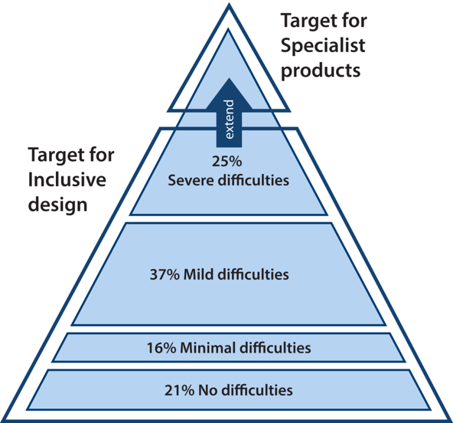
Enter Inclusive Design
Microsoft Inclusive Design Principles:
Recognize exclusion
Solve for one, extend to many
Learn from diversity
Continuum of population diversity pyramid
Notice, only 21% of people have ‘no-difficulties’
Difficulties are on a spectrum of:
Permanent
Temporary
Situational
Modern Design and Software Engineering
Must take into account the full audience
Must take into account the interconnectedness of society
Credit: University of Cambridge - Inclusive Design Toolkit
3rd Law of Tech: Technology comes in packages, big and small.
Further Thinking: All technology, big and small, needs to be designed with the client in mind.

Slide 3
Lists and Iteration

Slide 4
Lists
Fundamental to Python
List of items, any item.
mutable (can be modified)
machete = [4, 5, 2, 3, 6, 7, 8, 9] machete_names = ["A New Hope", "The Empire Strikes Back", "Attack of the Clones", "Revenge of the Sith", "Return of the Jedi", "The Force Awakens", "The Last Jedi", "The Rise of Skywalker"]
print("Star Wars {episode}: {title}".format(title=machete_names[2], episode=machete[2]))
Prints - Star Wars 2: Attack of the Clones
Notice: Indices like Strings

Slide 5
Useful List Functions
glacier_size = [0.53, 0.34, 0.59,
0.2, 0.28, 0.13,
0.25, 5.5, 3.25,
0.84, 0.5, 0.75] missing_glaciers = [0.19, 0.04, 0.08,
0.29, 0.22, 0.07, 0.12]
print(min(glacier_size)) # 0.13 print(max(glacier_size)) # 5.5 print(glacier_size.index(5.5)) #7
glacier_size[7] = "Five.Five" print(glacier_size[7]) # Five.Five
combined = glacier_size[7:9] + missing_glaciers[0:3] print(combined) # ["Five.Five", 3.25, 0.19, 0.04, 0.08]
len(list) - length of list
min(list)/max(list) - smallest or largest
sum – adds list together
+ - concatenates lists together
list.index(val) - returns index of a value

Slide 6
Tuples
Pro Skill: Named Tuple
Tuple but allows direct name references
Like lists, but…
immutable (can’t be changed)
common way to “fix” data
Named Tuple
Holds data in a named form
coords = namedtuple("Coordinates", ["Latitude", "Longitude"]) foco = coords("40.5853° N", "105.0844° W") print(foco.Latitude) # 40.5853° N
fixed = (1, 2, 3) print(fixed) print(fixed[1]) #2 fixed[1] = 10 #ERROR!

Slide 7
Printing Elements In Lists?
the while loop way
range(a, b)
Creates a number list from a to b
often used with for loops!
index = 0 while index < len(glaciers): print(glaciers[index], end = ' ') index += 1
introducing for loop
for size in glaciers: print(size, end=' ')
grabs each element
in order
ends when list ends
the above two loops – the same thing!

Slide 8
Let’s Code
def simple_cipher(msg, shift): encrypt = '' for char in msg: encrypt += chr(ord(char)+shift) return encrypt
def secure_message(history, key): encrypted = [] for msg in history: encrypted += simple_cipher(msg, key) return encrypted def decode_message(history, key): decoded = [] for msg in history: decoded += simple_cipher(msg, -key) return decoded

