Slide 1
Turing and Functions

Slide 2
Announcements
Todo:
Lab projects start!
1st Essay Next Week!
Do you have your iClicker Cloud setup?
Now is good time!
We will use it today!
Reminder – readings are due before lecture
You don’t have to do all of it - challenge problems can be challenging…
You can return to them.
We start off each lecture with a quiz from your reading!
ACM this Week
Success in CS Panel
Wednesday, 6:00 PM CSB 130
ACM-W this Week
Hike to Horsetooth Falls
Thursday, 5:30 PM Meet outside CSB front of building
Opening Question (talk with others in your group *before* class starts)
How do you define intelligence? What makes someone or something intelligent? Are your phones smart?
We will have an action from this!

Slide 3
Action
On person from each table
Write different words on the whiteboard that describe your conversation on how you defined intelligence?
Think word cloud – what are ways to describe something that is intelligent?

Slide 4
Alan Turing Quote
"I propose to consider the question, 'Can machines think?'"
Alan Turing - Computing and Intelligence, 1950.

Slide 5
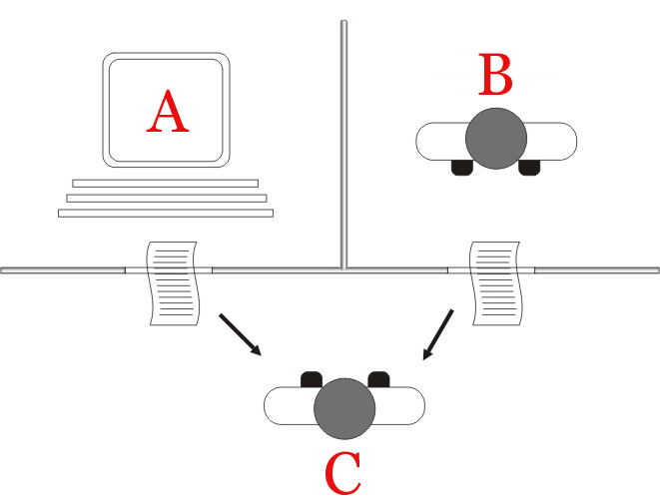
Turing Test - Philosophical A.I. Debate
Imitation Game
Easier than determining thinking
Does not determine intelligence
Chinese Room Problem Critique
What do you think?
Thinking of modern computing
What is a good way to do this test?
Hint: look at your phones
CHAT BOTS!
Jabberwacky being a prize winner.
Additional Reading: Chatbots Past and Future
By Juan Alberto Sánchez Margallo [CC BY 2.5 (https://creativecommons.org/licenses/by/2.5)], via Wikimedia Commons

Slide 6
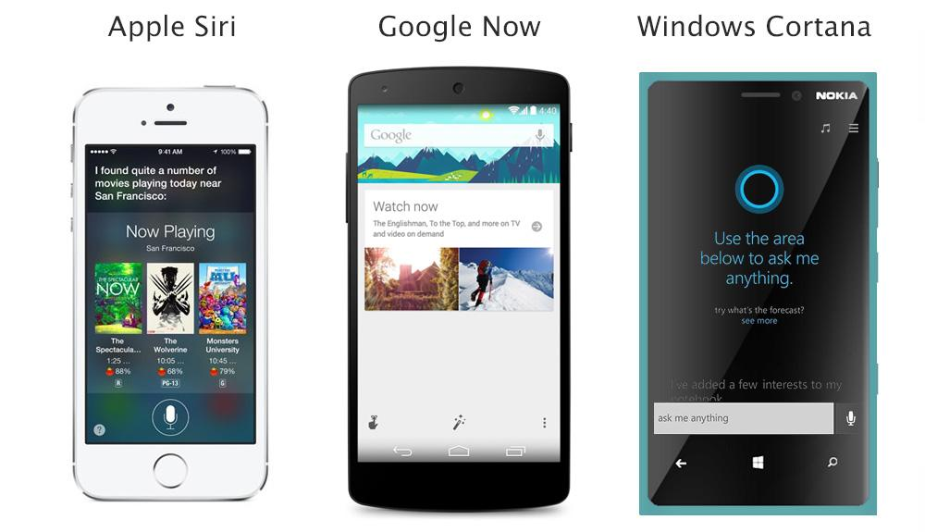
Famous Tech Based on Chatbots?

Slide 7

Caesar Cipher
Sentence: ABB
Shift it 1 place: BCC
Decoding - pretty easy to figure out by running all combinations
BUT - 159 quintillion combinations?
That would be much harder
Public domain image by Matt Crytpo http://en.wikipedia.org/wiki/File:Caesar3.png

Slide 8
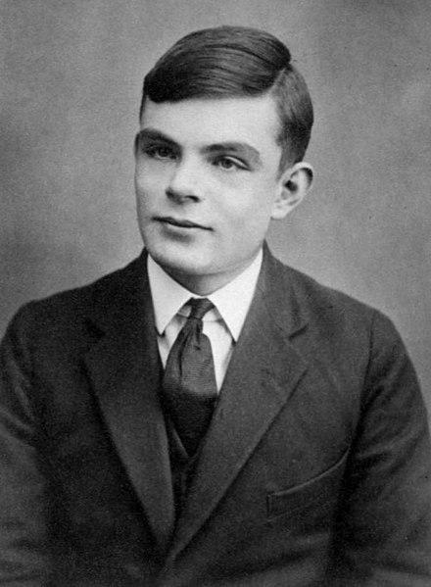
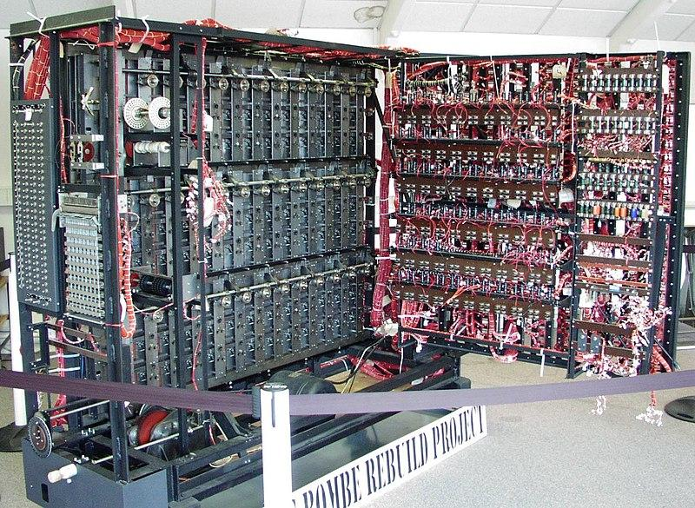

Alan Turing
Mathematician and Philosopher
Enigma Code Breaker - Bombe Machine
Series of interlocking wheels
Looked at all combinations
Turing Machine
Analog theoretical computer
We have ‘close approximations’
Turing Test
Imitation Game
Thinking is hard to define
Later life
Chemical Castration (DES)
Died age 41 from Cyanide poisoning
Queen pardoned him of ‘crimes’ - 2013
See page for author [Public domain], via Wikimedia Commons
Replica of Bombe Machine
Photographer: Tom Yates. Source

Slide 9
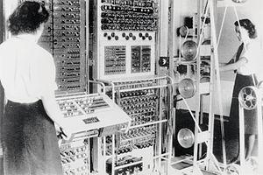
Who Programmed the Bombe?
Jean Valentine
Along with many others
Colossus machines
Call “Wrens”
Worked in parallel with the bombe
Woman programmed them
Considered “unskilled labor”
To the point of morning revelry
Mostly lost to history due to security restrictions
Many were not allowed to continue in computing.
Cryptographers were men, programmers were women
See page for author [Public domain], via Wikimedia Commons

Slide 10
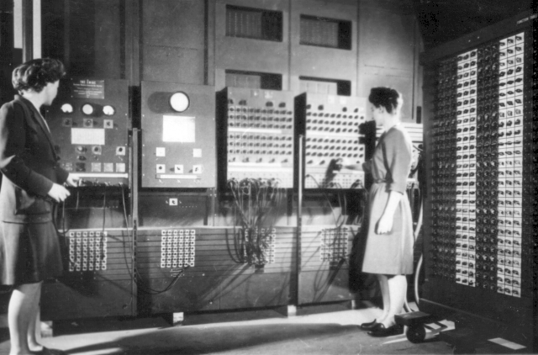
World War II - USA
Electronic Numerical Integrator and Computer (ENIAC)
The ‘silent’ programmers
Jean Jennings (Bartik)
Betty Snyder (Holberton)
Frances Bilas (Spence)
Kay McNulty (Mauchly Antonelli)
Marlyn Wescoff (Meltzer)
Ruth Lichterman (Teitelbaum).
Was considered “unskilled” labor
degrees in mathematics.
After the war?
They continued on after, had more, but limited freedom.
Defined the field
Changed the world
Programmers Betty Jean Jennings (left) and Fran Bilas (right) operate ENIAC's main control panel
By United States Army (Image from http://ftp.arl.army.mil/~mike/comphist/) [Public domain], via Wikimedia Commons

Slide 11
Now to your first code

Slide 12
Reading Review! (iClickers Ready?)
Given the output – what is the value for person?
Given the output – what is the value for adj?
If I pass in 10.0, is the output correct?
def longerFunc(person, adj, code): print("Hello " + person) print("Cryptography is the " + adj) code = code + code / 2 print("The hidden number is: ", int(code))
Output:
Hello Valentine
Cryptography is the bombe
The hidden number is: 15.0

Slide 13
Python
Line by line
Each line is an instruction
Basic expressions
Store values
Perform arithmetic on values
Call other functions on and using values
Basic Operations
+ (add numbers or concatenate Strings)
- (subtract numbers)
* (multiply numbers)
/ (divide numbers)
= (set value to a variable)
We will cover ** and % more next unit
computer = "Bombe Machine" # assignment of string to variable code = 10 # whole number - called "int" formula = (code * 3/2) – 2.1 # now a floating point number print("The code to the " + computer + " is ", end='') print(formula)
The code to the Bomb Machine is 12.9

Slide 14
Types in Python
Python using ”implicit”/weak typing
figures out types for you!
Unlike Explicit/Strongly Typed Languages (java)
Somethings you want to specify type
int - whole numbers only
float – floating point/decimal numbers
str – strings (more later)
Most useful on getting client input
answer = int(input(“get the answer”))
This code is also dangerous!
Last Example Again
computer = "Bombe Machine" # assignment of string to variable code = 10 # whole number - called "int" formula = (code * 3/2) – 2.1 # now a floating-point number print("The code to the " + computer + " is ", end='') print(int(formula))
The code to the Bomb Machine is 12
Notice: no .9!

Slide 15
This is all great, but…
computer = "Bombe Machine" # assignment of string to variable code = 10 # whole number - called "int" formula = (code * 3/2) – 2.1 # now a floating-point number print("The code to the " + computer + " is ", end='') print(int(formula))
computer = "Colossus" # different computer code = 12 # different code
formula = (code * 3/2) – 2.1 # now a floating-point number print("The code to the " + computer + " is ", end='') print(int(formula))
What happens if you want to use the same code over?
2 times, 10 times, 100 times, 1 million times?
what if I did the formula wrong?
Have to fix every line!
Code should be Reusable
Code should be DRY
Don’t Repeat Yourself
Worth repeating
Keep your code DRY!
Functions to the rescue

Slide 16

Reusable Code
Programming == Problem Solving
You look at the problem to solve
Clarify the problem and constraints
Break it up into *smaller* parts (Divide)
Outline the steps needed
Solve each step (Conquer)
Reassemble the pieces (Glue)
Completed program
The ENIAC women pioneered reusable code
But they also needed ways to modularize code
Functions!!!
Divide
Conquer
Conquer
Conquer
Glue

Slide 17
function
def cipher_machine_code(computer, code): formula = (code * 3 / 2) - 2.1 print("The code to the " + computer + " is ", end='') print(formula) # call the function twice cipher_machine_code("Bombe Machine", 10) cipher_machine_code("Colossus", 12)
def
defines the start of a function
indents keep the ‘code’ with the function
spacing matters!
parameters
allows for variables to the functions
print(your value)
function name print
your value is a parameter!

Slide 18
Side by side comparison
computer = "Bombe Machine" # assignment of string to variable code = 10 # whole number - called "int" formula = (code * 3/2) – 2.1 # now a floating-point number print("The code to the " + computer + " is ", end='') print(int(formula))
computer = "Colossus" # different computer code = 12 # different code
formula = (code * 3/2) – 2.1 # now a floating-point number print("The code to the " + computer + " is ", end='') print(int(formula))
def cipher_machine_code(computer, code): formula = (code * 3 / 2) - 2.1 print("The code to the " + computer + " is ", end='') print(formula) # call the function twice cipher_machine_code("Bombe Machine", 10) cipher_machine_code("Colossus", 12)
What if I needed to update the formula? Which is easier?

Slide 19
Return Values
Better yet
Functions do some work
and then return the answer
Other programs can then use those answers
As they need / best for their problem
Always the best paradigm to follow
Notice return in get_real_code
returns the value, done with the function
Pure Functional - Most all functions should return something!
def get_real_code(code): return (code * 3 / 2) - 2.1 def print_machine_info(computer, code): print("The code to the " + computer + " is ", end='') print(get_real_code(code)) def use_formula(code): solve_cipher(get_real_code(code) * 10)
Your turn – one person coding - type the code above, and then as a group figure out ways to modify it!
How do you test those changes?

Slide 20
Student Challenge
Team Coding
As group, write two functions
The first function takes in two parameters – first, last
It prints the ”welcome to the class (last), (first)”
The second function
Calls input to ask the client their first name
It calls input a second time to ask them their last name
it calls your first function to print out the result
Have one person on the table code using their laptop and zybooks IDE
The person who codes has to limit their input. They follow the instructions of others
We will alternate who codes each class, so you won’t always be typing.

Slide 21
Remember
Divide
Remember
Conquer
Conquer
Conquer
These are functions (mostly)
Glue

Slide 22
Let’s program
def get_real_code(code): return (code * 3 / 2) - 2.1 def print_machine_info(computer, code): print("The code to the " + computer + " is ", end='') print(get_real_code(code)) def use_formula(code): solve_cipher(get_real_code(code) * 10)

