Slide 1
File Hashing, Loops and Lists
Colorado State University
Computer Science Department
Slides Originally Created by Albert Lionelle (Albert.Lionelle@colostate.edu)

Slide 2

Sending Files Online
How do you know the file sent, is the correct file?
The quick brown fox jumps over the lazy dog.
Send File
The quick brown fox jumps over the lazy cat.

Slide 3
Hashing
Files are streams of bytes - ones and zeros
A file hash, is a number representation of that file (math formula to figure it out)
For example, ‘myfancyfile.html’
dfdec888b72151965a34b4b59031290a
If something gets modified - even one bit - the file won’t hash the same!
Even strings and objects can be hashed, and if the objects are ‘exactly’ the same, their hashes are the same
This provides consistency and integrity.
Most people don’t use this, but a cool concept to know for the future.

Slide 4
Hashing To Check Files
The quick brown fox jumps over the lazy dog.
Send File
The quick brown fox jumps over the lazy cat.
Send Hash Separately (or even post it publically)
dad18f1e2410a1955b93b13537c783fbf44b52bdcb1fbde59bcd9de25028c4ae
Client Checks Hash:
ae3700ed06626b431c3abaf48563bb47ae1f4e545ce8365ac8eca62f980f730d
Hashes are unique to CONTENT - even changing one character changes the hash!
Hashes are for checking consistency, not to hide contents
SHA-3 (newest), md5 still common

Slide 5
Encryption and Encrypting Files
Symmetric Encryption
We use this almost daily
HTTPS - or TLS
Public Key Encryption (asymmetric)
We should use this more

Slide 6
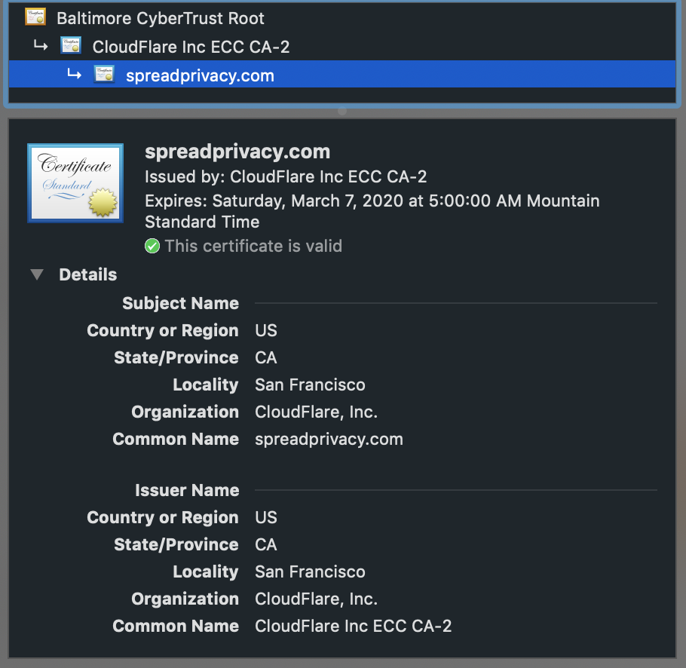
Transport Layer Security
Protocol
Used on top of the web protocols (www, IP, etc)
Stages:
Handshake
Double check certificate
Figure out encryption key
Connection is now encrypted for a limited time
We see it as: HTTPS
Also used in Virtual Private Networks (VPNs)
Side comment: it is possible to spoof certificates or root them. CS 356 and the CS 456 are great classes to learn how (and ways against). Open to minors and majors in CS.
Further Reading: https://en.wikipedia.org/wiki/Transport_Layer_Security https://spreadprivacy.com/what-do-security-certificates-do/

Slide 7


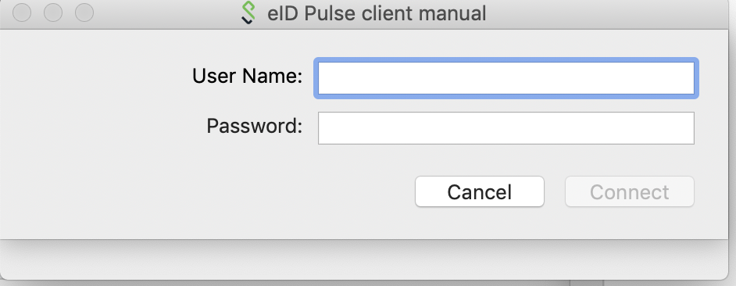

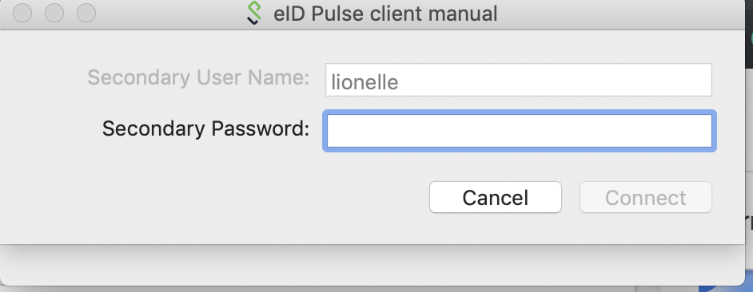
Virtual Private Networks (VPNs)
Your computer
You First Connect to a VPN Server
Tunnel all information through that server
Encrypted tunnel
Server then relays info to websites and to you
CSU Uses one
Pulse Secure
Uses 2 Factor Authentication
Encrypts all traffic
Pros
You ‘appear’ from CSU
Great for articles, etc
Cons
CSU becomes point of failure
But they are experts at doing this
Really - Go set it up
Encrypted Connection
VPN
Internet

Slide 8
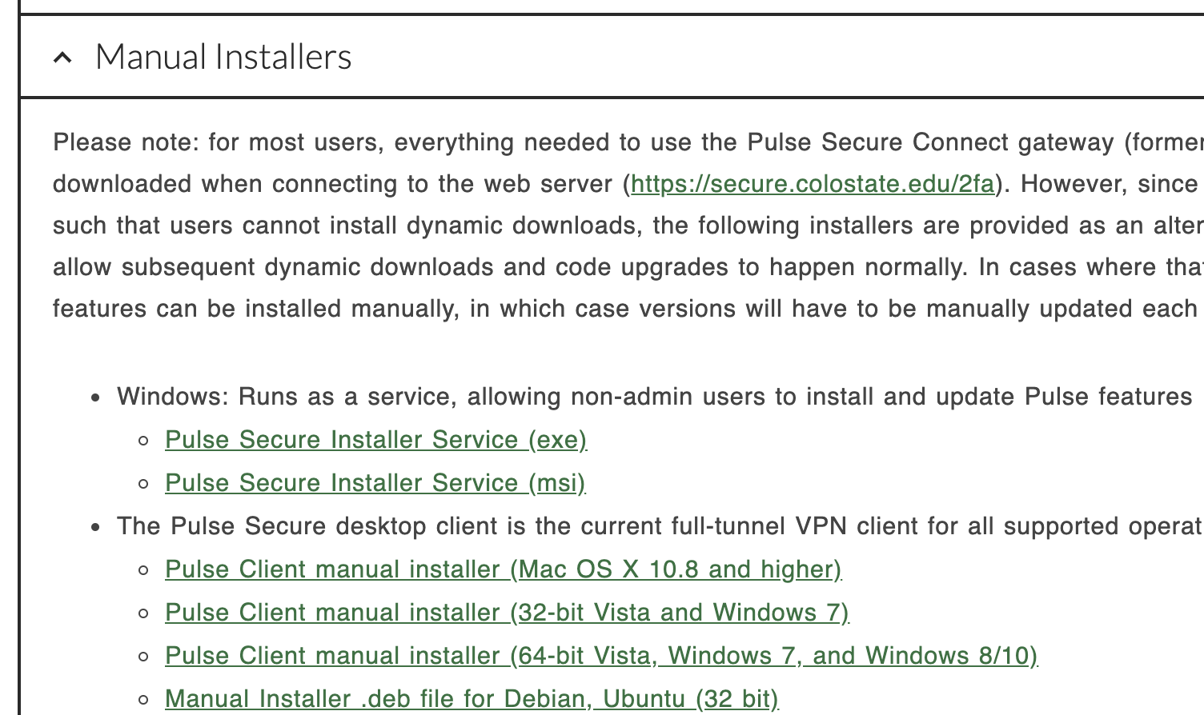
VPN Setup hints
Go Here: https://www.acns.colostate.edu/security/
Install the Application (don’t mess with securing via browser)
You will also need the Duo app on phone (for two factor)
Connect via browser once - too get config files
Whenever you are not on campus
Connect through the Pulse Client
This is all great, but what you want to encrypt something, only your friend can read?

Slide 9
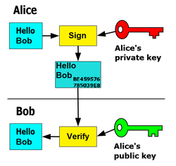
Public and Private Keys
Run a program (keygen)
Generate two keys
Public and Private
Public key - share with others
Private key - keep to yourself
Pairings are Unique
Public key used to encrypt
Only private can decrypt
Private key used to encrypt
Only public key can decrypt
Solves our File Hashing problem
You encrypt both the hash and file
Foundation for Blockchain and most encryption algorithms!

Slide 10


Break/Continue
Very commonly used
break
Forces an early exit from a loop!
continue
Forces a next iteration for a loop
Be careful with while loops
very common in for loops
odds = [] for val in [23, 12, 13, 16, 18, 2, 23, 17, 20, 191]: if val in odds: break if val % 2 == 1: odds.append(val) print(odds) # [23, 13]
odds = [] for val in [23, 12, 13, 16, 18, 2, 23, 0, 17, 20, 191]: if val in odds: continue if val % 2 == 1: odds.append(val) print(odds) # [23, 13, 17, 191]

Slide 11
Some more useful coding tools

Slide 12

Loop Else
odds = [] for val in [23, 12, 13, 16, 18, 2, 23, 0, 17, 20, 191, 10]: if val in odds: break if val % 2 == 1: odds.append(val) else: print("Found no duplicates!") # NOT printed!
Remember If Statements?
if True: else:
True means execute block
Else means execute block if first isn’t true
Loops – Execute block while true
but if not true?
run block of code, *once* after expression is false!
Guarantees one run after loop
As long as False happens
Matters for break!
Reasons?
Good for closing files, closing internet connections, security checkups, etc

Slide 13
List Comprehensions
Cool shorthand “magic”
a way to have a loop that generates a list in one line!
numbers = [random.randint(1,6) for i in range(1,10)] print(numbers) # [6, 5, 2, 4, 2, 6, 1, 3, 4]
Also, conditionally add something!
common for filtering lists
odds = [i*-1 for i in numbers if i % 2 == 1] print(odds)# [-5, -1, -3]

Slide 14
Let’s Code!
def reader(filename): with open(filename) as csvreader: lines = csv.reader(csvreader) plant_list = [line for line in lines] header = {} for i, col in enumerate(plant_list[0]): # first line is header header[col] = i return header, tuple(plant_list[1:]) def categorize(plant_list, named_indices, *args): by_category = {} lower_args = [arg.lower() for arg in args] for arg in lower_args: by_category[arg] = [plant for plant in plant_list if plant[named_indices["Category"]].lower() == arg] else: by_category["other"] = [plant for plant in plant_list if plant[named_indices["Category"]].lower() not in lower_args] return by_category def build_data(filename, *args): headers, lines = reader(filename) grouped_plants = categorize(lines, headers, *args) for arg in args: grouped_plants[arg] = {"average": (len(grouped_plants[arg]) / len(lines)), "plants": grouped_plants[arg] } else: grouped_plants["other"] = dict(average=(len(grouped_plants["other"]) / len(lines)), plants=grouped_plants["other"]) return grouped_plants,headers

