Slide 1
Data Privacy
Colorado State University
Computer Science Department
Slides Originally Created by Albert Lionelle (Albert.Lionelle@colostate.edu)

Slide 2
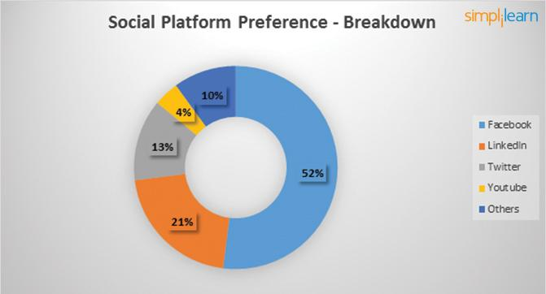
Data Mining and You
Further Reading: https://www.simplilearn.com/how-facebook-is-using-big-data-article https://zephoria.com/top-15-valuable-facebook-statistics/
https://medium.com/wibson/how-much-is-your-data-worth-at-least-240-per-year-likely-much-more-984e250c2ffa
Facebook
2.45 billion monthly active users
1.62 billion people on average log onto Facebook daily
Every 60 seconds on Facebook: 510,000 comments are posted, 293,000 statuses are updated, and 136,000 photos are uploaded.
300 petabyte data analysis warehouse (to start)
What do they track! (everything)
Likes
Faces / Images
Cookies, tagging, etc
“Your” Data Worth $240 a year, per person…

Slide 3
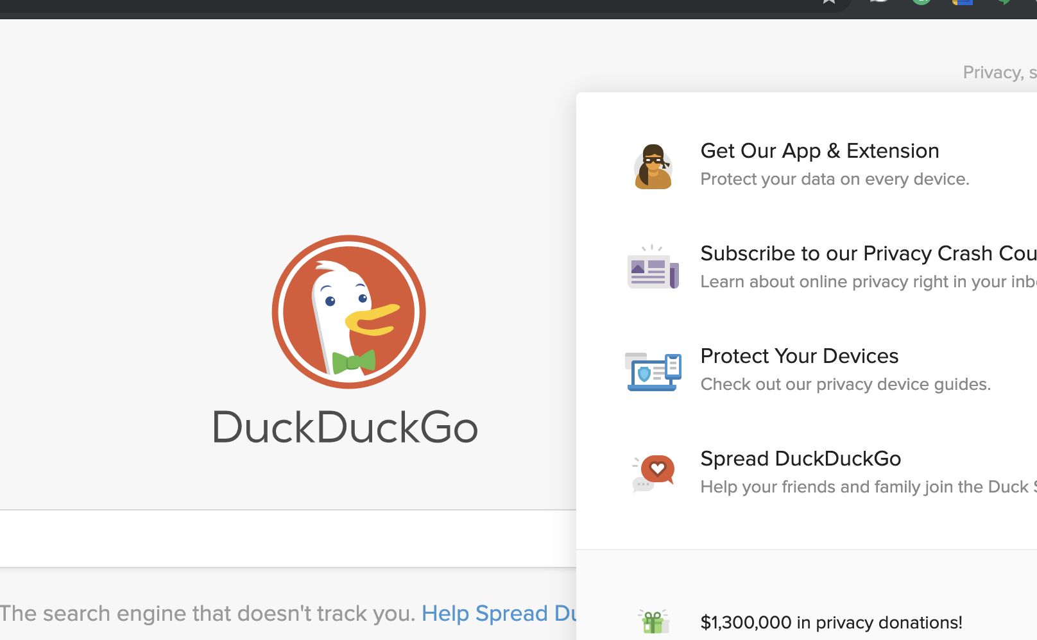

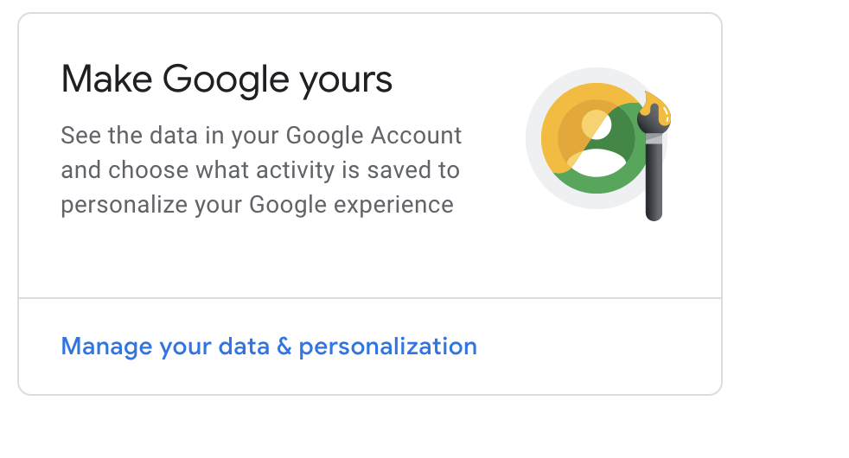
Tracking?
No one knows who owns data!
Do you own your data?
Google, Facebook and others - beg to differ
Simpler Case
Do you own your grades?
Does the school own your grade information?
Same argument!
Look at sites that don’t track your info
But - what tools do we lose?
What is the balance?
With that said, your data is only as secure as you make it.
We are our own worst security

Slide 4
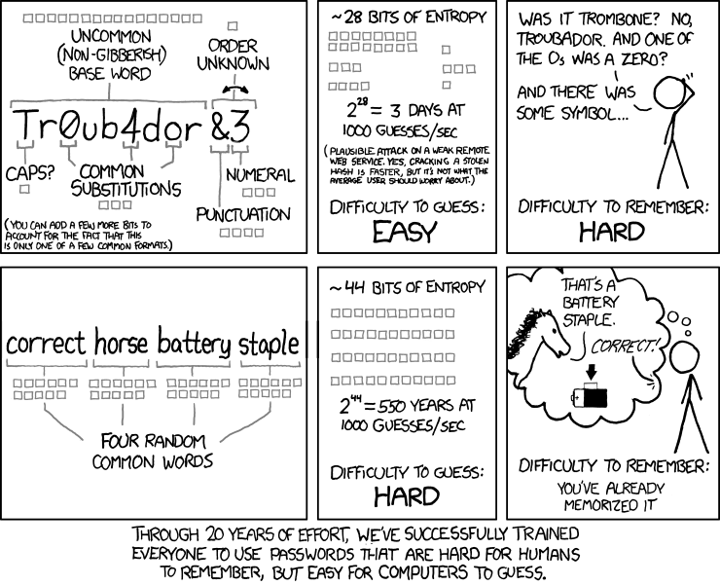
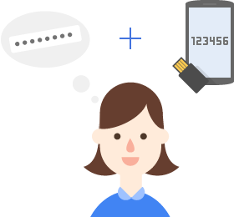
2-Step Authentication
For signin - not encryption!
Step 1
Enter your password
Step 2
You get a security code (often six digits)
Via an app or text message
Enter in the code
Really better than just a password
Admittedly, passwords should die
But how to balance user experience with security?

Slide 5
Homework (ok your choice)
https://myaccount.google.com/
Go there, and secure the information that is shared out!
https://www.facebook.com/help/325807937506242
Read up on facebook privacy options
https://www.facebook.com/settings (link to facebook’s privacy settings)
https://help.instagram.com/196883487377501
Read up on instagram privacy setting - and fix what you want
Set up Two-Factor Authentication!
https://www.google.com/landing/2step/
https://www.facebook.com/help/148233965247823
https://www.acns.colostate.edu/duo/ (yes, CSU - but more to this)
https://www.acns.colostate.edu/security/
It is worth the 30 minutes you spend on it!

Slide 6
More Recursion

Slide 7
Review
Recursion
A way to loop via method calls
Good at:
building sequences
breakdown complex iteration to simple methods
Divide-Conquer-Glue
Solve Base/ Simplest case first
Build the N=2+ case next
Tail Recursion
Store values as part of the parameters
Make use of default parameters to make this easier!

Slide 8
Using Recursion To Simplify
How would you use a loop if you wanted to?
Break up the list into thirds
Based on an input, look at the top third
Break up the list again, repeat?
Pretty complex as a loop!
but what about recursively?

Slide 9
Binary Search
One of the oldest documented search methods!
Roman documentation for ‘address book’
Assumes list is sorted (like a phone book, or routing table)
def binary_search(sorted_list, value, start=0, end=None): if end is None: end = len(sorted_list) if (end - start)+1 < 2: return -1 ## get middle index! middle = (end+start) // 2 #notice // why? if value == sorted_list[middle]: index = middle elif value < sorted_list[middle]: index = binary_search(sorted_list, value, start=0, end=middle) else: index = binary_search(sorted_list, value, start=middle+1, end=end) return index

Slide 10
Binary Search Example
def binary_search(sorted_list, value, start=0, end=None): if end is None: end = len(sorted_list) if (end - start)+1 < 2: return -1 ## get middle index! middle = (end+start) // 2 #notice //, why? if value == sorted_list[middle]: index = middle elif value < sorted_list[middle]: index = binary_search(sorted_list, value, start=0, end=middle) else: index = binary_search(sorted_list, value, start=middle+1, end=end) return index
[1, 15, 29, 32, 44, 56, 61, 76, 86, 96] - searching for 32
[1, 15, 29, 32, 44, 56, 61, 76, 86, 96]
[1, 15, 29, 32, 44, 56, 61, 76, 86, 96]
32 < 44? – yes!
32 < 29? – No!
found it!
Speed! Much quicker than looking at all values!

Slide 11
Overall Rules
Keep it simple!
No one ever does it right the first time
Focus on tail recursion, and simple recursion for now!
Practice, practice, practice
A few other classes will cover this again
No code along

