Slide 1
How did Programming Start?

Slide 2
Industries For Computing?
5 Min
Break into groups
Brainstorm industries in which computers are used in
How many require specialized applications?
Saying all is not a valid answer (for this)! – you must have an actual use before listing the industry
Go to a white board, and write down all the options you came up with!
Circle the one you think was the “first industry”
Deeper discussion:
Why are computers involved in so many?
What do they accomplish that humans can’t/don’t?

Slide 3
How did it all start?
First Industry
First Computer
First Programmer

Slide 4
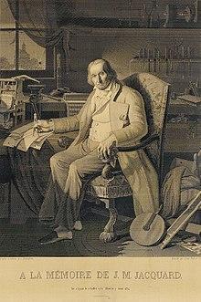
First Computer?
The industry - Weaving!
Jacquard loom / machine
Invented by Joseph Marie Jacquard in 1804
Cards set the patterns, colors, etc
Very specific use - not general purpose
“This portrait of Jacquard was woven in silk on a Jacquard loom and required 24,000 punched cards to create (1839). “ - ref: https://en.wikipedia.org/wiki/Jacquard_loom

Slide 5
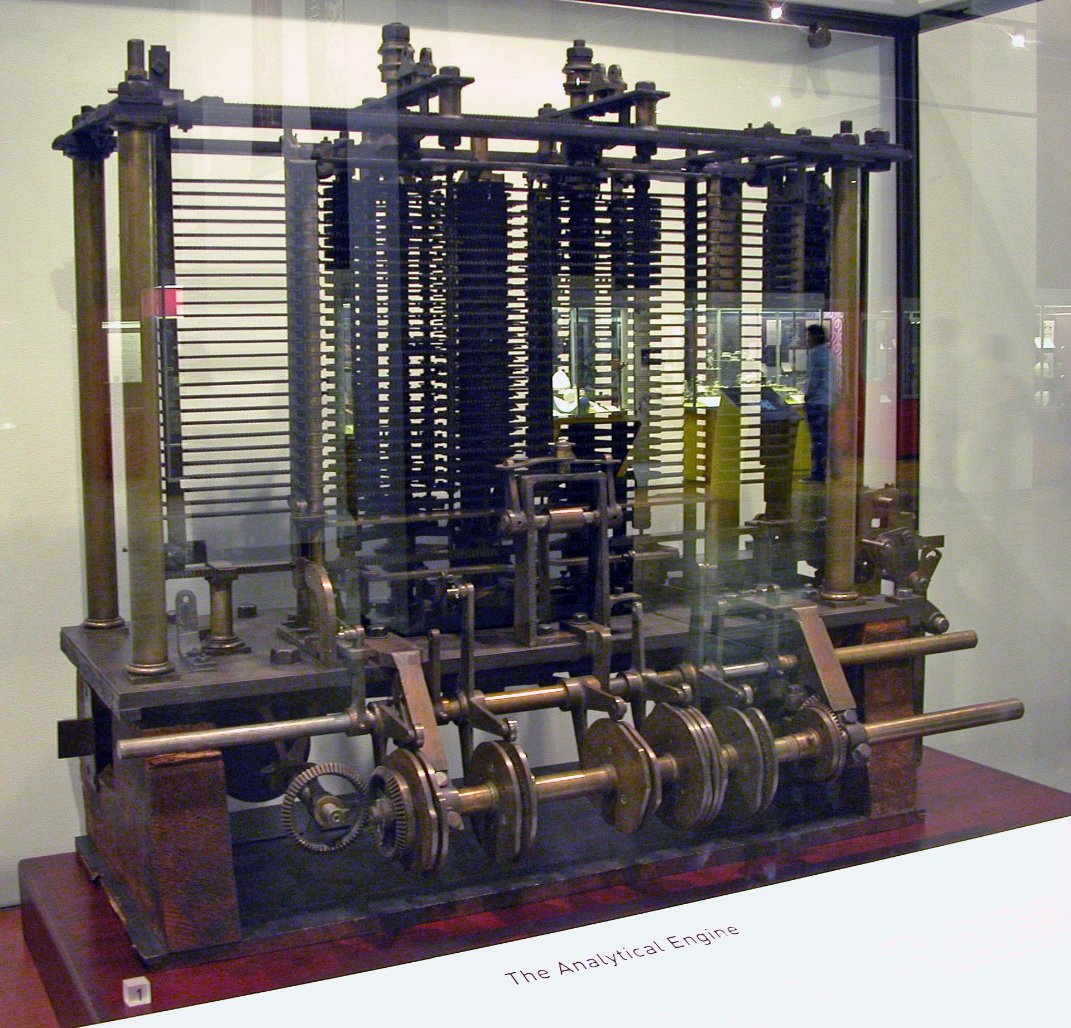
Analytical Engine
Charles Babbage
Polymath
“Father of the computer”
Mainly Theory
Purpose?
Algorithm Development and solving
1837
Bruno Barral (ByB) [CC BY-SA 2.5 (https://creativecommons.org/licenses/by-sa/2.5)], from Wikimedia Commons

Slide 6
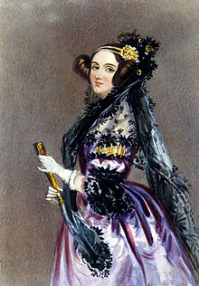
Enchantress of Numbers
She walks in beauty, like the night
Of cloudless climes and starry skies;
And all that’s best of dark and bright
Meet in her aspect and her eyes;
Thus mellowed to that tender light
Which heaven to gaudy day denies.
Excerpt from “She Walks in Beauty” by Lord Byron

Slide 7
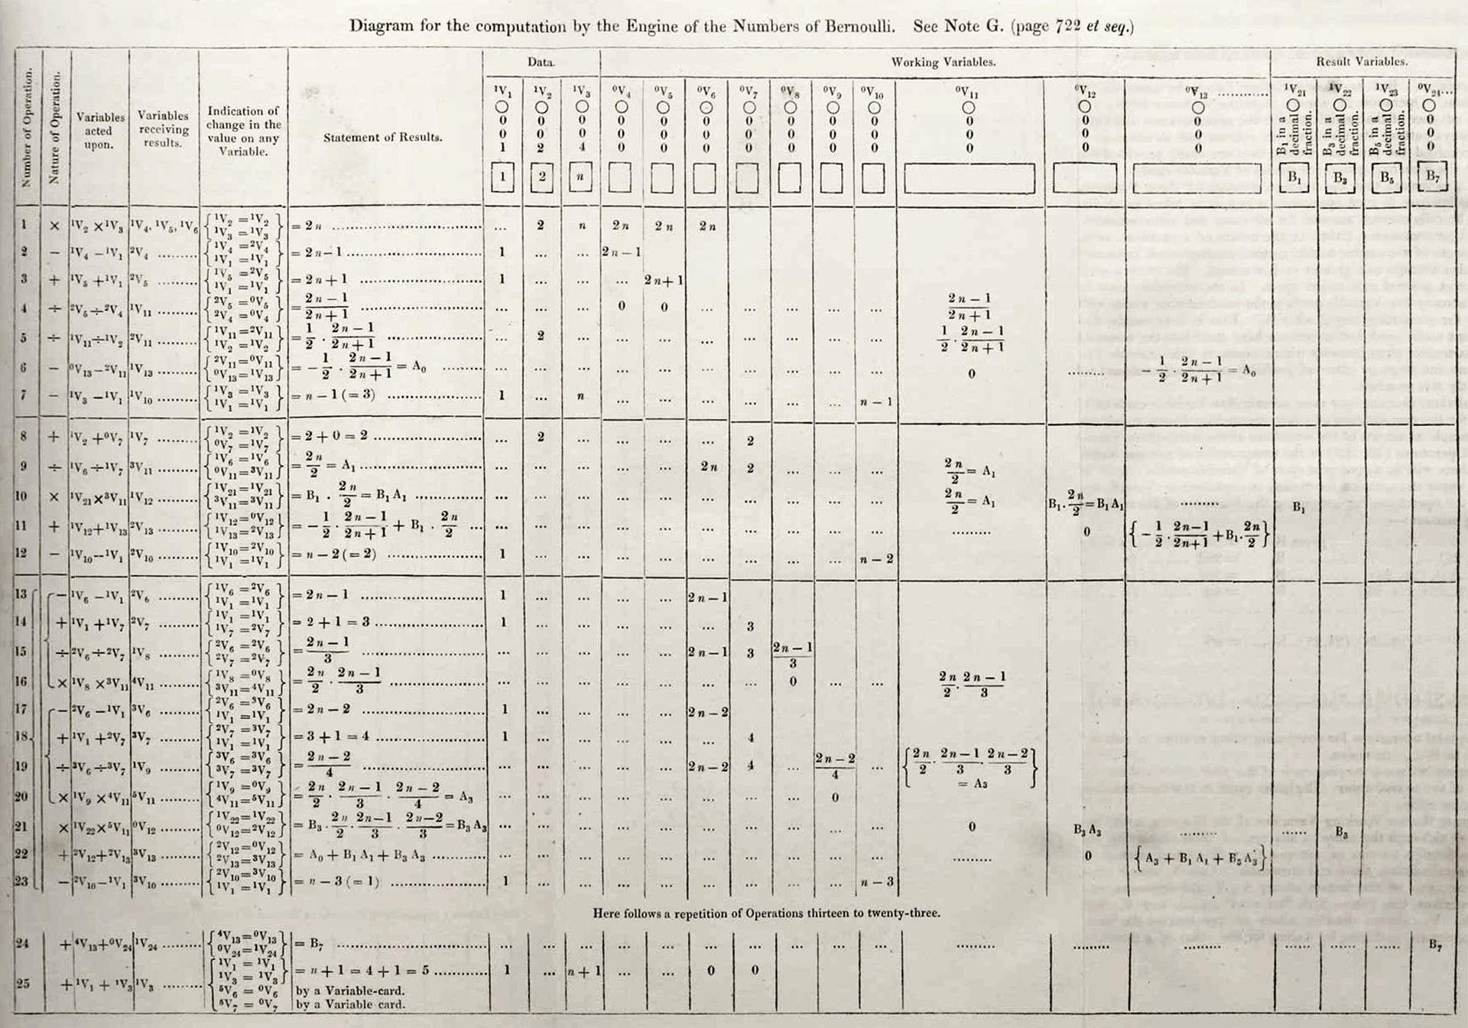
Ada Lovelace
Grew up in a rich but a single mother household
Father was the famous poet Lord Byron
Was known as a rebellious child and adult (non-conformist)
Mother insisted on her becoming a mathematician
She was unruly:
part artist
part scientist
part philosopher
Wrote the first “Computer Program”
Theorized computers could be ‘general purpose’ machines to solve complex problems.
By Ada Lovelace (http://www.sophiararebooks.com/pictures/3544a.jpg) [Public domain], via Wikimedia Commons
Additional Reading: Victorian computing visionary

Slide 8
Python, Your Intro Language

Slide 9
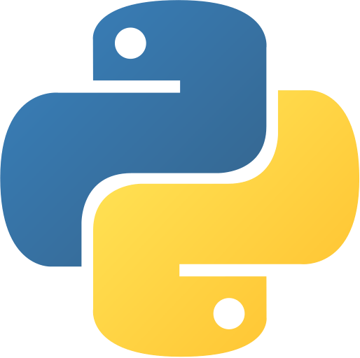
Python
A Modern Programming Language
Focuses on ‘scripting’
Interpreted
Takes another program to run the code
Common Uses
Research
Data science
Machine learning and Artificial Intelligence
Web development (backend)
Full applications and games
Becoming more common

Slide 10
Programs
Are a set of instructions
Like Cooking (common/historical analogy)
Like following a how-to guide
A computer only does what you tell it
It can’t guess
It can’t assume
It follows the instructions
for better or worse
Line by line, unless we say otherwise

Slide 11
Python Basics
Variables
Allow you to store information
puppyCounter = 100
puppyName = “Cerberus”
puppyName = ‘Cerberus’ #also allowed, but we will often use double quotes for Strings
Anything after the # sign is a comment, so not an instruction!
Output / Printing to the screen
print(“Ada Lovelace was the first programmer”)
print() signifies a function – that does the work for you!
code reusability
Input – From the console / client
input(“Who was the first programmer”)
But… We need to store the value!
answer = input(“Who was the first programmer”)

Slide 12
Let’s Look At Some Code!
answer = input(“Who was the first programmer?”)
print(answer + “ was the first programmer.”)

