Slide 1
Research, Logic, Conditionals

Slide 2
Announcements
Take a moment – talk about your
paper with your group
Open your iClicker Software/login
Type in your seat location

Slide 3
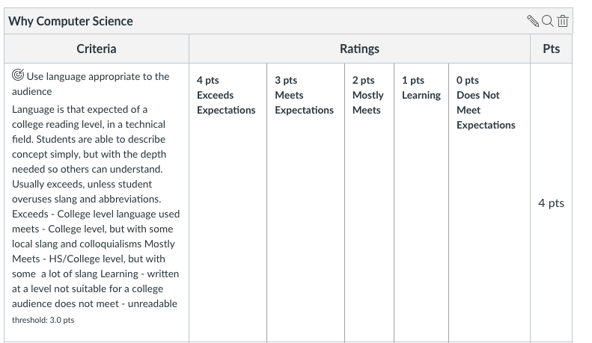
A Couple Reminders
Your first paper, “Why Computer Science” is due this module!
Hopefully, you already started!
Three parts:
Your Interview
Why you are interested in CS
One area of CS that interests you
with at least one citation to a source (yes, training you for citing sources)
Follow the Rubric: (in canvas)

Slide 4
Grading
Every Learning Outcome In Rubric
Scored between 1-4
0 if you skip that learning outcome completely
Final grade for paper 1-4
Based on most scores you have (rounded up)
For example
4, 4, 3, 3 = 4 for the paper
4, 3, 3, 2 = 3 for the paper
Exception:
If you score a 1 or 2 in any category, you may not score a 4 for the total!
Submitting a blank page, will grant you a 0
But allowed, if you want to ‘skip’ the paper
Don’t skip it! (Will seriously damage your grade)

Slide 5
Resubmitting?
You must meet with the instructor or TA – first
They will then regrade your new submission
If you score a 1 or 2 on the final paper score (not just a single category)
you will automatically be asked to re-submit
The goal is for you to do it correctly, more than just doing it!

Slide 6
FAQ
What type of format?
You can follow any style you want
but you must follow a style
Recommended Style: (highly recommended)
ACM/IEEE Style Guidelines
IEEE Overview - Purdue Online Writing Lab
Includes simple intext and biographical citations
Very commonly used in tech industries
Minimum number of pages?
We don’t have a minimum, only a maximum / stop reading page
Most people it will take a couple pages
Accommodations Window
Max of 3 days. We have to be strict, or won’t have time to grade them all

Slide 7
It’s Logic

Slide 8
Poorly Defined Logic of the 50/60s
Industry was used to building products
Machines are products
But Code was not
For the first time, the value shifted from the product to the person
You are a company’s most valuable commodity!
Especially true with computer science
This created a dichotomy
In some cases, still exists today
Automatic Programming / Coding
At the heart of this!
If you can replace coders with machines..
Enter Cobol and Univac
Additional Reading: Techs Ultimate Success

Slide 9
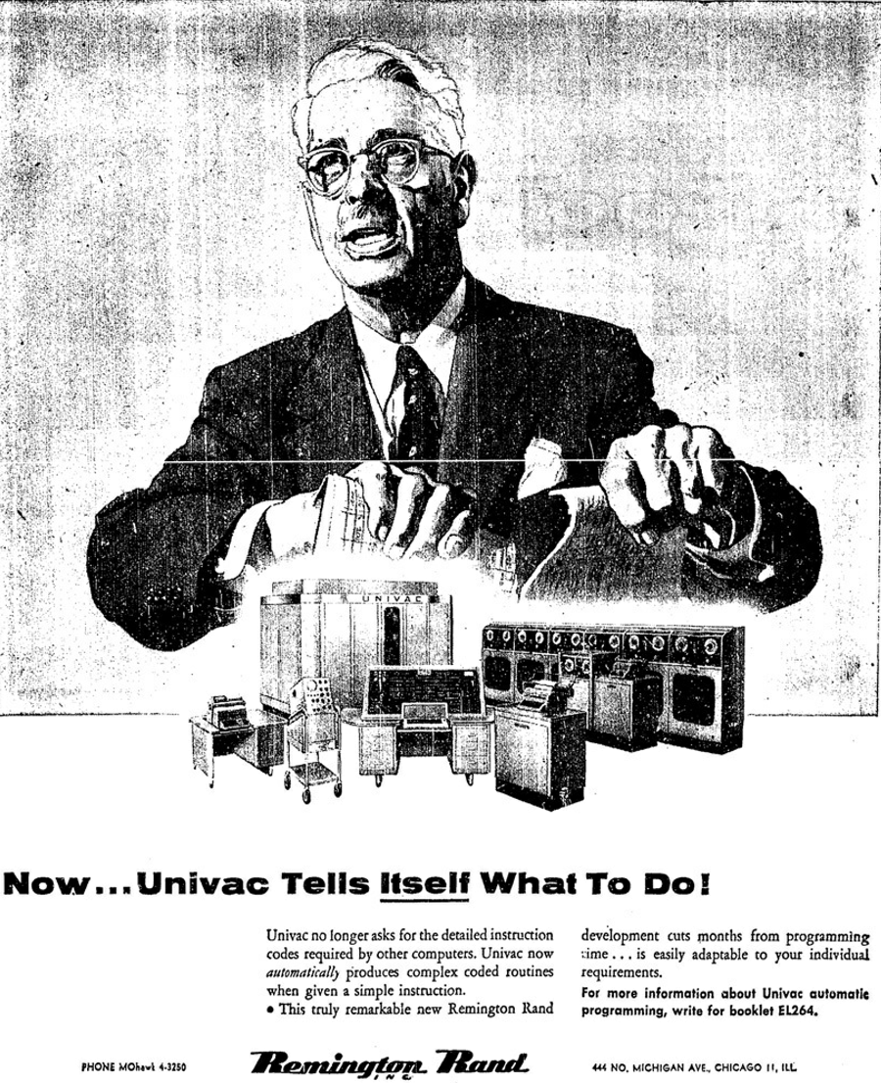
No more coders?
Actual ad. for the Univac after the creation of Cobol
Let’s think about it…
The industry didn’t know what to do with programmers
Some wanted to get rid of them
Others wanted to hire more
Truth
Everyone was tied to this new thing called a computer
Programmers were becoming even more important
Second law: Invention is the mother of necessity.

Slide 10
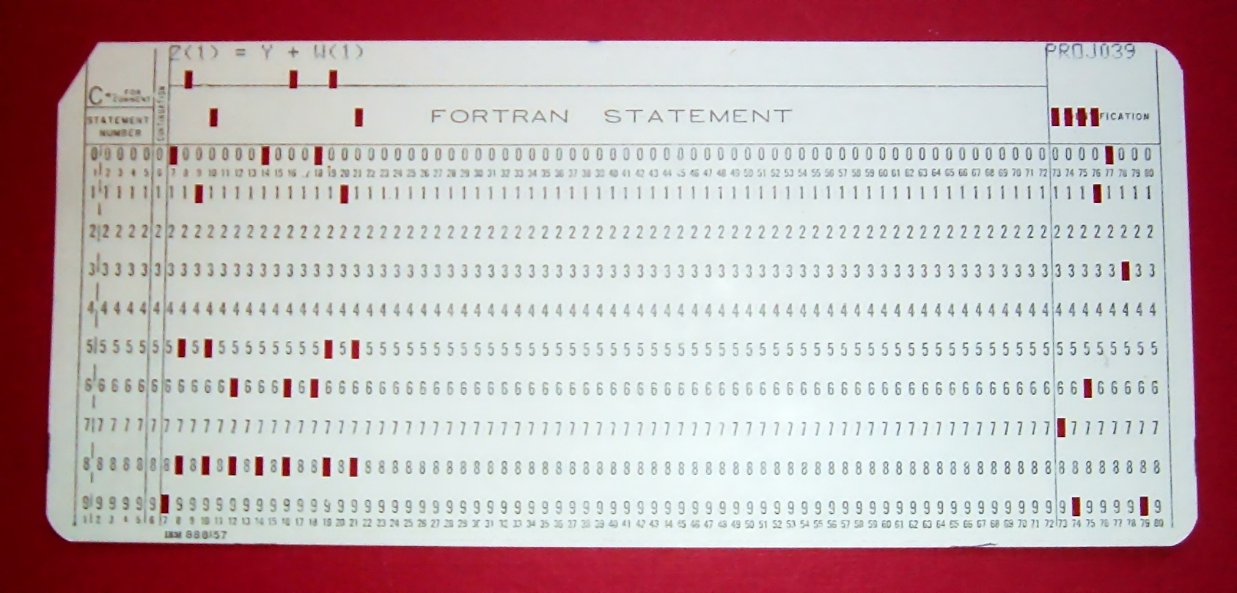
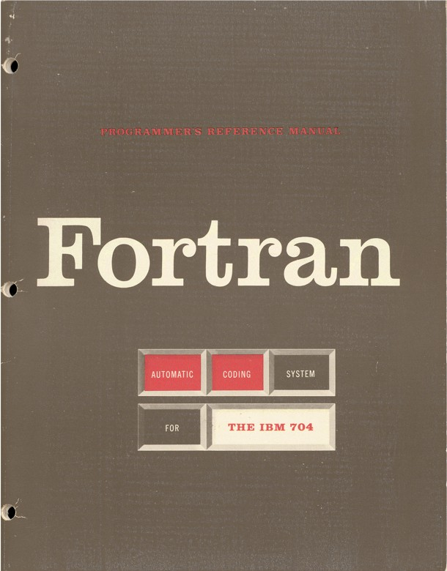
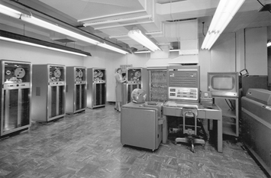
Fortran
Designed by John Backus
first optimizing compiler
Very important or wouldn’t work
1957 (10 years after WW II)
Punch Cards
Machine time limited
Designed programs on paper
Shared times
English -> punch cards -> machines
Designed for business use
Accounting
Math calculations
All text based
Hidden Figures <- Go watch it!

Slide 11
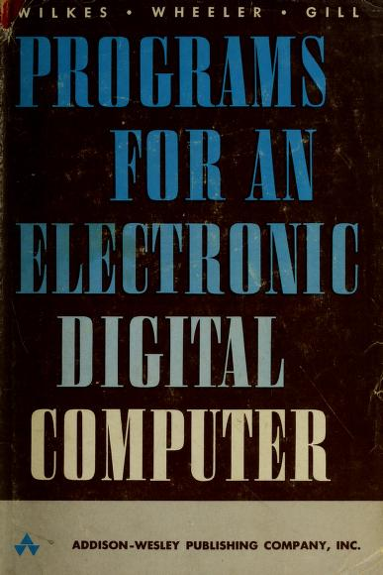
Secrets from the past?
Rare for a program to work right the first time
“The Preparation of Programs for an Electronic Digital Computer” (1951)
Considered the world's first programming book
Still true!
Imagine compilers:
Only generate code once a day
Even then, there would be bugs
Lone ranger mentality
Coming in fixing code, not sharing how it is done
This started to push women out of the industry
Would be specialized to certain fields
Wouldn’t usually get along with management
Management wanted to break free of their programmers

Slide 12
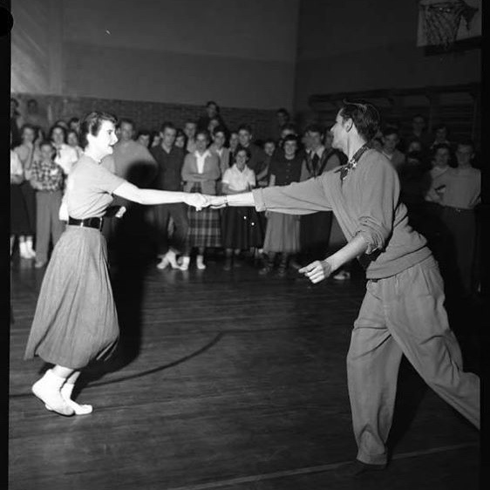
What does it take to be a good programmer - 1950s/60s edition?
IBM Programming Aptitude Test
number series
figure analogies
arithmetical reasoning
Cooking?
“Your Career in Computing” - 1968
If you can read a cookbook, you can be a programmer!
Worry about details while keeping big picture in mind
Books even said females could be better programmers
In truth
Wanted cheaper labor
Trying to fulfill a shortage - with women that others were pushing away
There has almost always been a shortage of programmers - we have one now.

Slide 13
Logic Problem Time
Three Boxes
ALL of them are mislabeled
We can pick one item from one box
We can see that one item.
We must relabel all boxes, based on the one item we see
Apples
Oranges
Apples and Oranges

Slide 14
Solution
Apple box - possible correct answers: Oranges OR Apples and Oranges
Orange Box - possible correct answers: Apples OR Apples and Oranges
If I pick from both boxes, I could end up with either apple or orange - no definitive answer
Apples and Orange Box - possible correct answers: Apples OR Oranges
This seems like a definitive answer - as we know if we pick one, the other is not in there
Let’s assume we pick an orange from the “Apples and Oranges: box
Apples
Apples & Oranges
Oranges
Apples
Apples and Oranges
Oranges

Slide 15
Basic Conditionals
Logic that evaluates as
Yes or No
True or False (called a Boolean)
Essential in all programming languages
You mentally do this all the time
100 pennies greater than $1?
Common logic operators
== Equals
< Less than (is left less than right)
> Greater than
<= Less than OR equal
>= Greater than OR equal
!= not equal ( ! is your NOT character)

Slide 16
Structure of if statements
if without else
if with else
def get_happy(puppies): happy = False if puppies >= 100: happy = True return happy
def get_happy2(puppies): if puppies >= 100: happy = True else: happy = False return happy
# conditions are operations, so you can return the result def get_happy3(puppies): return puppies >= 100

Slide 17
Elif?
elif – used for chaining if statements
def broken_rogue(dice_roll): if dice_roll >= 10: if dice_roll > 15: print("Trap Disarmed!") else: print("Get the 10-foot pole...") elif dice_roll >= 5: print("As far as I am aware, no traps.") else: print("Found the trap!")
broken_rogue(10) # prints Get the 10-foot pole...
broken_rogue(16) # Trap Disarmed!
broken_rogue(5) # As far as I am aware, no traps. broken_rogue(1) # Found the trap!

Slide 18

Secret Ninja Logic Trick
Work it out!
Draw it out - flow chart!
Really - just that
Often we over think it
if puppyCounter > 100:
true
false
Scream - So many puppies!
Sad panda, need more puppies

Slide 19
Let’s Code!
def check_for_traps(dice_roll, difficulty, contains_trap): if dice_roll >= difficulty: return contains_trap elif dice_roll >= 5: return False else: return not contains_trap def disarm_trap(dice_roll, difficulty): return dice_roll >= difficulty

