Slide 1
Amazing Grace

Slide 2
Today Most Code is Compiled
main.py
You write in English
The ‘compiler’ converts it to machine readable code
Why?
We don’t want to write in numbers
Machines want numbers and hardware instructions
This idea was a MAJOR breakthrough (1952)
General purpose computing
Reusable code across machines
Compiled languages (java is an exception), must be:
compiled to specific machine architecture / operating system
more structure, but faster
Interpreted Languages (Python, Javascript, LISP, etc)
require another program on the machine
reads the code, converts to machine at “runtime”
speed cost, but greater flexibility
Steve Russell wrote the first interpreter for LISP (1958)
print(“hello world”)
python interpreter - “loads” main.py, runs it on the machine
0001100001010101010101010101001010101010101010100101010101010101010101010100101010101010101010100101010101010101010101010010101010101001001010001

Slide 3
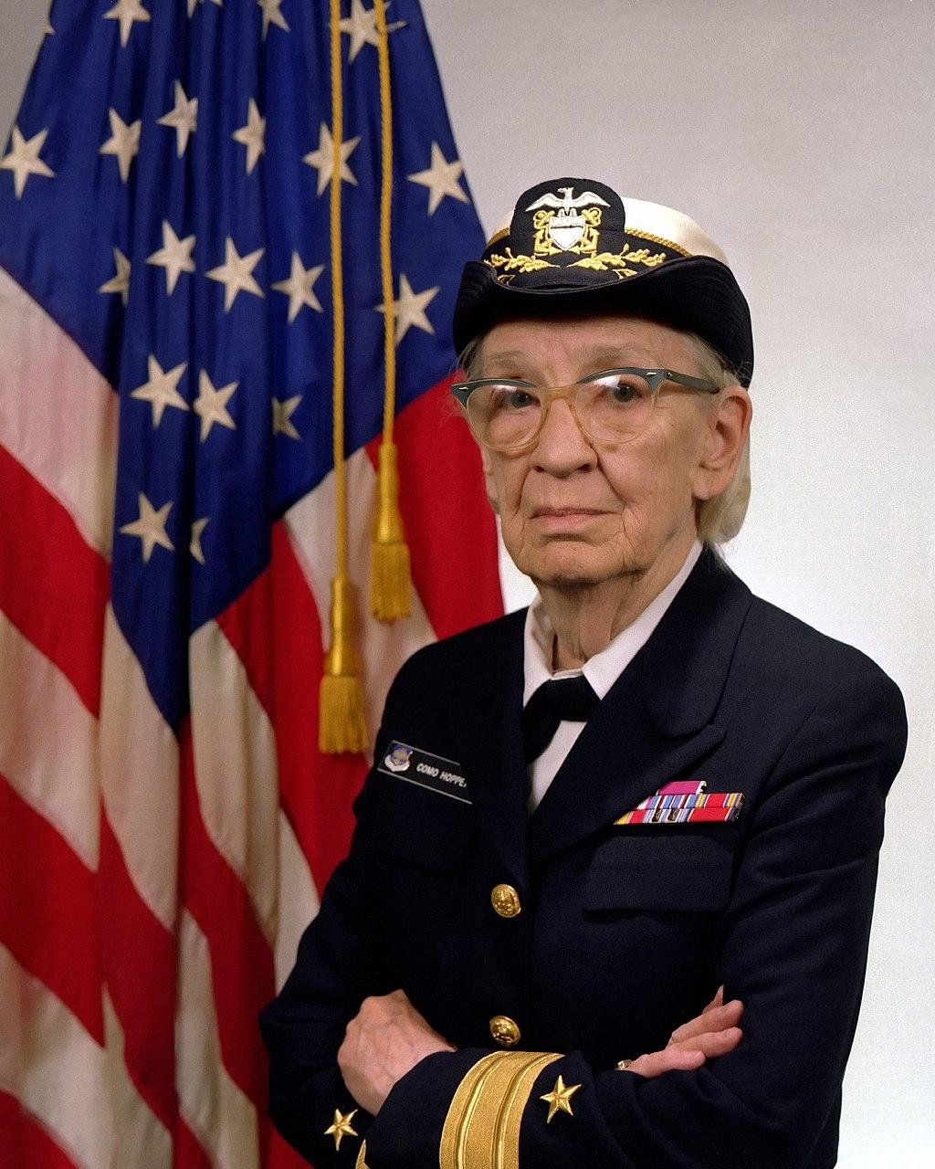
Pioneer of Compiled Code
Admiral Grace Murray Hopper
Nicknames, Amazing Grace, Grandma COBOL
Mark I computer
Built by Howard Aiken,
Programming by Grace Murray Hopper (and others).
Believed programing languages could be
Machine independent
Compiled from English to machine code
Same program, multiple machines
Invented the COBOL language
Also believed in Automatic Coding:
Code that writes itself - eventually A.I. that writes code for you
Pointed out later in life that “coding” is different than “programming”
Believed the programmer was greater than the engineer
By James S. Davis [Public domain], via Wikimedia Commons. Source

Slide 4
Automatic Coding vs. Programming?
Coding
Syntax
How you do something
What you are doing in this class
It follows specific rules
Can be self-taught
Programming
Design
Theory
Specification
It requires the creative component
A good programmer has to be more than a coder. She has to be an problem solver, a designer, an artist and engineering.
Divide
Remember
Conquer
Conquer
Conquer
Glue

Slide 5
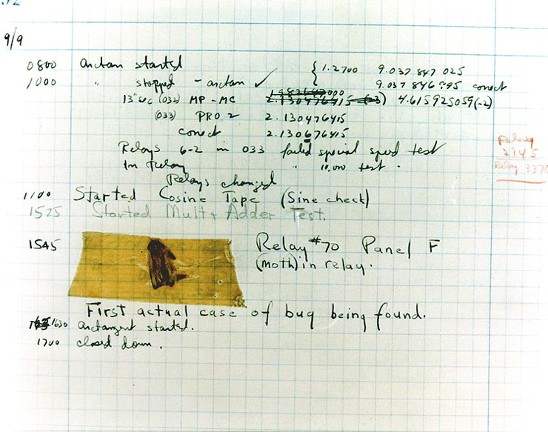
The first computer bug?
Actual bug in a computer relay, found by Grace
Good story, but….
Did not invent the term ‘debugging’
Was used in engineering for many years before
Debugging is used in programming
It often takes patience, practice and repetition.
Coding bugs (not actual bugs) were common
wanted to remove the human error by automation
By Courtesy of the Naval Surface Warfare Center, Dahlgren, VA., 1988. [Public domain], via Wikimedia Commons

