Slide 1
Strings and String Formatting

Slide 2
A Word is a Word
Technology is a human activity
Humans construct words to derive meaning
Computers should be able to handle human readable strings and characters - not just numbers 0s and 1s.
Not originally part of most languages
Even some modern languages are only used to single characters (letters or digits) without Strings built in
To understand Strings:
Let’s Play Hangman!

Slide 3
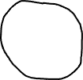
Hang-them: Who Created Python?
Strings are ordered lists of characters!
Characters – visible and hidden
\n, \t – most common
Locations of characters
Called indices / index – start at 0
Have functionality attached to them (methods and operations)
G
u u
o o
s s
a
G u i d o v a n R o s s u m
_ _ _ _ _ _ _ _ _ _ _ _ _ _ _ _
0 1 2 3 4 5 6 7 8 9 10 11 12 13 14 15
t
e

Slide 4
String Functionality
+ means String concatenation
Adding two strings together
returns new string (don’t forget to store!)
string[start:end] means substring
returns a smaller string based on values
start location (inclusive)
end location (exclusive)
both are optional.
If start is left out, starts at 0
If end is left out, goes to len(string) - 1
fname = "Howard" mname = "Phillips" longname = "of the Lovecraft" length = len(fname) # sets 6 to length! finitial = fname[0] # returns H, sets it to finitial minitial = mname[0] # returns P, sets it to minitial lname = longname[7:] # returns Lovecraft print(finitial + minitial + lname) print(len(lname))
error!
print(finitial + "." + minitial + ". " + lname + len(lname))
Typing to the rescue
print(finitial + "." + minitial + ". " + lname + str(len(lname)))
len(string) – is a function that returns the total characters in a String
str(int or float) – converts an int or float to a String

Slide 5
String Formatting
print(finitial + "." + minitial + ". " + lname + str(len(lname)))
The above code is messy!
String has built in formatting options (every extensive)
{} – means fill in this location with a variable
{0} – take the first variable in the list, and use that
{name} – uses the variable name
combined = "{}.{}. {}".format(finitial, minitial, lname) message = "{name} is {length} long".format(length=len(combined), name=combined) print(message)

Slide 6
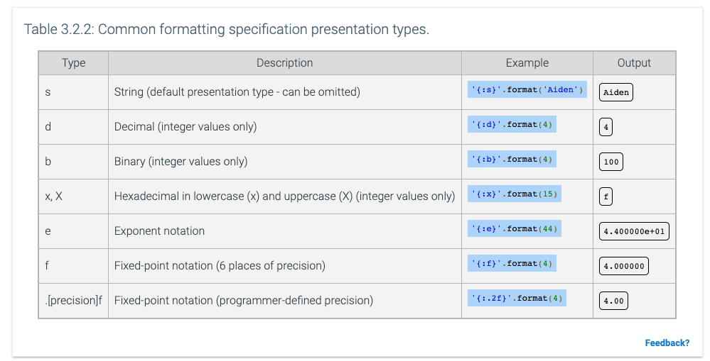
Formatting Numbers?
:d and :.nf are most common
especially for precents!
thirty_three = 1/3 * 100 print(str(thirty_three) + "%") print("{:.2f}%".format(thirty_three))
33.33333333333333%
33.33%
also, common <N
“pads” with spacing, so always length N
print("|{:<30}|".format(combined))
|H.P. Lovecraft |

Slide 7
Let’s Code!
## lets code! def get_author_name(fname, mname, lname): return "{}.{}. {}".format(fname[0], mname[0], lname) def get_percent_difficult(words, complex_words): complex = words / complex_words return "{.2f}%".format(complex)

