Slide 1
Pronounced Modulo

Slide 2
Computer Science is….
Solving real world problems using technology as our means to solve them.
Corollary: Computer Sciences seek to improve the world around them by attempting to solve some of the worlds unsolvable problems.

Slide 3
And it begins with
Reminder
val += somethinig
val = val + something
Very common and very useful
+= -=
*= **=
/= //= %=
Storing values in variables
Performing operations (Review)
= assignment operator
+ addition or concatenation
- subtraction
* multiplication
/ division
Adding
// - Floored(round down) division
** - exponential
% modulo

Slide 4
Specialized Operations
** - Exponent
5 ** 2 is commonly written as 5² in English
val = 5 ** 2 print(val) #prints 2
// - floored / rounded down division
5 // 2
val = 5 // 2 print(val) # prints 2
Why not use int(5 / 2)?
Unlike int(), keeps float type, less cost
val = 5.0 // 2 print(val) # prints 2.0

Slide 5
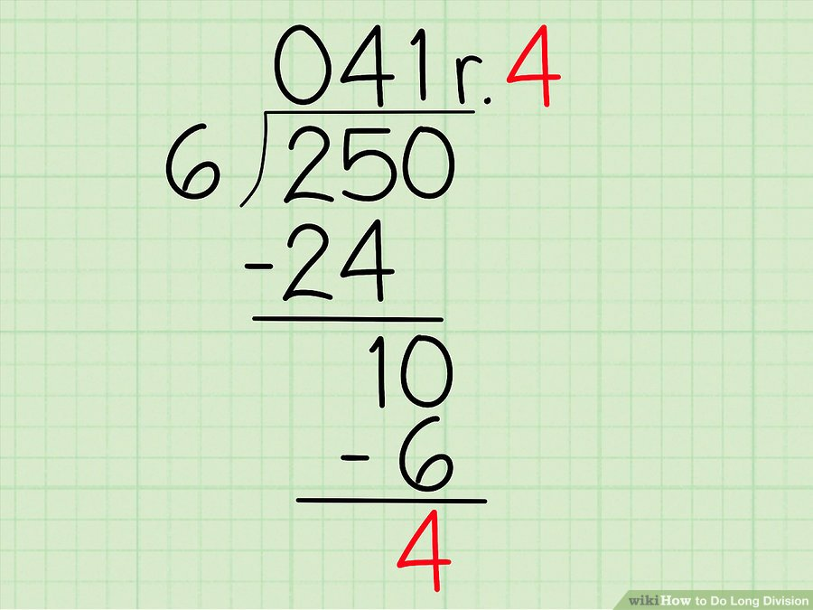
Modulo - Extremely useful operation
% - it is the remainder of a division statement?
Always return the remainder
So
x = 250 % 6
x would be 4
So combining them
whole = 250 // 6
remainder = 250 % 6
whole = 41
remainder = 4

Slide 6

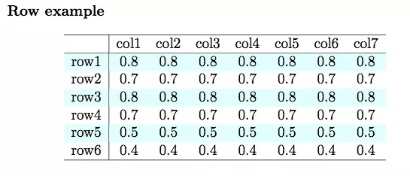
What are some cases to use it?
Setting people into groups
Forcing a range (think about rolling dice) - random() % 6; - random number between 0 and 5
Determining Even and Odd - random() % 2 - if 0, even, if 1, odd

Slide 7
Getting From Numbers to Text
ASCII and Unicode
https://unicode-table.com/en/
Maps numbers to a character
A = 65
B = 66
a = 97
This is how computers went from numbers only to text!
ord(character) – returns the number value of the character
chr(number) - returns the character value of the number
print(chr(ord('A')+2))
What is printed?

Slide 8
Let’s Code
def find_shift(number, key): return number % key def simple_cipher(message, shift): index = 0 encrypted = "" while index < len(message): encrypted += chr(ord(message[index]) + shift) index += 1 return encrypted

