Slide 1
Python to Java

Slide 2
CS 164 – In Java
Why Java?
Python is great for certain situations
Yes, used in industry
But languages are tools, use the best tool for the job
Java is…
Most common language in the world (due to android OS)
Compiled language
Build around Object Oriented Programming
Abstraction
Inheritance
Encapsulation
Polymorphism
Focuses on building objects and using objects
Java is not Javascript!

Slide 3
Basic Formatting
public class MyProgram { public static void myCoolMethod() { System.out.println("Done") } public static void myCoolMethod() {
System.out.println("Done2")
} // entry point! This is a comment! public static void main(String[] args) { myCoolMethod() myCoolMethod2() } }
Java
Every file is a “class” / object
methods
indentation
doesn’t matter
curly brackets instead
semi-colons
Python
files are “ideas” loosely coupled
def my_cool_method(): # do something cool print("Done") def my_cool_method2(): # do something cool2 print("Done2") my_cool_method() my_cool_method2()

Slide 4
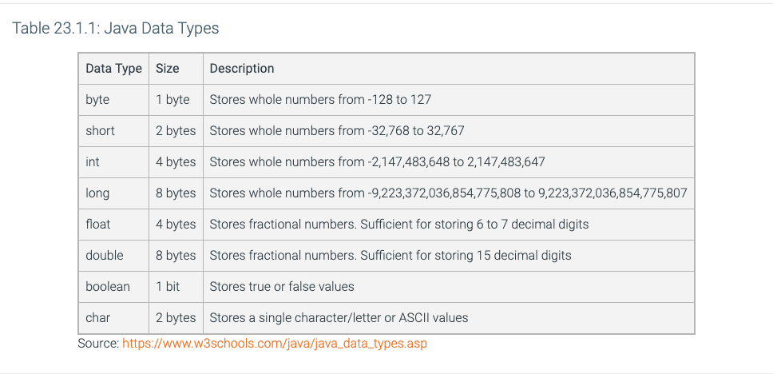
Java – type matters
Java (C, C++, C#, others)
Strongly Typed
Meaning programmer *must* tell it the type
and programmer must keep the type!
public static void typeExample() { int x = 10; x = 10.5; // ERROR! – won’t compile float y = 10.5; }
def typeExample(): x = 10 x = 10.5 # valid

Slide 5
conditionals
no elif
but can chain, else + if, creating “else if”
Yes, methods have to specify type, if returning value
Yes, the parameter has type, only int work here
public static int if_test(int value, int value2) { int rtn = 0; // going to be -1, 0, 1 if(value < value2) { rtn = -1; } else if(value > value2) { rtn = 1; } return rtn; // else assumed by 0 }

Slide 6
Loops
while loop
same, slightly different syntax
for loop
for loop in java, uses indices!
for:each loop in java is same as python for:in
do-while
python does not have equivalent, one run always
public static String for_test(String letter, int times) { String result = ""; for(int i = 0; i < times; i++) { result += letter; } return result; }

Slide 7
Java Strengths?
Makes you think about
How data is stored
Focuses on larger program design!
Expansive library, used in industry
Word to the wise:
Everyone has their favorite language (kotlin!)
Divide – Conquer - Glue
Valid for all languages!
It is a mindset
It is a way to look at the world
It is a way to solve problems
Above All…
I hope you take CS 164!

