Slide 1
Complex Conditions

Slide 2
Announcements

Slide 3
Activity: What do you envision?
Education?
Hobbies?
Hair Color?
Sexual Preferences?
What movies would they watch?
Gender?
Race?
Clothes?
Ability?
A
B
C
First plane travel was on a family private jet
Highly educated
Did not take out college loans for undergrad
Owns a plane by way of their company
Attended a predominately white school
Attended a private elementary school
Stays up-to-date on financial markets
Occasionally listens to podcasts
Drives an electric vehicle variant (PHEV)
Rarely cooks
Entrepreneur
Lived in grandparents basement, due to family not having a home
Attended school in a very poor school district (> 60% free/reduced lunch)
Only afforded the Christmas meal by raiding the coin savings jar.
Has regularly worked in manual labor
Always struggled with math and reading
Constantly worried about money
Roman-Catholic family
One of four children, and tons of cousins
Drug addict family members in and out of jail
Regularly participates in Rocky Horror Picture Show Shadow Casts for fun
Dresses up regularly
Often attends Pride events
Relationships are not considered society normal
Has had slurs yelled at them
Has had eyes operated on to see
Grew up singing and dancing in musicals Been paid in professional theater
Has won cooking competitions
Certified life coach

Slide 4

Unconscious Bias

Slide 5
Unconscious Bias
We all have it
Psychology
Sees lion eat friend, forms opinion on brain that hairy things with sharp pointing things are bad
This is brain using ‘pattern matching’ and learning association
What makes it bad?
When we unconsciously do it
When we don’t self-reflect and see we are doing it
When we let it affect our decisions
Especially towards people and products
The most common one?
Not race, gender or social-economic background
The most common is for individuals who need special services (hearing or vision impaired, etc)

Slide 6
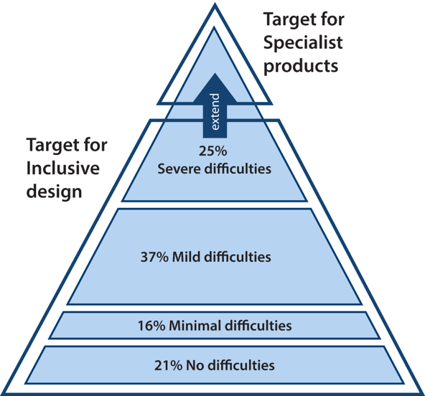
Enter Inclusive Design
Microsoft Inclusive Design Principles:
Recognize exclusion
Solve for one, extend to many
Learn from diversity
Continuum of population diversity pyramid
Notice, only 21% of people have ‘no-difficulties’
Difficulties are on a spectrum of:
Permanent
Temporary
Situational
Modern Design and Software Engineering
Must take into account the full audience
Must take into account the interconnectedness of society
Credit: University of Cambridge - Inclusive Design Toolkit
3rd Law of Tech: Technology comes in packages, big and small.
Further Thinking: All technology, big and small, needs to be designed with the client in mind.

Slide 7
Conditional Operators (review)
> - greater than
< - less than
>= - greater or equal to
<= - less or equal to
== - equal to
!= - not equal to
val = 100 < 10 * 10 print(val)
val = 100 <= 10 * 10 print(val)
False
True

Slide 8
Evaluating More Statements
And - both statements must be true
Or – either statement must be true
Not - ”flips” statement
val = int(input("Number of puppies? ")) if val < 100 and val * 2 > 50: print("That's a start") else: print("Really")
friend = input("What is better?") if friend == "Cat" or friend == "Dog": print("they are all good!") else: print("A what now?")

Slide 9
Order of Evaluation
What happens in this statement?
companion = input("Who is your favorite companion? ") companion2 = input("Who is the clever one? ") if companion == "Amy" or companion == "Martha" and companion2 == "Clara": print("They are all good!") else: print("Did you forget Clara?")
Enter: Amy, and Bob
Evaluates as True
and is evaluated first, so just Amy is all that is needed
Is this what we want?
How do we fix it?

Slide 10
Practice 1
Write a line of code that returns true if one is “Rock” and two is “Scissors”
def check_single(one, two): # todo!

Slide 11
Parens Matter!
Use them.
Make code cleaner, easier to read and fixes a lot of order issues!
companion = input("Who is your favorite companion? ") companion2 = input("Who is the clever one? ") if (companion == "Amy" or companion == "Martha") and companion2 == "Clara": print("They are all good!") else: print("Did you forget Clara?")

Slide 12
Practice 2
Given the code, complete the game statements
Hint add more if statements!
def check_single(one, two): if one == "Rock" and two == "Scissors" : return True

Slide 13
Conditional Expressions
Also called - Ternary statements
not required – but commonly used
always arguments on what is better
Do what you find easiest to read!
format
expr_when_true if condition else expr_when_false
doc = 13 companion = "Clara" if doc == 12 else "Yasmin" print(companion) # prints Yasmin

Slide 14
Practice 3
def rock_paper_scissors(): winner = False while not winner:
player1 = input("Rock, Paper, or Scissors? ")
player2 = input("Rock, Paper, or Scissors? ")
p1_win = check_single(player1, player2)
p2_win = check_single(player2, player1)
## todo
def check_single(one, two): if one == "Rock" and two == "Scissors" : return True elif one == "Scissors" and two == "Paper": return True elif one == "Paper" and two == "Rock": return True return False
write statements that print:
Player1 Won or Player2 Won! based on the results
if player1 or player2 wins, end the game (notice while condition)
else it keeps repeating

Slide 15
Let’s Code
def rock_paper_scissors(): winner = 0 while not winner:
player1 = input("Rock, Paper, or Scissors? ")
player2 = input("Rock, Paper, or Scissors? ")
winner = check_single(player1, player2)
winner = check_single(player2, player1)
def check_single(one, two): if one == "Rock" and two == "Scissors" : return True elif one == "Scissors" and two == "Paper": return True elif one == "Paper" and two == "Rock": return True return False

