Slide 1
Design Thinking and Lists and Loops

Slide 2
Design Thinking & Software Engineering
Software Engineering focuses on designing system to solve the problems
Like architecture for but for software!
Design is at the heart of computer science
Creative Design
Dealing with large systems
Problem solving is about designing solutions to those problems
Design Thinking
User Centered Design
Human-Centered Design
Been around for ~40 years in Computer Science
John Arnold 1959
IDEO - 1990 coined term

Slide 3
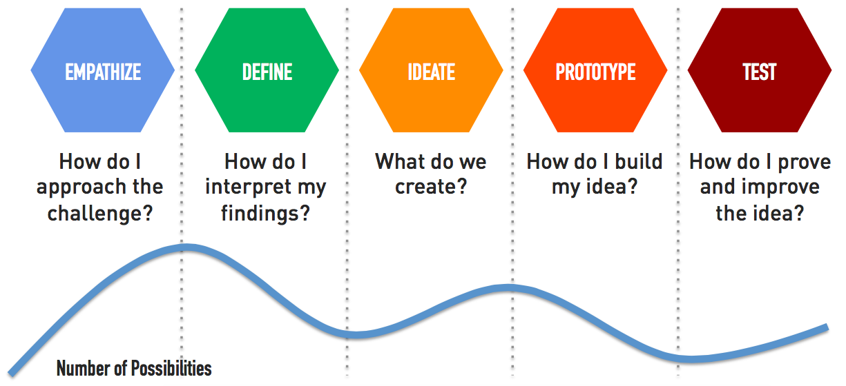
What is design thinking?
Empathize - Find People
Define - Look for patterns
Ideate - Design principles
Prototype - Make Tangible
Test - Iterate Relentlessly
Further Reading: What is design thinking, Design Thinking

Slide 4
How to Practice
Take 4 minutes to define 6 challenges that are interesting to you.
3 Dreams/Things you wish existed and 3 gripes/things that could be better (Challenges!)
Practice this on a regular basis
Alice laughed. “There’s no use trying,” she said: “one can’t believe impossible things.”
I daresay you haven’t had much practice,” said the Queen. “When I was your age, I always did it for half-an-hour a day. Why, sometimes I’ve believed as many as six impossible things before breakfast.”
Alice in Wonderland
Credit for slide idea: Elisa Cundiff

Slide 5
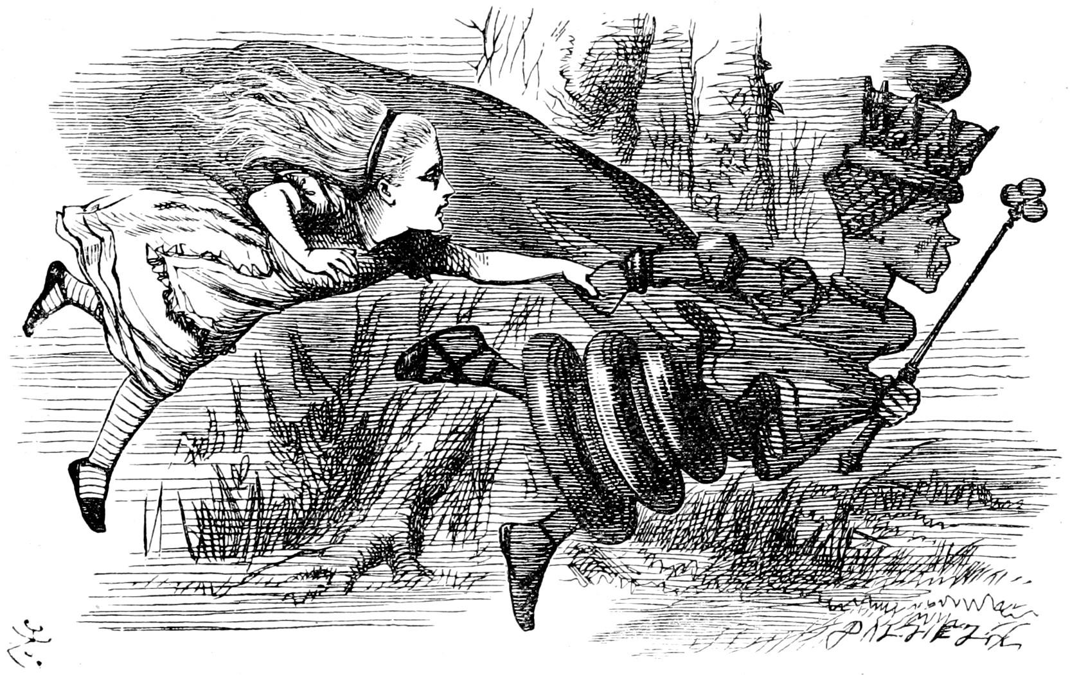
Next Steps
Emphasize
Talk with others about your ideas
Find diverse audiences to talk to
Talking with your friends and family only introduces unconscious bias
Define
Define your problem before you write code
Ideate
Design your solution before you write code
This can be a rough idea
Map out your code on paper
Prototype
Start writing!
Reiterate
It is alright to change it / make it incremental!

Slide 6
Lists and Iteration

Slide 7
Lists
Fundamental to Python
List of items, any item.
mutable (can be modified)
machete = [4, 5, 2, 3, 6, 7, 8, 9] machete_names = ["A New Hope", "The Empire Strikes Back", "Attack of the Clones", "Revenge of the Sith", "Return of the Jedi", "The Force Awakens", "The Last Jedi", "The Rise of Skywalker"]
print("Star Wars {episode}: {title}".format(title=machete_names[2], episode=machete[2]))
Prints - Star Wars 2: Attack of the Clones
Notice: Indices like Strings

Slide 8
Useful List Functions
glacier_size = [0.53, 0.34, 0.59,
0.2, 0.28, 0.13,
0.25, 5.5, 3.25,
0.84, 0.5, 0.75] missing_glaciers = [0.19, 0.04, 0.08,
0.29, 0.22, 0.07, 0.12]
print(min(glacier_size)) # 0.13 print(max(glacier_size)) # 5.5 print(glacier_size.index(5.5)) #7
glacier_size[7] = "Five.Five" print(glacier_size[7]) # Five.Five
combined = glacier_size[7:9] + missing_glaciers[0:3] print(combined) # ["Five.Five", 3.25, 0.19, 0.04, 0.08]
len(list) - length of list
min(list)/max(list) - smallest or largest
sum – adds list together
+ - concatenates lists together
list.index(val) - returns index of a value

Slide 9
Tuples
Pro Skill: Named Tuple
Tuple but allows direct name references
Like lists, but…
immutable (can’t be changed)
common way to “fix” data
Named Tuple
Holds data in a named form
coords = namedtuple("Coordinates", ["Latitude", "Longitude"]) foco = coords("40.5853° N", "105.0844° W") print(foco.Latitude) # 40.5853° N
fixed = (1, 2, 3) print(fixed) print(fixed[1]) #2 fixed[1] = 10 #ERROR!

Slide 10
Printing Elements In Lists?
the while loop way
range(a, b)
Creates a number list from a to b
often used with for loops!
index = 0 while index < len(glaciers): print(glaciers[index], end = ' ') index += 1
introducing for loop
for size in glaciers: print(size, end=' ')
grabs each element
in order
ends when list ends
the above two loops – the same thing!

Slide 11
Let’s Code
def simple_cipher(msg, shift): encrypt = '' for char in msg: encrypt += chr(ord(char)+shift) return encrypt
def secure_message(history, key): encrypted = [] for msg in history: encrypted += simple_cipher(msg, key) return encrypted def decode_message(history, key): decoded = [] for msg in history: decoded += simple_cipher(msg, -key) return decoded

