Slide 1
Design Thinking Continued and A Strings Life

Slide 2
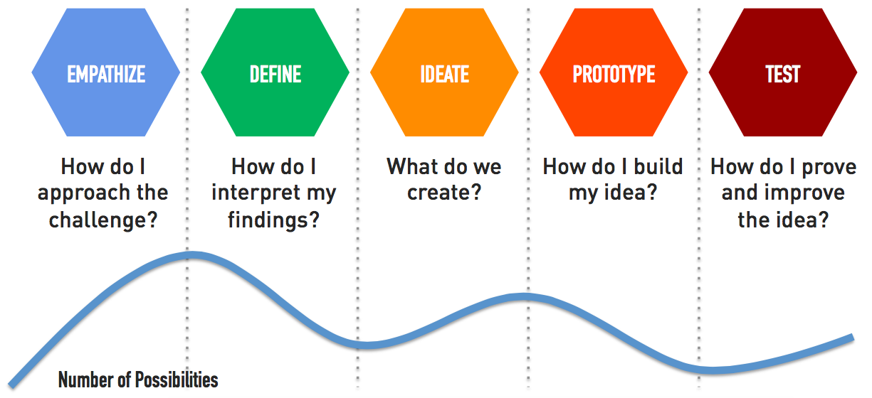
Defining?
Defining problems is hard!
The more iteration and empathize you do - the better!
Reframe as Questions
Every Method, Every program, Every loop, You Write
What is your quest?
What do you know?
What do you need?
What can you figure out?

Slide 3
Design Thinking
Applied in multiple industries!
Can even be a way to look at life

Slide 4
Slides in progress

Slide 5
Recap - Strings
Built into Python
Essentially – specialized list of characters
ordered
immutable
List functions (len)
work on Strings
Concatenation is common (+)
str() - turns numbers to String “types”
barbarian = "conan the barbarian!" first = barbarian[0:5] print(first) # conan no_last = barbarian[:-1] print(no_last) # conan the barbarian barb = barbarian[-10:] print(barb) # barbarian!
Remember! – Write the indices under the String
Conan
0 1 2 3 4

Slide 6
String Methods
Conditional Operators and Strings
== - both are equal – including case
> - letter by letter comparison
string in string – in operator
works with lists/tuples
replace(old, new)
replace(old, new, count)
find(x)
find(x, start)
find(x, start, end)
rfind(x)
count(x)
isalnum() - no specials or puncuation
lower() – change all to lowercase
upper() – change all to uppercase
strip() – remove training and leading spaces

Slide 7
Find – and Patterns
Programmers look for patterns
Strings often have patterns
Exploit the patterns!
sample="Field One:pH=7.2,P2O5=23,K20=5,Ca=40,S=30,Lat=40.5853°N,Lon=105.0844°W;Field Two:K20=6,P2O5=23,pH=7.1,Ca=41,S=30,Lat=40.5852°N,Lon=106.0844°W"
def get_calcium(data):
ca_start = data.find("Ca")
ca_start_num = data.find("=", ca_start) + 1
ca_end = data.find(",", ca_start)
return data[ca_start_num:ca_end]
print(get_calcium(sample, 0)) # 40 print(get_calcium(sample, sample.find(";"))) # 21
def get_calcium(data, start): ca_start = data.find("Ca", start) ca_start_num = data.find("=", ca_start) + 1 ca_end = data.find(",", ca_start) return data[ca_start_num:ca_end]

Slide 8
Split and Join
split – converts a string into list of strings
split on the string passed into it!
csv = "skeleton,13,12,20".split(",") # ['skeleton', '13', '12', '20’]
join – builds a single string from a list of items
line = ";".join(csv) # skeleton;13;12;20

Slide 9
Let’s Code
def get_element(analysis, element): start = analysis.find("=", analysis.find(element)) + 1 end = analysis.find(",", start) return analysis[start:end]
def build_card(samples, elements): analysis_card = "+" + "=" * 24 + "+\n" for field in samples.split(";"): analysis_card += "|" + "-" * 24 + "|\n" analysis_card += "| {:<23}|\n".format(field[0:field.find(":")]) analysis_card += "|" + "-" * 24 + "|\n" for element in elements: if element.lower() in field.lower(): analysis_card += "| {:<10}{:>10} |\n".format(element, get_element(field.lower(), element.lower())) analysis_card += "+" + "=" * 24 + "+\n" return analysis_card def run_analysis(): response = input("Run report (full or individual elements by comma)? ").strip() elements = ["Ca", "S", "K20", "P2O5", "Mg"] if response.lower() == "full" else response.split(",") print(build_card(sample, elements))

