Slide 1
How did Programming Start?

Slide 2
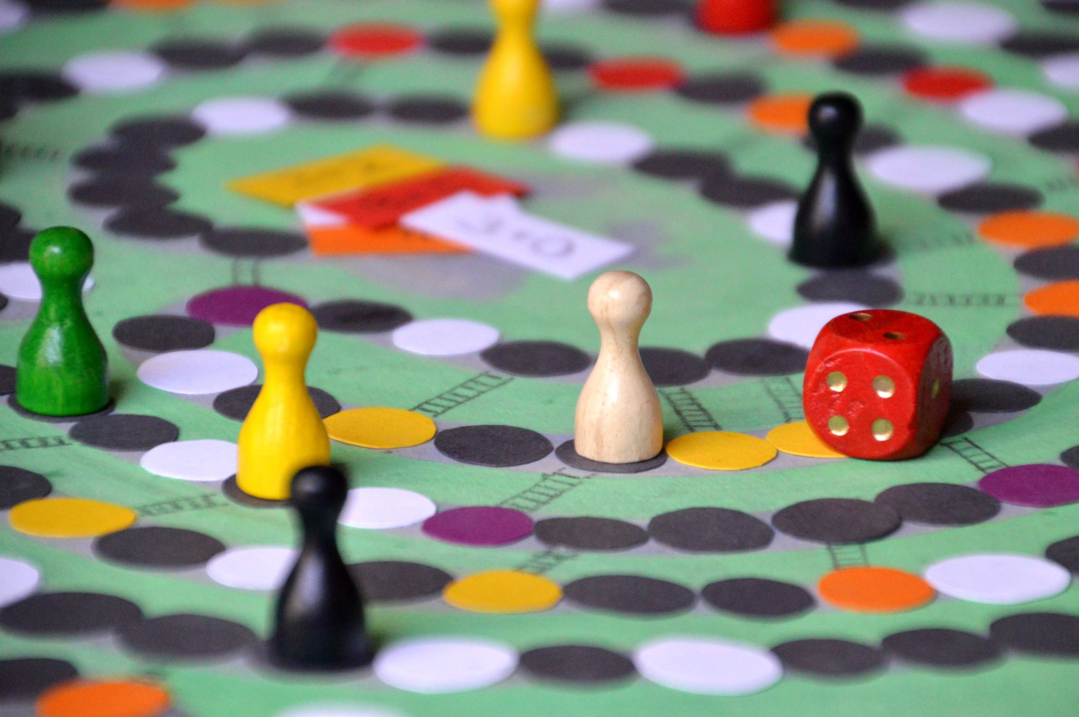
Weekly Announcements!
Welcome Question: Favorite board/card Game or game in general? Remember: Introduce yourself, chat, and I will see if you can recall everyone as the table!
TODO Reminders:
Setup MS Teams
Reading 1 (Zybooks)
Syllabus Quiz
Knowledge Check
Will have these up every week!
Start of every class as you come to class.
Make sure to start the welcome question as soon as you sit down (meant to be done before class starts)
Monday end of day - be through Reading 2
ACM / ACM-W - Welcome Back Boardgames!
Pinon Hall 131 (the study area)
Thursday (26th) 5:30 PM
A super popular event, great way to meet others in the major, and have fun!

Slide 3
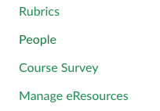
Zybooks Reminders
Make sure it syncs back to canvas
If you click through the canvas link – it ‘auto syncs’ (think autosaves)
Alright if the score is low, it will overwrite the score as you do more
But – Always open assignment in canvas and “click through” before you start working
Can easily ‘time out’
Not syncing?
Check emails – Canvas reports First.Last@colostate.edu
you may have used ename@colostate.edu
Especially if you didn’t follow instructions to wait until the first reading to sign up
Fix – add your First.Last – email to your zybooks profile.
More complicated issue if you created two accounts, only zybooks support can merge them
Access Code? Manage eResources
Not there? Contact Bookstore

Slide 4
Industries For Computing?
5 Min
Break into groups
Brainstorm industries in which computers are used in
How many require specialized applications?
Saying all is not a valid answer (for this)! – you must have an actual use before listing the industry
Go to a white board, and write down all the options you came up with!
Circle the one you think was the “first industry”
Deeper discussion:
Why are computers involved in so many?
What do they accomplish that humans can’t/don’t?

Slide 5
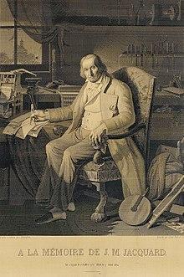
First Computer?
The industry - Weaving!
Jacquard loom / machine
Invented by Joseph Marie Jacquard in 1804
Cards set the patterns, colors, etc
Very specific use - not general purpose
“This portrait of Jacquard was woven in silk on a Jacquard loom and required 24,000 punched cards to create (1839). “ - ref: https://en.wikipedia.org/wiki/Jacquard_loom

Slide 6
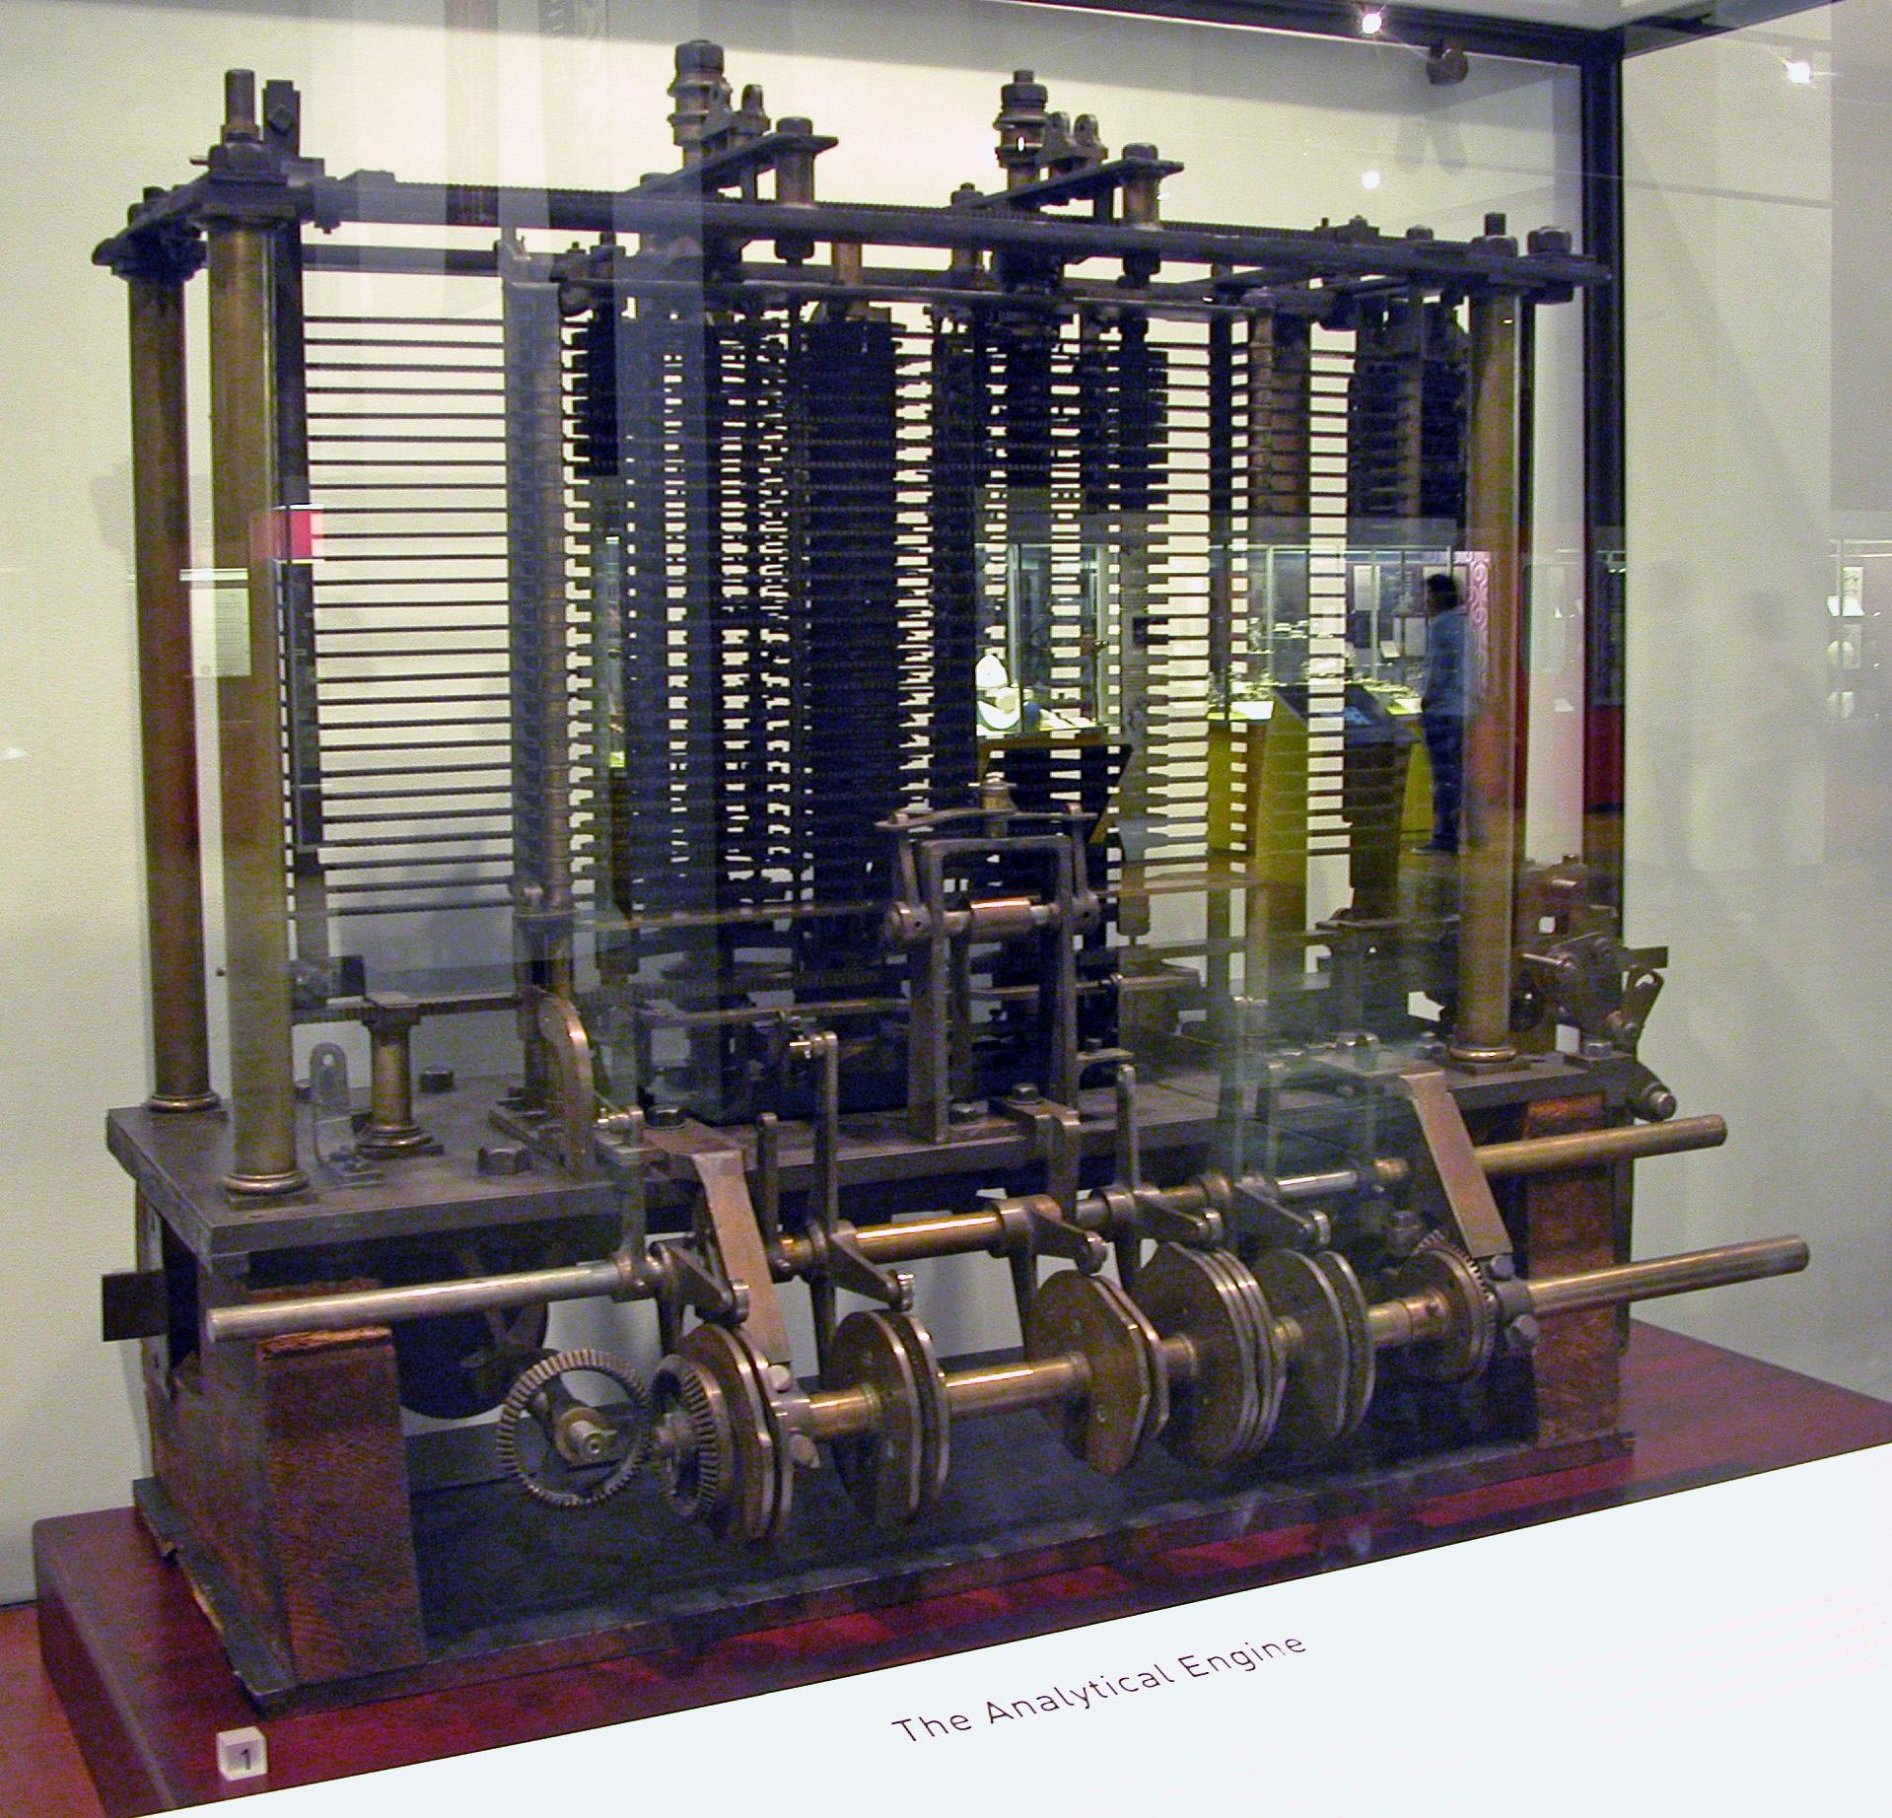
Analytical Engine
Charles Babbage
Polymath
“Father of the computer”
Mainly Theory
Purpose?
Algorithm Development and solving
1837
Bruno Barral (ByB) [CC BY-SA 2.5 (https://creativecommons.org/licenses/by-sa/2.5)], from Wikimedia Commons

Slide 7
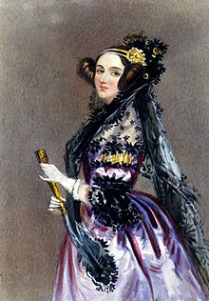
Enchantress of Numbers
She walks in beauty, like the night
Of cloudless climes and starry skies;
And all that’s best of dark and bright
Meet in her aspect and her eyes;
Thus mellowed to that tender light
Which heaven to gaudy day denies.
Excerpt from “She Walks in Beauty” by Lord Byron

Slide 8
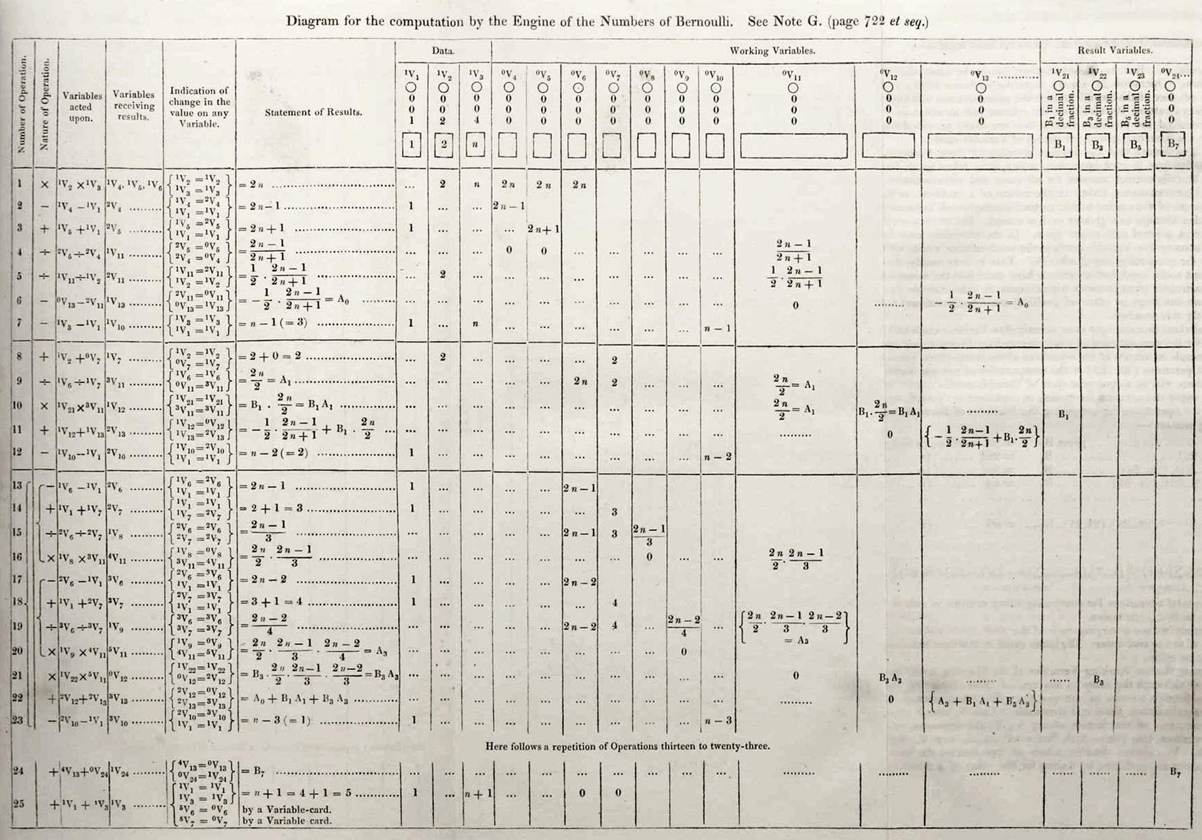
Ada Lovelace
Grew up in a rich but a single mother household
Father was the famous poet Lord Byron
Was known as a rebellious child and adult (non-conformist)
Mother insisted on her becoming a mathematician
She was unruly:
part artist
part scientist
part philosopher
Wrote the first “Computer Program”
Theorized computers could be ‘general purpose’ machines to solve complex problems.
By Ada Lovelace (http://www.sophiararebooks.com/pictures/3544a.jpg) [Public domain], via Wikimedia Commons
Additional Reading: Victorian computing visionary

Slide 9
Python, Your Intro Language
Quick Reminder: You should do reading before lecture.
Content assumes you have.

Slide 10
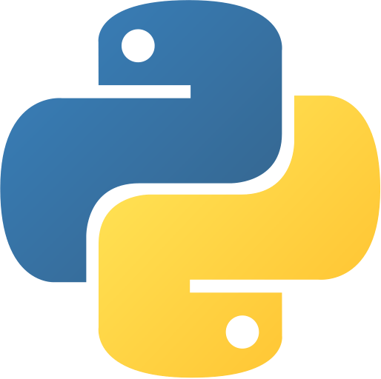
Python
A Modern Programming Language
Focuses on ‘scripting’
Interpreted
Takes another program to run the code
Common Uses
Research
Data science
Machine learning and Artificial Intelligence
Web development (backend)
Full applications and games
Becoming more common

Slide 11
Programs
Are a set of instructions
Like Cooking (common/historical analogy)
Like following a how-to guide
A computer only does what you tell it
It can’t guess
It can’t assume
It follows the instructions
for better or worse
Line by line, unless we say otherwise

Slide 12
Python Basics
Variables
Allow you to store information
puppyCounter = 100
puppyName = “Cerberus”
puppyName = ‘Cerberus’ #also allowed, but we will often use double quotes for Strings
Anything after the # sign is a comment, so not an instruction!
Output / Printing to the screen
print(“Ada Lovelace was the first programmer”)
print() signifies a function – that does the work for you!
code reusability
Input – From the console / client
input(“Who was the first programmer”)
But… We need to store the value!
answer = input(“Who was the first programmer”)

Slide 13
Let’s Look At Some Code!
As a team, write a two line program:
Prompts the client with the question “Who was the first programmer?”
Prints in response “(their input) was the first programmer.”
You do not have to do this in a computer!
Just work on paper or a white board with your team.
answer = input(“Who was the first programmer?”)
print(answer + “ was the first programmer.”)

Slide 14
Thought Question
What great world event pushed computers as an essential tool towards victory?

