Slide 1
Ethical Design of Software
Colorado State University
Computer Science Department
Slides Originally Created by Albert Lionelle (Albert.Lionelle@colostate.edu)

Slide 2
Announcements
Opening Question
Are there any habits you have developed over the past 4 weeks that you want to improve / change going into the rest of the semester?
How are you going to hold yourself accountable to building better habits?
Labs – back to two this week
Takes more time to look through them!
Try to plan them out – before – you write them!
Tips for being successful in this course
Do the readings (just participation) before *every* lecture
Look at the labs / even try it, the night before lab!
Helps to know what questions to ask
Plan out what you want to do before you write it
3-4 nights a week – Knowledge Check (go back!)
Practiced recall, spaced over time is the best way to study, no matter the field!
Provide example code while learning how to work on it
Spend no more than 20 minutes on this – ask for help in general if stuck! (post the knowledge check and ask)
ACM Board Game Night
When: Wednesday, September 22 at 6:00pm
Where: Computer Science Building room 130
RSVP: https://forms.gle/UejirB4uDCJoRhGK9
ACM-W – No meeting, officer meeting only (but others welcome – so ask if interested! )

Slide 3
The Ethical Dilemma
Programmers have
Phenomenal ability to influence society
Especially in a content delivery society
Influence groups they never expected
World wide audience
This power often is unintentional
First law of technology: Technology is neither good nor bad; nor is it neutral.
Ethical Question - Can Technology fully meet a group’s needs or preferences, if members who identify with that group are not part of the creation of that technology?
Airbags are a famous example of failure

Slide 4
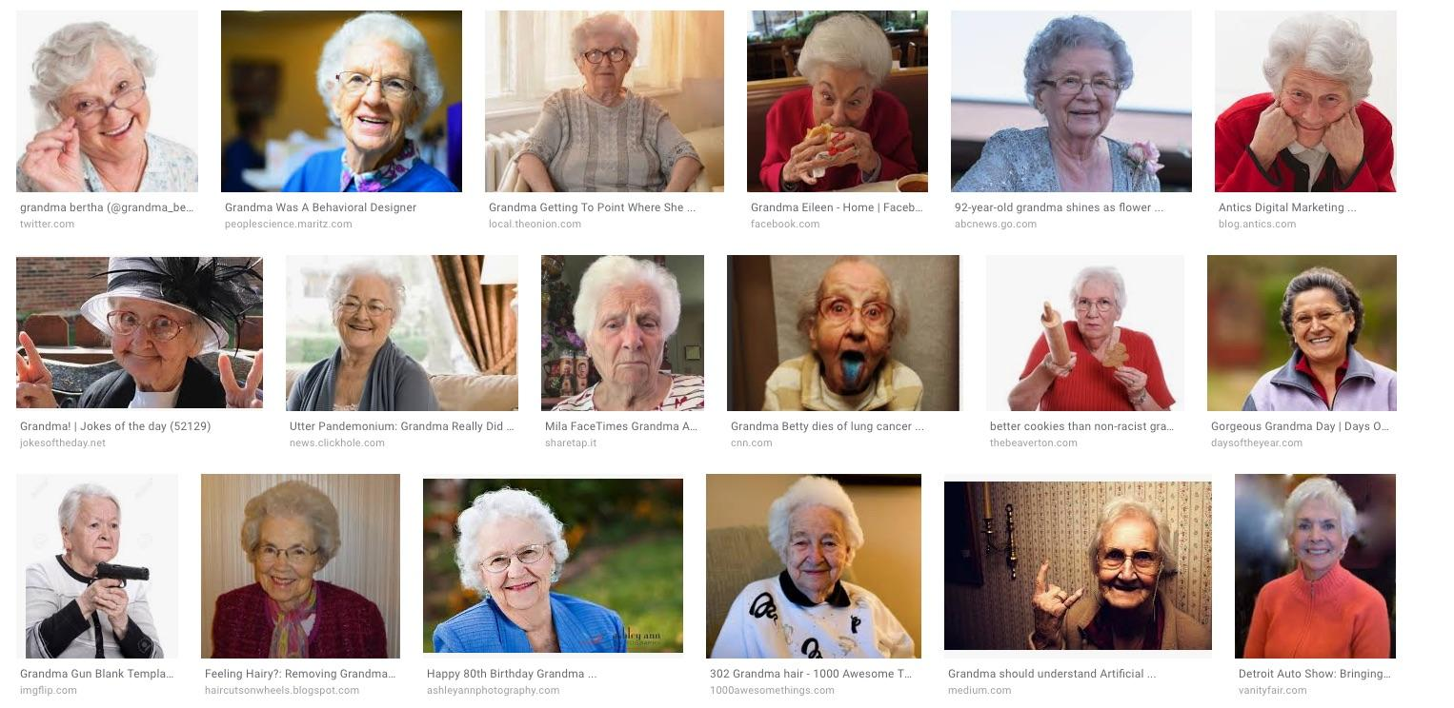
Not all failure is catastrophic
Searching “grandma” or “grandmother” in google image search
This is known as Training Bias
In this case, society labeled data!
Read more about A.I. Bias from Microsoft
Group discuss - what are cases that you see bias in modern applications?

Slide 5
Bias in A.I. Real World Examples
Dataset Bias Machine vision technologies—such as web cameras to track user movements—that only work well for small subsets of users based on race (predominantly white), because the initial training data excluded other races and skin tones.
Associations Bias Language translation tools that make gender assumptions (e.g. pilots are male and flight attendants are female).
Automation Bias Beautification photo filters reinforce a European notion of beauty on facial images, like lightening skin tone.
Interaction Bias Humans deliberately input racist or sexist language into a chatbot to train it to say offensive things.
Confirmation Bias Shopping sites that show recommendations for things the customer has already bought. Updated example: Newsfeeds (facebook, google news) only recommending articles like the ones you share.
All examples from: In Pursuit of Inclusive AI, Joyce Chou, Roger Ibars, Oscar Murillo, Microsoft Corporation

Slide 6
What Is Next?
What are some things we can do to prevent bias?
What are some paths the industry is following?

Slide 7
Computer Science is….
Solving real world problems using technology as our means to solve them.
Corollary: Computer Sciences seek to improve the world around them by attempting to solve some of the worlds unsolvable problems.

Slide 8
And it begins with
Reminder
val += somethinig
val = val + something
Very common and very useful
+= -=
*= **=
/= //= %=
Storing values in variables
Performing operations (Review)
= assignment operator
+ addition or concatenation
- subtraction
* multiplication
/ division
Adding
// - Floored(round down) division
** - exponential
% modulo

Slide 9
Specialized Operations
** - Exponent
5 ** 2 is commonly written as 5² in English
val = 5 ** 2 print(val) #prints 25
// - floored / rounded down division
5 // 2
val = 5 // 2 print(val) # prints 2.0
Why not use int(5 / 2)?
Floor and truncation are slightly different
val = -5.0 // 2 print(val) # prints -3.0

Slide 10
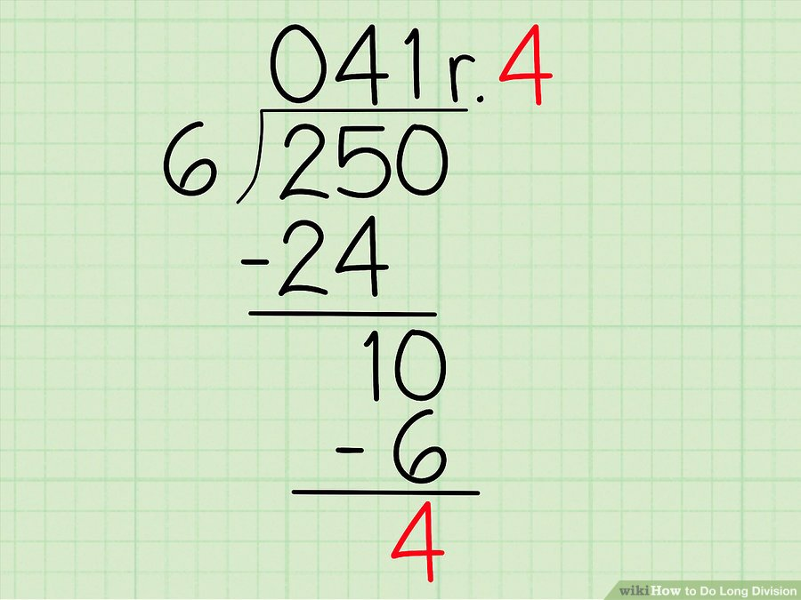
Modulo - Extremely useful operation
% - it is the remainder of a division statement?
Always return the remainder
So
x = 250 % 6
x would be 4
So combining them
whole = 250 // 6
remainder = 250 % 6
whole = 41
remainder = 4

Slide 11
Practice One
Finish the function below
Reminder – dividend is the number you are dividing against, the divisor is what you divide it by
250 / 6 - 250 is dividend, 6 is the divisor.
def division(dividend, divisor): ## student code here return "Answer: {} with remainder {}".format(whole, remainder)

Slide 12

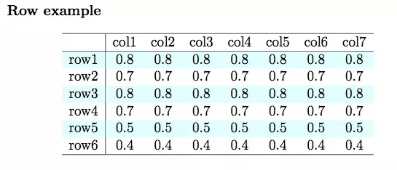
What are some cases to use it?
Setting people into groups
Forcing a range (think about rolling dice) - random() % 6; - random number between 0 and 5
Determining Even and Odd - random() % 2 - if 0, even, if 1, odd

Slide 13
Getting From Numbers to Text
ASCII and Unicode
https://unicode-table.com/en/
Maps numbers to a character
A = 65
B = 66
a = 97
This is how computers went from numbers only to text!
ord(character) – returns the number value of the character
chr(number) - returns the character value of the number
print(chr(ord('A')+2))
What is printed?

Slide 14
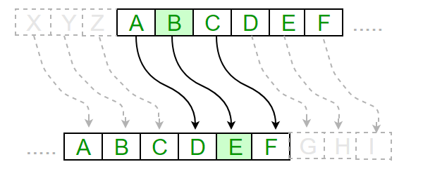
Practice Loops and Module
def shift(char, key): return ## todo def simple_cipher(message, key): index = 0 encrypted = "" ## todo
return encrypted
shift
takes in a character, and shifts it across the alphabet based on key
encrypted
takes a string and key, and returns the encrypted string based on the key shift
uses loops
Work on shift first (hint, last slide)
print(chr(ord('A')+2))

Slide 15
Let’s Code
def find_shift(number, key): return number % key def simple_cipher(message, shift): index = 0 encrypted = "" while index < len(message): encrypted += chr(ord(message[index]) + shift) index += 1 return encrypted

