Slide 1
How did Programming Start?

Slide 2
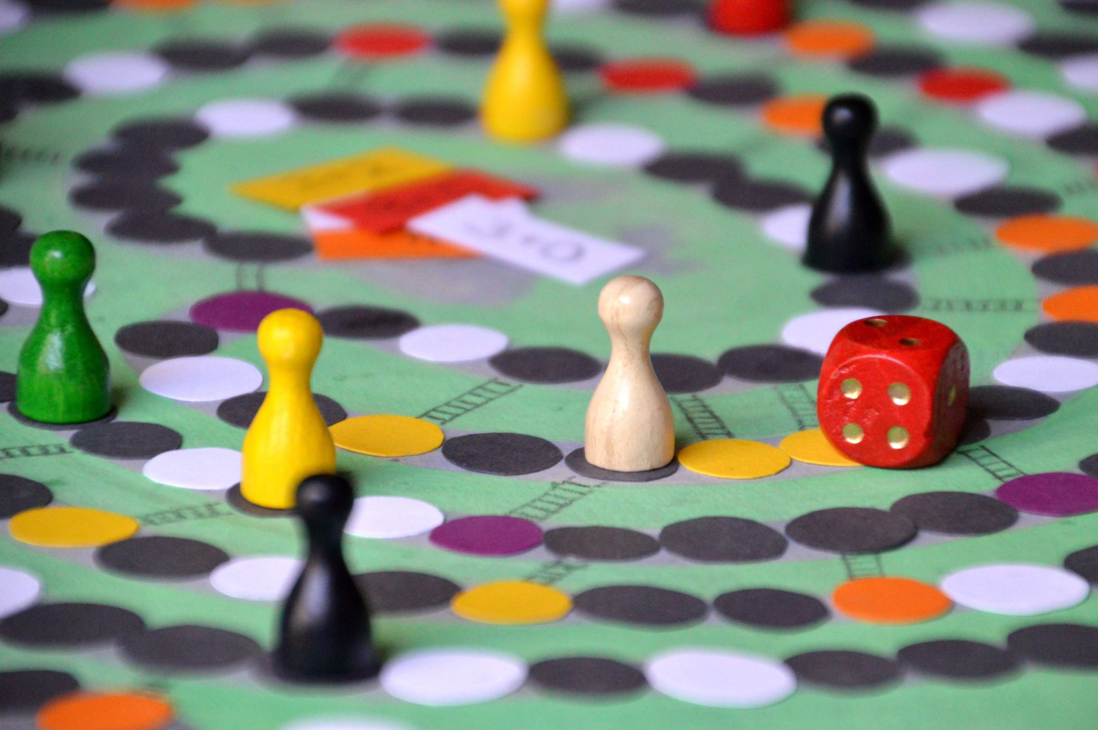
Weekly Announcements!
Welcome Question: Favorite board/card Game or game in general? Remember: Introduce yourself, chat, and I will see if you can recall everyone as the table!
TODO Reminders:
Reading 0 & 1 (Zybooks)
Knowledge Check
Lab 00 this week!
Will have these up every week!
Start of every class as you come to class.
Make sure to start the welcome question as soon as you sit down (meant to be done before class starts)
Help Sessions: Start This Week
Reminder – readings are due before lecture
You don’t have to do all of it - challenge problems can be challenging…
You can return to them.

Slide 3

Zybooks Reminders
Make sure it syncs back to canvas
If you click through the canvas link – it ‘auto syncs’ (think autosaves)
Alright if the score is low, it will overwrite the score as you do more
But – Always open assignment in canvas and “click through” before you start working
Can easily ‘time out’
Not syncing?
Check emails – Canvas reports First.Last@colostate.edu
you may have used ename@colostate.edu
Especially if you didn’t follow instructions to wait until the first reading to sign up
Fix – add your First.Last – email to your zybooks profile.
More complicated issue if you created two accounts, only zybooks support can merge them
Access Code? Manage eResources
Not there? Contact Bookstore

Slide 4
Six Laws of Technology
We will come back to these all semester

Slide 5
Technology is Human
A lady came up to the great violinist Fritz Kreisler after a concert and gushed, “Maestro, your violin makes such beautiful music.” Kreisler held his violin up to his ear and said, “I don’t hear any music coming out of it.”
You see, the instrument, the hardware, the violin itself, was of no use without the human element. But then again, without the instrument, Kreisler would not have been able to make music. - Dr. Melvin Kranzberg

Slide 6
Six “Laws of Technology”
by Melvin Kranzberg
Technology is neither good nor bad; nor is it neutral.
Tech companies should try to anticipate how their tech can be used
Should they even try? Do they have a social responsibility?
Invention is the mother of necessity.
Tech adds to tech.
Technology comes in packages, big and small.
From the nuclear bomb to the smart watch
Although technology might be a prime element in many public issues, nontechnical factors take precedence in technology-policy decisions.
Corollary - people who do not know about tech, make the laws about tech - unless we intervene
All history is relevant, but the history of technology is the most relevant.
As tech leads to tech
Technology is a very human activity.
Additional Reading: 6 Laws of Tech, 6 Laws of Tech Story and Metaphor

Slide 7
Which Law Does This Describe?
TELUS: In 2005, Canada’s second-largest telecommunications company, Telus, began blocking access to a server that hosted a website supporting a labor strike against the company.
A - Technology is neither good nor bad; nor is it neutral
B - Invention is the mother of necessity.
C - Technology comes in packages, big and small.
D - Although technology might be a prime element in many public issues, nontechnical factors take precedence in technology-policy decisions.
E - All history is relevant, but the history of technology is the most relevant.

Slide 8
But how did this all start?

Slide 9
Industries For Computing?
5 Min
Break into groups
Brainstorm industries in which computers are used in
How many require specialized applications?
Saying all is not a valid answer (for this)! – you must have an actual use before listing the industry
iClicker Question
Do you have one you agree on that is the first industry? Type it out!
Deeper discussion:
Why are computers involved in so many?
What do they accomplish that humans can’t/don’t?

Slide 10
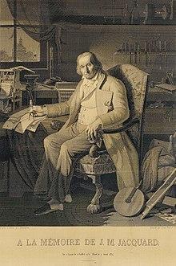
First Computer?
The industry - Weaving!
Jacquard loom / machine
Invented by Joseph Marie Jacquard in 1804
Cards set the patterns, colors, etc
Very specific use - not general purpose
“This portrait of Jacquard was woven in silk on a Jacquard loom and required 24,000 punched cards to create (1839). “ - ref: https://en.wikipedia.org/wiki/Jacquard_loom

Slide 11
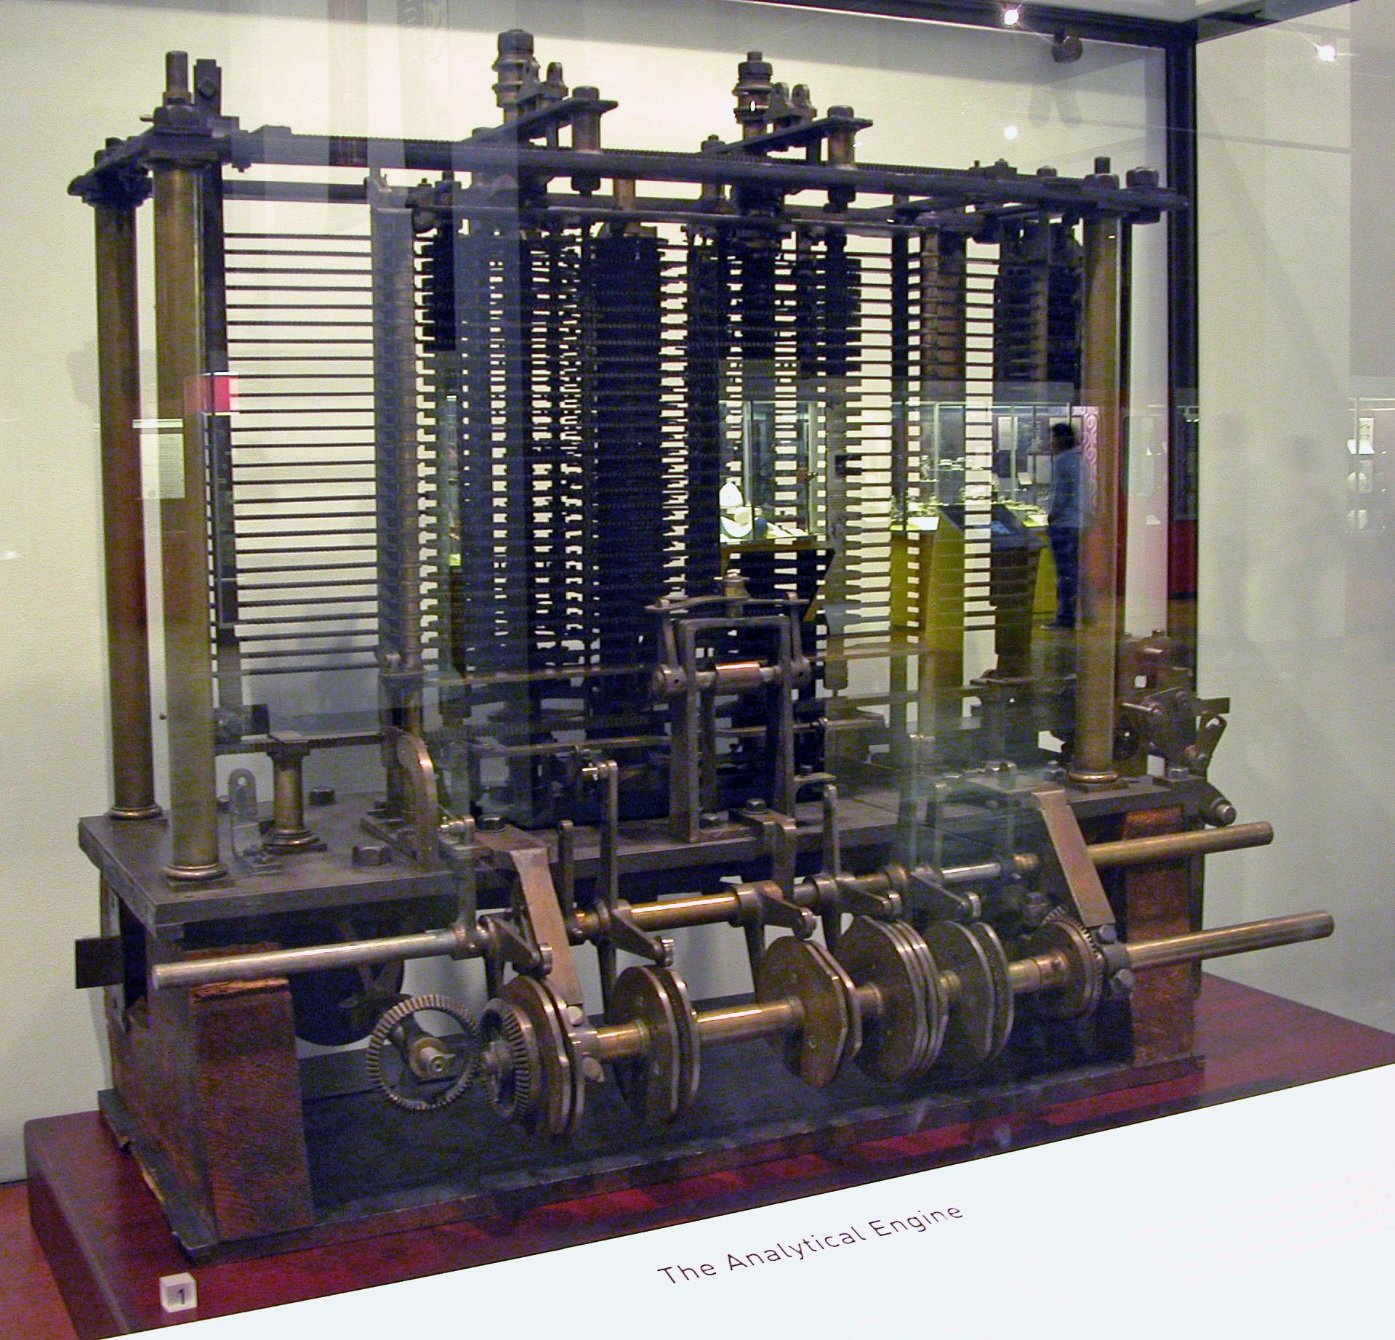
Analytical Engine
Charles Babbage
Polymath
“Father of the computer”
Mainly Theory
Purpose?
Algorithm Development and solving
1837
Bruno Barral (ByB) [CC BY-SA 2.5 (https://creativecommons.org/licenses/by-sa/2.5)], from Wikimedia Commons

Slide 12
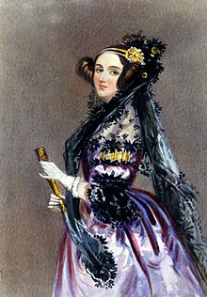
Enchantress of Numbers
She walks in beauty, like the night
Of cloudless climes and starry skies;
And all that’s best of dark and bright
Meet in her aspect and her eyes;
Thus mellowed to that tender light
Which heaven to gaudy day denies.
Excerpt from “She Walks in Beauty” by Lord Byron

Slide 13
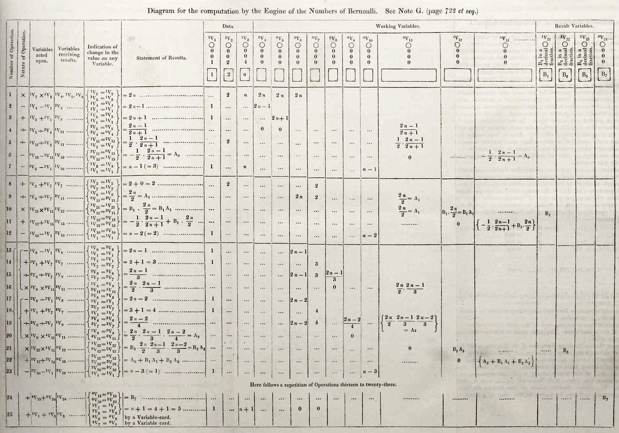
Ada Lovelace
Grew up in a rich but a single mother household
Father was the famous poet Lord Byron
Was known as a rebellious child and adult (non-conformist)
Mother insisted on her becoming a mathematician
She was unruly:
part artist
part scientist
part philosopher
Wrote the first “Computer Program”
Theorized computers could be general purpose machines to solve complex problems.
By Ada Lovelace (http://www.sophiararebooks.com/pictures/3544a.jpg) [Public domain], via Wikimedia Commons
Additional Reading: Victorian computing visionary

Slide 14
Computing Needs: World War II

Slide 15
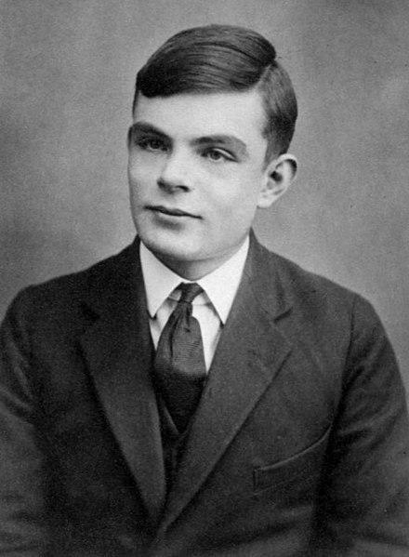
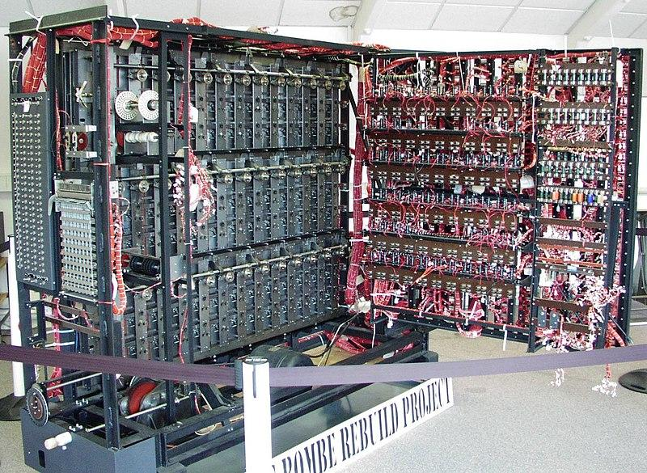

Alan Turing
Mathematician and Philosopher
Enigma Code Breaker - Bombe Machine
Series of interlocking wheels
Looked at all combinations
Turing Machine
Analog theoretical computer
We have ‘close approximations’
Turing Test
Imitation Game
Thinking is hard to define
Later life
Chemical Castration (DES)
Died age 41 from Cyanide poisoning
Queen pardoned him of ‘crimes’ - 2013
See page for author [Public domain], via Wikimedia Commons
Replica of Bombe Machine
Photographer: Tom Yates. Source

Slide 16
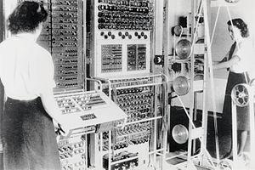
Who Programmed the Bombe?
Jean Valentine
Along with many others
Colossus machines
Call “Wrens”
Worked in parallel with the bombe
Woman programmed them
Considered “unskilled labor”
To the point of morning revelry
Mostly lost to history due to security restrictions
Many were not allowed to continue in computing.
Cryptographers were men, programmers were women
See page for author [Public domain], via Wikimedia Commons

Slide 17
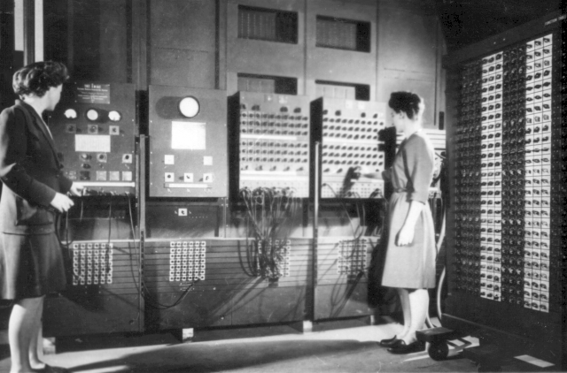
World War II - USA
Electronic Numerical Integrator and Computer (ENIAC)
The ‘silent’ programmers
Jean Jennings (Bartik)
Betty Snyder (Holberton)
Frances Bilas (Spence)
Kay McNulty (Mauchly Antonelli)
Marlyn Wescoff (Meltzer)
Ruth Lichterman (Teitelbaum).
Was considered “unskilled” labor
degrees in mathematics.
After the war?
They continued on after, had more, but limited freedom.
Defined the field
Changed the world
Programmers Betty Jean Jennings (left) and Fran Bilas (right) operate ENIAC's main control panel
By United States Army (Image from http://ftp.arl.army.mil/~mike/comphist/) [Public domain], via Wikimedia Commons

Slide 18
Python, Your Intro Language
We will start in detail on Wednesday!
Quick Reminder: You should do reading before lecture.
Content assumes you have.

