Slide 1
Design Thinking Continued and A Strings Life

Slide 2
Announcements
Opening Question:
How is your paper coming along?
Reminder – readings are due before lecture
You don’t have to do all of it - challenge problems can be challenging…
You can return to them.
We start off each lecture with a quiz from your reading!
Make sure to review knowledge checks and spread out their use!
Thursday Lecture (optional – but encouraged) – “So you think you may want to major or minor in CS?” (hint: your first semester is the easiest semester to declare! After that, it gets harder)
Todo:
Inclusive Design Paper – This Week!!
CS 164 – Next Course In Sequence, also consider CS 220 (math and stats especially)
CO Jobs Report 2021 – 77% of *all* new jobs in Colorado require programming
60% of all STEM jobs requires *advanced* (200-300 level)

Slide 3
Design Thinking & Software Engineering
Software Engineering focuses on designing system to solve the problems
Like architecture for but for software!
Design is at the heart of computer science
Creative Design
Dealing with large systems
Problem solving is about designing solutions to those problems
Design Thinking
User Centered Design
Human-Centered Design
Been around for ~40 years in Computer Science
John Arnold 1959
IDEO - 1990 coined term

Slide 4
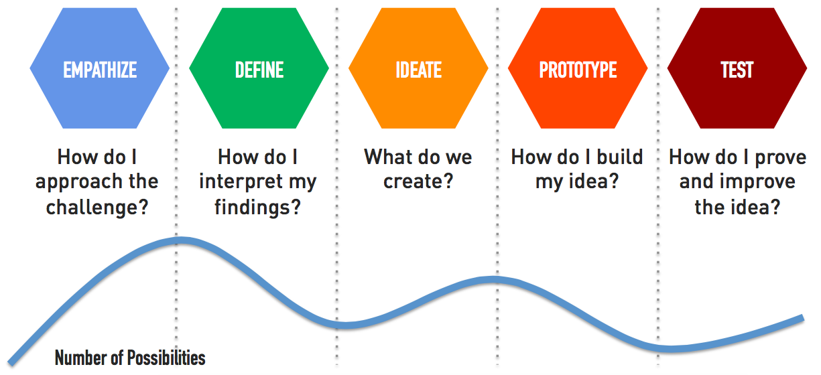
What is design thinking?
Empathize - Find People
Define - Look for patterns
Ideate - Design principles
Prototype - Make Tangible
Test - Iterate Relentlessly
Further Reading: What is design thinking, Design Thinking

Slide 5
How to Practice
Take 4 minutes to define 6 challenges that are interesting to you.
3 Dreams/Things you wish existed and 3 gripes/things that could be better (Challenges!)
Practice this on a regular basis
Alice laughed. “There’s no use trying,” she said: “one can’t believe impossible things.”
I daresay you haven’t had much practice,” said the Queen. “When I was your age, I always did it for half-an-hour a day. Why, sometimes I’ve believed as many as six impossible things before breakfast.”
Alice in Wonderland
Credit for slide idea: Elisa Cundiff

Slide 6
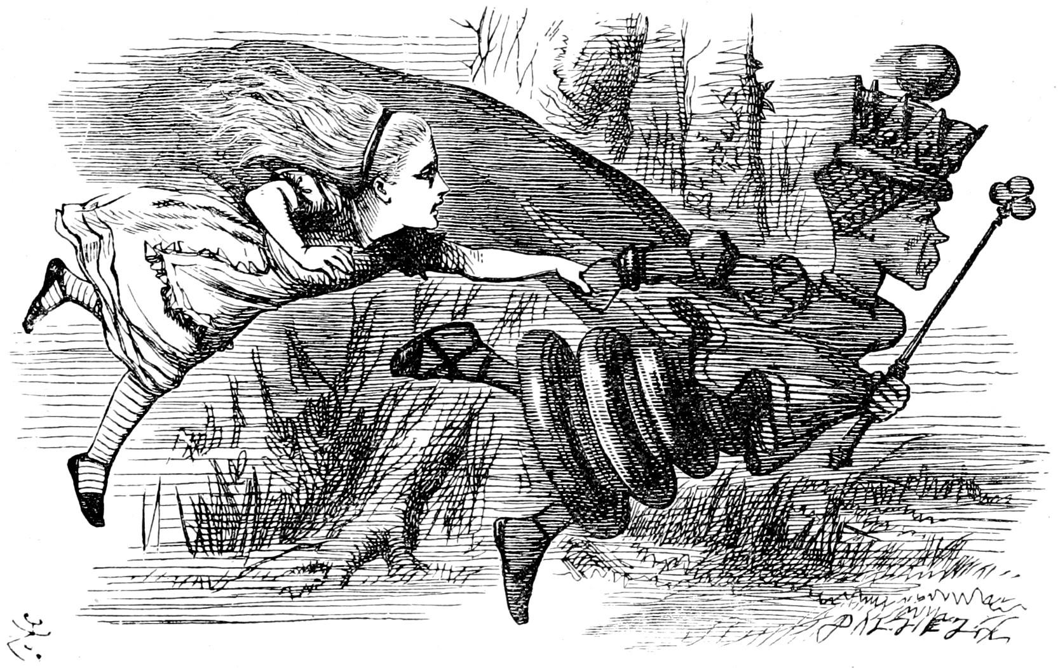
Next Steps
Emphasize
Talk with others about your ideas
Find diverse audiences to talk to
Talking with your friends and family only introduces unconscious bias
Define
Define your problem before you write code
Ideate
Design your solution before you write code
This can be a rough idea
Map out your code on paper
Prototype
Start writing!
Reiterate
It is alright to change it / make it incremental!

Slide 7
Defining?
Defining problems is hard!
The more iteration and empathize you do - the better!
Reframe as Questions
Every Method, Every program, Every loop, You Write
What is your quest?
What do you know?
What do you need?
What can you figure out?

Slide 8
Design Thinking
Applied in multiple industries!
Can even be a way to look at life

Slide 9
Recap - Strings
Built into Python
Essentially – specialized list of characters
ordered
immutable
List functions (len)
work on Strings
Concatenation is common (+)
str() - turns numbers to String “types”
barbarian = “conan the barbarian!” first = barbarian[0:5] print(first)
# conan
no_last = barbarian[:-1] print(no_last)
# conan the barbarian
barb = barbarian[-10:] print(barb)
# barbarian!
Remember! – Write the indices under the String
Conan
0 1 2 3 4

Slide 10
String Methods
Conditional Operators and Strings
== - both are equal – including case
> - letter by letter comparison
string in string – in operator
works with lists/tuples
replace(old, new)
replace(old, new, count)
find(x)
find(x, start)
find(x, start, end)
rfind(x)
count(x)
isalnum() - no specials or puncuation
lower() – change all to lowercase
upper() – change all to uppercase
strip() – remove training and leading spaces

Slide 11
Split and Join
split – converts a string into list of strings
split on the string passed into it!
csv = "skeleton,13,12,20".split(",") # ['skeleton', '13', '12', '20’]
join – builds a single string from a list of items
line = ";".join(csv) # skeleton;13;12;20

Slide 12
Find – and Patterns
Programmers look for patterns
Strings often have patterns
Exploit the patterns!
sample="Field One:pH=7.2,P2O5=23,K20=5,Ca=40,S=30,Lat=40.5853°N,Lon=105.0844°W;Field Two:K20=6,P2O5=23,pH=7.1,Ca=41,S=30,Lat=40.5852°N,Lon=106.0844°W"
def get_calcium(data):
ca_start = data.find("Ca")
ca_start_num = data.find("=", ca_start) + 1
ca_end = data.find(",", ca_start)
return data[ca_start_num:ca_end]
print(get_calcium(sample, 0)) # 40 print(get_calcium(sample, sample.find(";"))) # 21
def get_calcium(data, start): ca_start = data.find("Ca", start) ca_start_num = data.find("=", ca_start) + 1 ca_end = data.find(",", ca_start) return data[ca_start_num:ca_end]

Slide 13
Practice
Useful Functions
in operator
find function
slice operator [:]
Given the following String
“Amy:Classes=CHEM107(B),GEO120(C),CS164(A);Rory:classes=CS150B(B),CHEM107(A-),MATH151(B)”
Write code that helps you find grade:
Based On student and course
Case is *optional* (hint: recall .lower())
Step 1 – write it out!
Step 2 – Notice the pattern!
Can you find just the student? – ok, code that now
Can you find the class after you find the student, but before the next student? Ok, code that out!
def find_grade(student, course, data_str): #TODO Your Code Here

Slide 14
Let’s Code
def get_element(analysis, element): start = analysis.find("=", analysis.find(element)) + 1 end = analysis.find(",", start) return analysis[start:end]
def build_card(samples, elements): analysis_card = "+" + "=" * 24 + "+\n" for field in samples.split(";"): analysis_card += "|" + "-" * 24 + "|\n" analysis_card += "| {:<23}|\n".format(field[0:field.find(":")]) analysis_card += "|" + "-" * 24 + "|\n" for element in elements: if element.lower() in field.lower(): analysis_card += "| {:<10}{:>10} |\n".format(element, get_element(field.lower(), element.lower())) analysis_card += "+" + "=" * 24 + "+\n" return analysis_card def run_analysis(): response = input("Run report (full or individual elements by comma)? ").strip() elements = ["Ca", "S", "K20", "P2O5", "Mg"] if response.lower() == "full" else response.split(",") print(build_card(sample, elements))

