Slide 1
HTML Files and Python Dictionaries

Slide 2
Announcements
Opening Question:
Try to brain storm *everything* you know about lists, and write it down.
Reminder – readings are due before lecture
You don’t have to do all of it - challenge problems can be challenging…
You can return to them.
We start off each lecture with a quiz from your reading!
Make sure to review knowledge checks and spread out their use!
LABS – are mostly empty. If can go to them to get help, and they should be full.
Todo:
Start labs right away
CS 164 – Next Course In Sequence, also consider CS 220 (math and stats especially)
CO Jobs Report 2021 – 77% of *all* new jobs in Colorado require programming
60% of all STEM jobs requires *advanced* (200-300 level)
31% of all Bachelor of Arts degree titled jobs also required coding skills
2016 Report found on average jobs that require coding skills paid $22,000 more

Slide 3
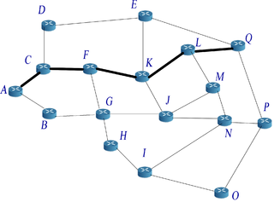
Internet Review
Further Reading:
WWW History, 100 Websites that Shaped the Web, Collection of Internet History Links
Layers
Physical Wires transmitting bits
IP and DNS - figuring out where to go
Routing and TCP helps transfer packets
HTTP/S - helps determine files
World Wide Web (WWW)
Tim Berners Lee (WWW Consortium)
Marc Andreesen (Netscape)
CERN Laboratories - first Website
End of 1993 - 26 websites in existence
End of 1994 - Amazon, 1 million browsers
By 1998 - 750,000 commercial sites
All of this is based on the layers - files transferred through multiple computers

Slide 4

HTML and HTTP

Slide 5
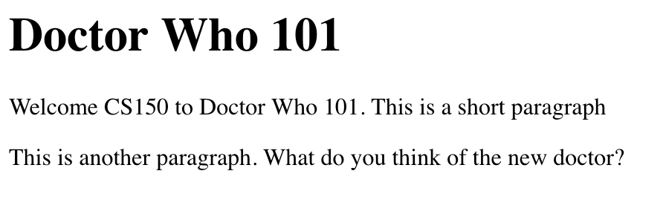
HTML example
<!DOCTYPE html>
<html lang="en">
<body>
<h1>Doctor Who 101</h1>
<p>Welcome CS150 to Doctor Who 101. This is a short paragraph.</p>
<p>This is another paragraph. What do you think of the new doctor?</p>
</body>
</html>
Further Reading/Tutorial: https://www.w3schools.com/html/

Slide 6
Websites Are Files
The internet has evolved
HTML pages (Semantic Hints)
Cascading Style Sheets (Look and Feel)
Color, semantics, and some layout
Javascript (Functionality)
ECMAScript !
Javascript is not Java
Your computer talks to another computer
Sending files back and forth!
Your browser displays the file
Similar to how a word doc displays files
Browser - Reads and displays.
.HTML
.css
.css
.css
.
s
.js
They talk!
Server Sends Files

Slide 7
Web-Applications
Android Phone App - Java or Kotlin
Apple Phone app - Obj C or Swift
Webpage - browser / computer
.HTML
.css
.css
.css
Server(s)
Database
.js
.js
.js
RESTful Api / Controller
Server Business Logic
Server Sends Files
Often sends data in JSON format (structured data, key:value pairs)

Slide 8
Dictionaries
key:value pairs – in Python

Slide 9
Dictionary
{'Murdoch': ['Cut & Thrust', 'Rapier Spear', 'Rapier', 'Combat Archery', 'Armored Combat’],
'Valtaja': ['Cut & Thrust', 'Rapier Spear', 'Rapier’],
'Aegeon': ['Cut & Thrust', 'Rapier Spear', 'Rapier', 'Armored Combat', 'Great Weapons’],
'Felix': ['Armored Combat', 'Great Weapons’],
'Miriam': ['Cut & Thrust', 'Great Weapons']}
Maps key:value pairs
“Maps” not used in Zybooks, commonly used later
Great way to store values with a name (key) to access
key – has to be unique!
grades = {“assignment1”: 2, “assignment2”:2}
Example:
authorized = {"Murdoch": ["Cut & Thrust", "Rapier Spear", "Rapier", "Combat Archery"], "Valtaja": ["Cut & Thrust", "Rapier Spear", "Rapier"], "Aegeon": ["Cut & Thrust", "Rapier Spear", "Rapier", "Armored Combat", "Great Weapons"], "Felix": ["Armored Combat", "Great Weapons"]}
print(authorized["Murdoch"]) # ['Cut & Thrust', 'Rapier Spear', 'Rapier', 'Combat Archery']
authorized["Murdoch"].append("Armored Combat")
print(authorized["Murdoch"]) # ['Cut & Thrust', 'Rapier Spear', 'Rapier', 'Combat Archery', 'Armored Combat']
authorized["Miriam"] = ["Cut & Thrust", "Great Weapons"]
print(authorized)

Slide 10
Practice
Write a dictionary that stores grades (like example on last slide)
grades = {“assignment1”: 2, “assignment2”:4}
Have at least five different assignments in the dictionary.
Write code that changes one of the assignments grades to be a different value
Challenge problem:
Let someone add and update grades through the console/terminal ( remember “input(“enter a value”))

Slide 11
Looping Through Dictionaries
dict.keys() - give list of keys
in no particular order!
dict.values() - give items *without keys*
dict.items() - gives tuple of (key, value)
for key, value in authorized.items(): print("{} is authorized in {}".format(key, value))
Murdoch is authorized in ['Cut & Thrust', 'Rapier Spear', 'Rapier', 'Combat Archery', 'Armored Combat']
Valtaja is authorized in ['Cut & Thrust', 'Rapier Spear', 'Rapier']
Aegeon is authorized in ['Cut & Thrust', 'Rapier Spear', 'Rapier', 'Armored Combat', 'Great Weapons']
Miriam is authorized in ['Cut & Thrust', 'Great Weapons’]
Felix is authorized in ['Armored Combat', 'Great Weapons']
What if I wanted to print in alphabetical order?

Slide 12
Practice 2
Take the code you wrote before
Loop through all the values – printing out assignment name and grade next to it.
Code below will help
for key, value in authorized.items(): print("{} is authorized in {}".format(key, value))

Slide 13
Let’s Code
def is_auth(name, auth, auth_dict): return auth in auth_dict[name] def add_auth(name, auth, auth_dict): if not is_auth(name, auth, auth_dict): auth_dict[name].append(auth)
else: auth_dict[name] = [auth] def remove_auth(name, auth, auth_dict): if is_auth(name, auth, auth_dict): auth_dict[name].remove(auth) def clear_fighter(name, auth_dict): return auth_dict.pop(name, None)

