Slide 1
Research, Logic, Conditionals

Slide 2
Announcements
Opening Question
Try to explain how to make PB&J Sandwich. How many steps does it take? Did you really include all steps?
Your Paper is DUE Thursday
Late window until Sunday (hard cutoff)
Reminder – readings are due before lecture
You don’t have to do all of it - challenge problems can be challenging…
You can return to them.
Help Sessions
Go to them! They make a difference
Help session teams should be setup
If you are not on a private channel with your other help session team mates, let us know
Thursday lab – meant to be done by Tuesday
February 2nd : ACM – Presentation: Tech Interviews
February 3rd : ACM-W – Career Fair Prep

Slide 3
Discussion
Who did you interview for the paper?
What did you learn?
What are some commonalities between the interviews at your table?

Slide 4
Discussion
What topics did you pick? What was the inspiration for it?
What did you learn?
What are some commonalities between the interviews at your table?

Slide 5
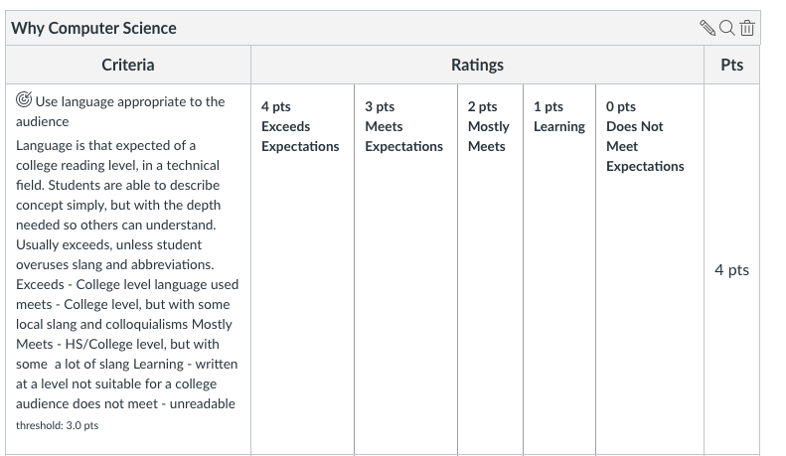
A Couple Reminders
Your first paper, is due this module!
Hopefully, you already started!
Follow the Rubric: (in canvas)
Most common mistake: not using references!

Slide 6
Grading
Every Learning Outcome In Rubric
Scored between 1-4
0 if you skip that learning outcome completely
Final grade for paper 1-4
Based on most scores you have (rounded up)
For example
4, 4, 3, 3 = 4 for the paper
4, 3, 3, 2 = 3 for the paper
Exception:
If you score a 1 or 2 in any category, you may not score a 4 for the total!
Submitting a blank page, will grant you a 0
But allowed, if you want to ‘skip’ the paper
Don’t skip it! (Will seriously damage your grade)

Slide 7
Resubmitting?
You must meet with the instructor or TA – first
They will then regrade your new submission
If you score a 1 or 2 on the final paper score (not just a single category)
you will automatically be asked to re-submit
The goal is for you to do it correctly, more than just doing it!

Slide 8
FAQ
What type of format?
You can follow any style you want
but you must follow a style
Recommended Style:
ACM/IEEE Style Guidelines
IEEE Overview - Purdue Online Writing Lab
Includes simple intext and biographical citations
Very commonly used in tech industries - we modify it slightly, still keep double spacing, and font sizing
Minimum number of pages?
We don’t have a minimum, only a maximum / stop reading page
Most people it will take a couple pages
Accommodations Window
Max of 3 days. We need to be strict, or won’t have time to grade them all

Slide 9
Practice Problems

Slide 10
Coding Practice / Follow Along
Write a code that
takes two parameters from the client
a name, and then number
It then prints out the name and number separated by a comma
The number should only have at most two decimal places.
Example Output
Amy Pond,12.2
Rory Williams,14.22
Clara Osborn,100.12

Slide 11
Practice Two
Take the same code, and break it up into two functions
One function just handles the formatting of the name number
hint: it should take in two parameters and return a string
The second function handles the client input, and printing to the screen
Hint: it will call your first function

Slide 12
Lab Practice Time
Work on a lab at your table.
You may discuss with others
but you may not share code
Feel free to ask questions
I will go over parts as asked

