Slide 1
1s and 0s add up

Slide 2
Announcements
Opening Question:
What is your favorite thing to do online?
Reminder – readings are due before lecture
You don’t have to do all of it - challenge problems can be challenging…
You can return to them.
We start off each lecture with a quiz from your reading!
Make sure to review knowledge checks and spread out their use!
Grade on Midterm 83% - great job, but more importantly
Hope this reminds you to keep coming to class and keeping up!
Todo:
Start labs right away
CS 164 – Next Course In Sequence, also consider CS 220 (math and stats especially)
CO Jobs Report 2021 – 77% of *all* new jobs in Colorado require programming
60% of all STEM jobs requires *advanced* (200-300 level)

Slide 3
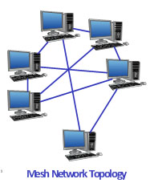
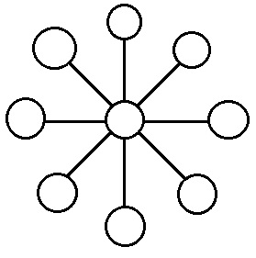
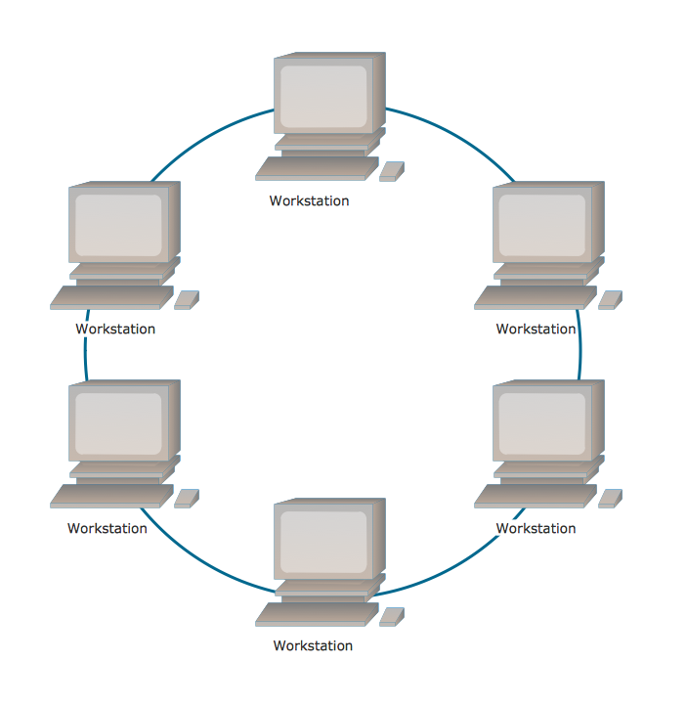
Understanding Networks of Computers
Circularly (Ring) Connected
Faults?
Centralized Hub
Faults?
Strengths?
Where is it used?
Distributed Mesh
Faults?
Strengths?
Where is it used?

Slide 4

The Internet is really, really great

Slide 5
Definitions to know
URL - Uniform Resource Locators - http://www.cs.colostate.edu/~cs150b
The protocol is the portion ending in ://
http, https, ftp, scp, ssh, etc
The host or top-level domain
colostate.edu
The filename or page name itself
Can also include directories, such as ~cs150
In this case, there is a default file - index.html
HTTP - HyperText Transfer Protocol (HTTPS - encrypts it as Secure)
IP Address - Internet Protocol
128.0.0.1 (IPv4)
2001:CDBA:0000:0000:0000:0000:3257:9652 (IPv6)
DNS - Domain Name Server
Converts URL host names to IPs
Routers then have you connect to that server using the IP
Further reading: https://www.lifewire.com/top-internet-terms-for-beginners-2483381

Slide 6
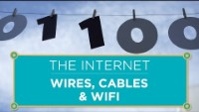
Binary?

Slide 7
Binary - Why does it matter?
Computers are large sets of memory
Each memory location has a state of ‘on’ (1) or off (0).
These states are how everything is stored
And the focus of Computer Engineering majors
They are also called ‘finite state machines’
Finite number of states (one or zero - yes or no, on or off)
A machine full of them
Not magic but science
Having tons of tiny states allows us to represent all the things computers do!
This is a much deeper topic for a 200 level class.
Knowing binary
Will help us understand how much memory is being taken up for primitive and objects
As every thing created takes up a portion of the finite states in the machine. (over simplified)

Slide 8
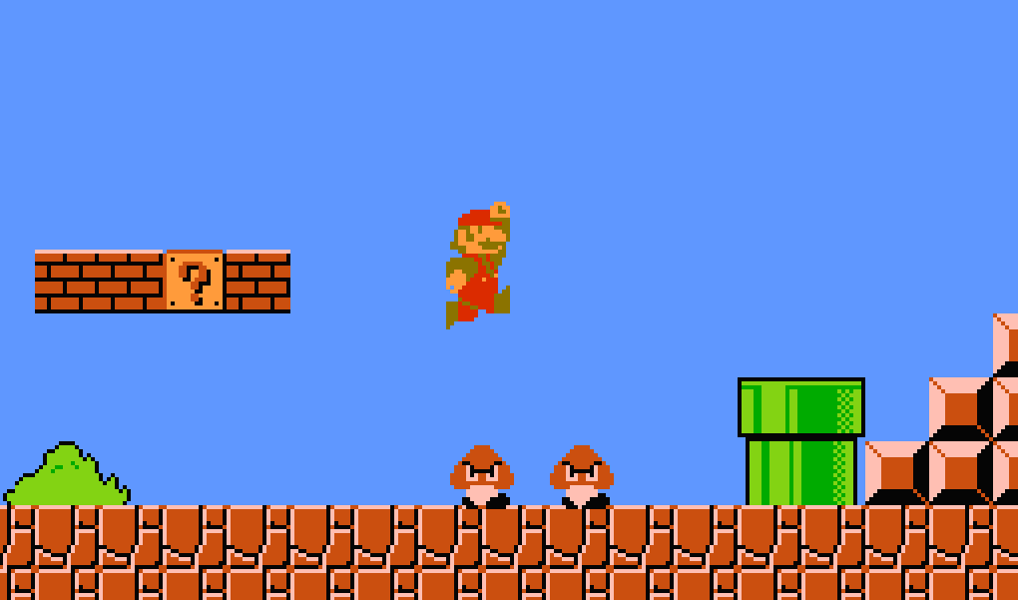
Let’s go back to memory allocation
Byte has 8 Bits
Computer represent data in bits
But we need to allocate the room
1 or 0
1
1 or 0
1
1 or 0
1
1 or 0
1
1 or 0
1
1 or 0
1
1 or 0
1
1 or 0
1

Slide 9
Binary Tests
00001111 =
10001000 =
00010001 =
15
00001111
64 32 16 8 4 2 1 .
8+4+2+1 = 15
136
17

Slide 10
Python Types?
val = bin(15) print(val) # 0b1111 val = bin(136) print(val) # 0b10001000
print(val[2:]) # 10001000
print(int(val, 2)) # 135
val = 0b111 print(int(val)) # 7
numeric
int
You can change the ‘base’ with a second argument
float
bin
not in the book, coverts number to binary
also, you can set a value as binary by leading with 0b
sequential
string
list
tuple
set (list, with unique values only)
dict
We will come back to dict - maps indices to names!

Slide 11
Coding Practice
First – Create a list with four numbers. Have the numbers be anywhere between 0 to 255 (your choice, just add them by default)
Second – create a second list.
Convert each number in the first list to binary (bin(val) ) – and add it to the second list.
Third - Print out the new list

