Slide 1
Inclusive Design and Lists and Loops

Slide 2
Announcements
Opening Question:
How are you studying for this course? Knowledge checks, practice coding assignments, etc?
Reminder – readings are due before lecture
You don’t have to do all of it - challenge problems can be challenging…
You can return to them.
We start off each lecture with a quiz from your reading!
Make sure to review knowledge checks and spread out their use!
Grace Hopper Celebration – Check Canvas Announcement
Todo:
Start on Inclusive Design Paper (due next week)
CS 164 – Next Course In Sequence, also consider CS 220 (math and stats especially)
CO Jobs Report 2021 – 77% of *all* new jobs in Colorado require programming
60% of all STEM jobs requires *advanced* (200-300 level)

Slide 3
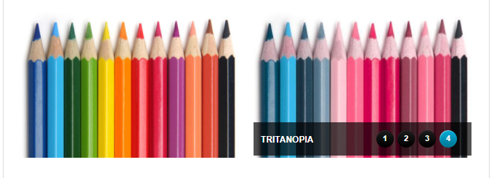
Definitions
Accessible Design
Meets compliance
Often requires special tools or accommodations
Universal Design
Makes it so compliance is met by default
Websites – Colorblindness for example!
Green and Blue
Bad Color Combinations
Design with contrasting, so no matter the way people see it, they can still see it!
Inclusive Design
Accessible by different ability levels, gender identification, backgrounds, and cultural identities without alienation

Slide 4
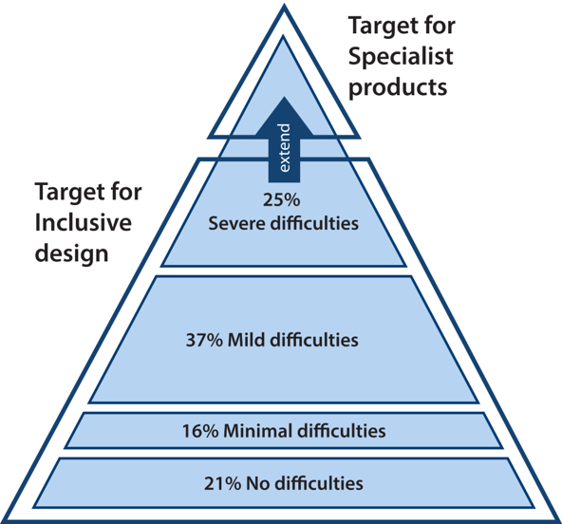
Enter Inclusive Design
Microsoft Inclusive Design Principles:
Recognize exclusion
Solve for one, extend to many
Learn from diversity
Continuum of population diversity pyramid
Notice, only 21% of people have ‘no-difficulties’
Modern Design and Software Engineering
Must take into account the full audience
Must take into account the interconnectedness of society
Credit: University of Cambridge - Inclusive Design Toolkit
3rd Law of Tech: Technology comes in packages, big and small.
Further Thinking: All technology, big and small, needs to be designed with the client in mind.

Slide 5
Variable Ability Levels
Difficulties are on a spectrum of:
Permanent
Temporary
Situational
Temporary Example:
You broke your hand, so will have difficulty texting for a few months.
Situational Example:
You are holding tea in your hand, so making difficult to text your friend.
Permanent Example:
You got in a car wreck from texting and driving and are paralyzed from the neck down. (also, don’t text and drive!)
What are some examples you can think of?

Slide 6
Lists and Iteration

Slide 7
Reading Checking
powerball = [4, 22, 35, 38, 39, 20, 2] mega = [1, 26, 48, 51, 59, 25, 2] lucky = [22, 28, 33, 38, 43, 17] lotto = [9, 16, 22, 31, 33, 40]
Given the lists to the left. Answer the following questions as they appear
len(mega)
7
min(powerball)
2
powerball[1:2]
22

Slide 8
Lists
Fundamental to Python
List of items, any item.
mutable (can be modified)
machete = [4, 5, 2, 3, 6, 7, 8, 9] machete_names = ["A New Hope", "The Empire Strikes Back", "Attack of the Clones", "Revenge of the Sith", "Return of the Jedi", "The Force Awakens", "The Last Jedi", "The Rise of Skywalker"]
print("Star Wars {episode}: {title}".format(title=machete_names[2], episode=machete[2]))
Prints - Star Wars 2: Attack of the Clones
Notice: Indices like Strings

Slide 9
Useful List Functions
glacier_size = [0.53, 0.34, 0.59,
0.2, 0.28, 0.13,
0.25, 5.5, 3.25,
0.84, 0.5, 0.75] missing_glaciers = [0.19, 0.04, 0.08,
0.29, 0.22, 0.07, 0.12]
print(min(glacier_size)) # 0.13 print(max(glacier_size)) # 5.5 print(glacier_size.index(5.5)) #7
glacier_size[7] = "Five.Five" print(glacier_size[7]) # Five.Five
combined = glacier_size[7:9] + missing_glaciers[0:3] print(combined) # ["Five.Five", 3.25, 0.19, 0.04, 0.08]
len(list) - length of list
min(list)/max(list) - smallest or largest
sum – adds list together
+ - concatenates lists together
list.index(val) - returns index of a value

Slide 10
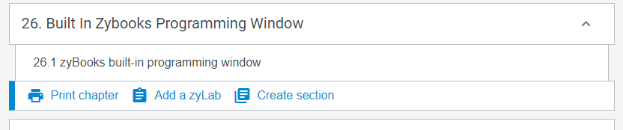
Practice
In a python coding window (zybooks)
Create list with each of your names as elements
Print the smallest name
Print the largest name
Will it allow you to ‘sum’ the list?
A for yes, B for no

Slide 11
Tuples
Pro Skill: Named Tuple
Tuple but allows direct name references
Like lists, but…
immutable (can’t be changed)
common way to “fix” data
Named Tuple
Holds data in a named form
coords = namedtuple("Coordinates", ["Latitude", "Longitude"]) foco = coords("40.5853° N", "105.0844° W") print(foco.Latitude) # 40.5853° N
fixed = (1, 2, 3) print(fixed) print(fixed[1]) #2 fixed[1] = 10 #ERROR!

Slide 12
Printing Elements In Lists?
the while loop way
range(a, b)
Creates a number list from a to b
often used with for loops!
index = 0 while index < len(glaciers): print(glaciers[index], end = ' ') index += 1
introducing for loop
for size in glaciers: print(size, end=' ')
grabs each element
in order
ends when list ends
the above two loops – the same thing!

Slide 13
Coding Challenge
Given a list of Numbers
Add all the elements together
Add all *even* elements together
Hint: You will use a loop
Hint: You will use modulo (%)

Slide 14
Let’s Code
def simple_cipher(msg, shift): encrypt = '' for char in msg: encrypt += chr(ord(char)+shift) return encrypt
def secure_message(history, key): encrypted = [] for msg in history: encrypted += simple_cipher(msg, key) return encrypted def decode_message(history, key): decoded = [] for msg in history: decoded += simple_cipher(msg, -key) return decoded

