Slide 1
CS 152: Introduction, Types, and
Variables
CS 152: Python for STEM
Colorado State University
Computer Science Department
Slides Originally Created by Albert Lionelle and Updated by Marcia Moraes

Slide 2

Weekly Announcements!
TODO Reminders:
Setup MS Teams
Reading 1 (zyBooks)
Reading 2 (zyBooks)

Slide 3
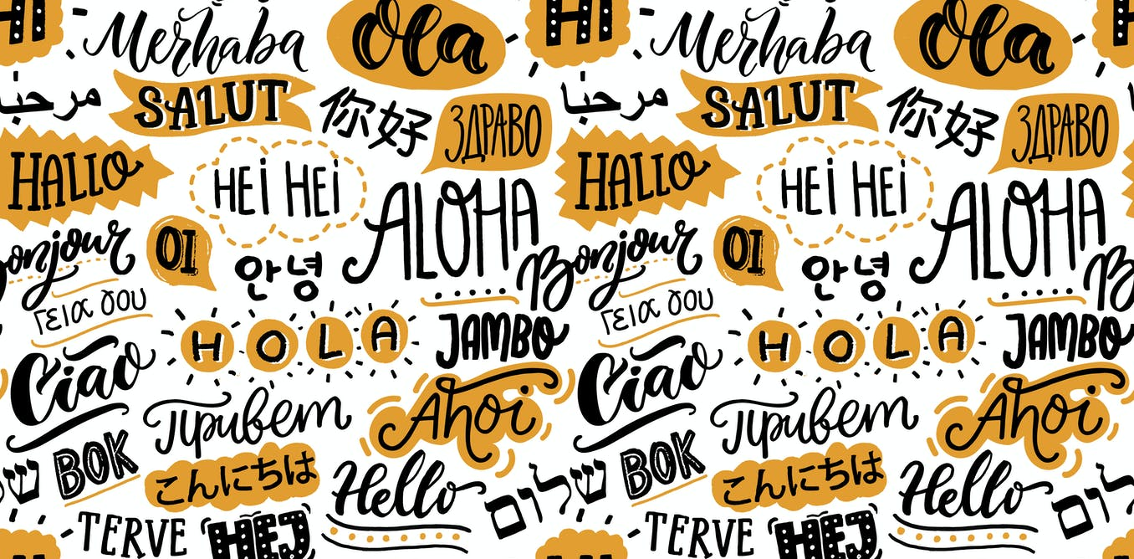
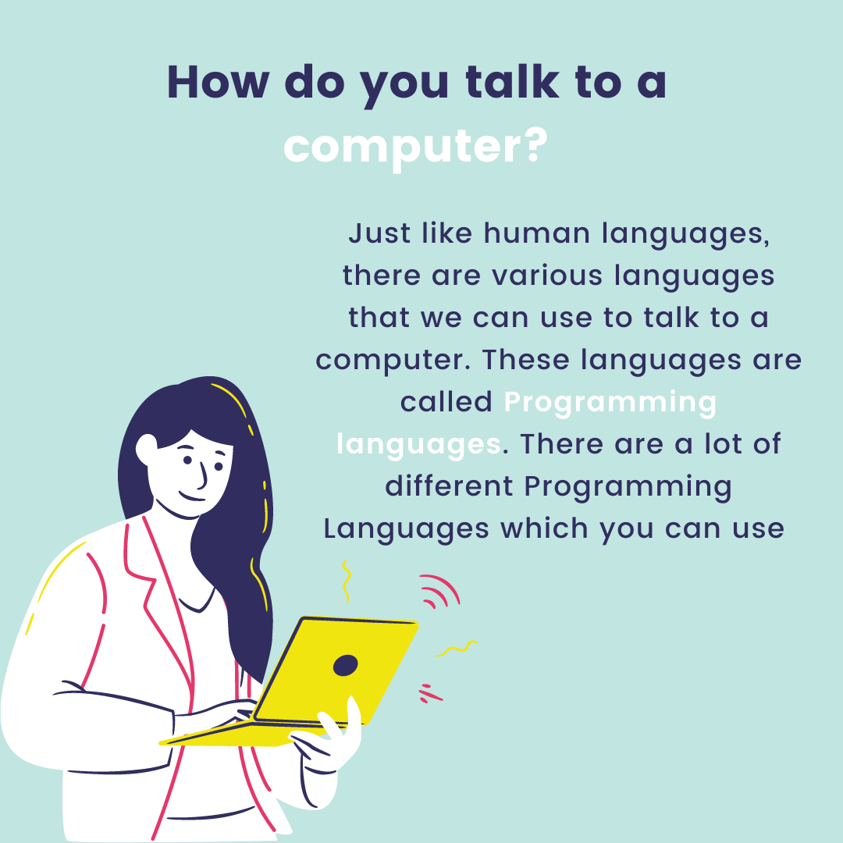
Learning to program is…
Image available at: https://images.theconversation.com/files/222595/original/file-20180611-191978-7zidl7.jpg?ixlib=rb-1.1.0&q=45&auto=format&w=926&fit=clip
to learn a new language! The computer language ☺!
Image available at: https://miro.medium.com/max/1400/1*8eT_CDXmoc2LLVHtu9Z5qw.png

Slide 4
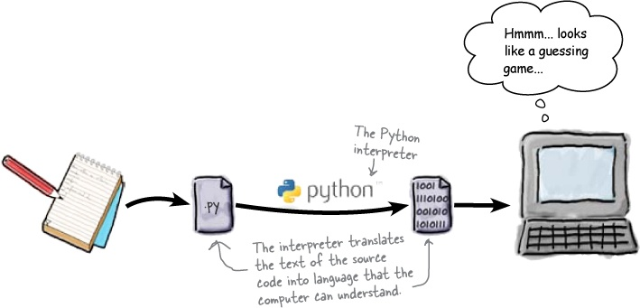
Learning the Python Language
Line by line
Each line is an instruction
Basic instructions
Store values
Perform arithmetic on values
Call other functions on and using values
Image available at: https://www.oreilly.com/library/view/head-first-programming/9780596806682/httpatomoreillycomsourceoreillyimages1943857.png.jpg

Slide 5
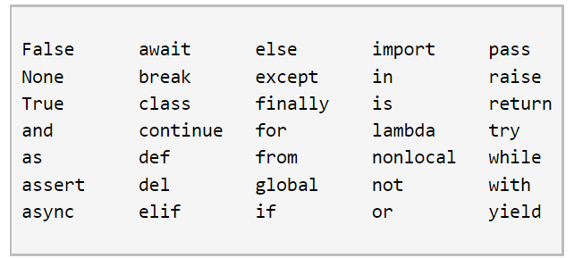
Storing Values: Variables
Variable
is a place to hold a value
has an identifier/name (can not be any reserved keywords)
Reserved keywords examples
Assignment statement
assigns the left-side variable with the right-side expression's value

Slide 6
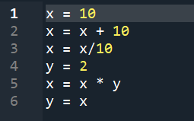
Storing Values: Variables – Class Activity 1
Consider the program below to answer the questions:
How many variables do we have in this program?
What are their names/identifier?
What is the final value of each variable?
What happen if we run this program?

Slide 7
Output: Printing
Function print()
Prints a message that could be:
A string literal - text enclosed in quotes
print(‘hello world!’) or print(“hello world!”)
A variable value
print(x)
A value resulting from an expression
print(x + 10)
A combination of all of the previous
print(‘value of x = ’, x, ‘ ’, ‘value of x + 10 = ’, x + 10)

Slide 8
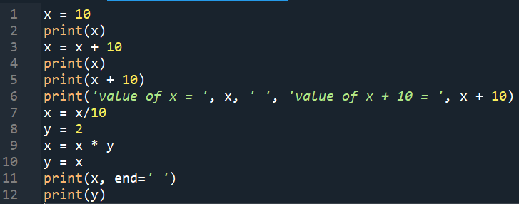
Output: Printing – Class Activity 2
What does end=‘ ’ mean in the print on line 11?
Write down in a piece of paper the exact output for the program if we run it.

Slide 9
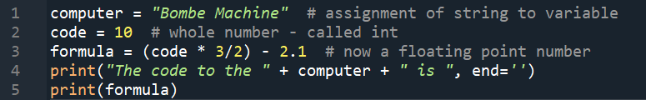
Output: Printing – Class Activity 3
How many variables do we have in this program?
What are their names/identifier?
What is the final value of each variable?
Write down in a piece of paper the exact output for the program if we run it.

Slide 10
Types in Python
Python using ”implicit”/weak typing
figures out types for you!
Unlike Explicit/Strongly Typed Languages (Java)

Slide 11





Syntax Errors – Class Activity 4
violate a programming language's rules
Find and correct the error(s) in each statement below:

Slide 12

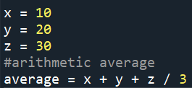
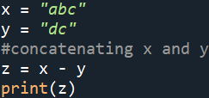
Logical Errors – Class Activity 5
the program is logically flawed
Find and correct the error(s) in each statement below:

Slide 13
Peer Coding – Class Activity 6
Write a Python program that swaps the value of two variables.
For example, if variable a = 10 and variable b = 20 at the beginning of the program, after swapping their values “a” will have 20 and “b” will have 10
Explain why do you think your program works.
Explain what do you need to do in order to make your program “general”, meaning that it could work for any two values defined by a user.

Slide 14
Peer Coding – Class Activity 7
Access Canvas and go to the “In Class Activity: ASCII Art”.

