Slide 1
CS 152: String Slices
CS 152: Python for STEM
Colorado State University
Computer Science Department
Slides Originally Created by Albert Lionelle and Updated by Marcia Moraes

Slide 2

Weekly Announcements!
TODO Reminders:
Reading 9 (zybooks) – you should have already done that ☺
Lab 06
Reading 10 (zybooks) – you should have already done that ☺
Lab 07
Reading 11 (zybooks) – you should have already done that ☺

Slide 3
Recall Activity
What is string slicing? Explain with your own words.
Write your answer in our today’s attendance assignment.

Slide 4
String Slicing
Slice notation has the form:
my_str[start:end]
creates a new string whose value contains the characters of my_str from indices start to end - 1
str = "CS152 - Python for STEM"
str_Cs152 = str[0:5]
print(str)
print(str_Cs152)
What is printed?
What instructions should we use
to parse “Python” from str?

Slide 5
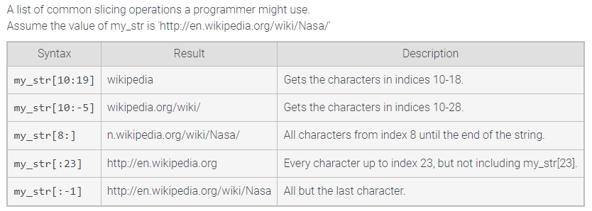
Slicing operations

Slide 6
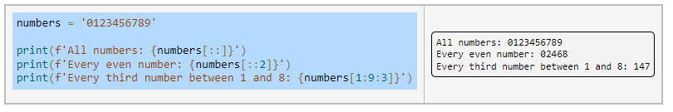
Slice stride
Slice notation also provides for a third argument, known as the stride. The stride determines how much to increment the index after reading each element.

Slide 7
Field with
Defines the minimum number of characters that must be inserted into the string.
If the replacement value is smaller in size than the given field width, then the string's left side is padded with space characters.
Specify by including an integer after the colon
{name:16}
specify a width of 16 characters

Slide 8
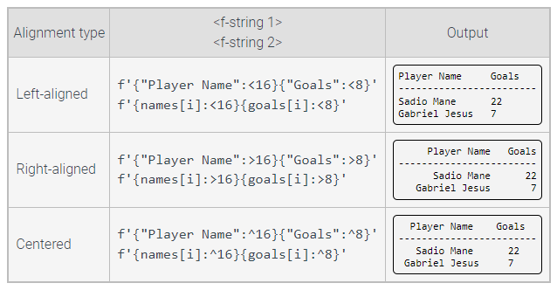
Align Character

Slide 9
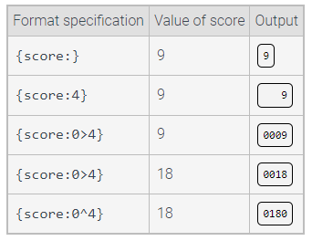
Fill Character
is used to pad a replacement field when the string being inserted is smaller than the field width
default fill character is whitespace

Slide 10
Floating Point Precision
indicates how many digits to the right of the decimal should be included in the output of floating types.
f'{1.725:.1f}'
1.7
f'{1.5:.3f}’
1.500
f'{1.666:.2f}'
1.67

Slide 11
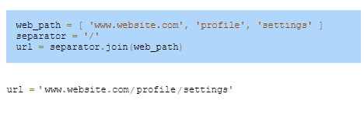
String functions
replace(old, new)
find(x)
count(x)
split(delimiter) – if no delimiter is passed, whitespace is considered the delimiter
join()

Slide 12
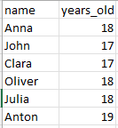
Coding Activity
With a Peer:
Write a Python function that receives the name of a csv file, reads the content of the file and calculate the sum and average of the years old data. The average should be printed with 2 decimals after the point.
Consider that the csv file has the following format.
Tip: rewrite the readCSVFile function provided in Canvas.

Slide 13
Coding Activity
With a Peer:
Write a Python function that receives the name of a csv file, reads the content of the file and create a list with the years old that are in that file. Consider that the csv file has the format shown here.
Tip: rewrite the readCSVFile function provided in Canvas.
Write a new version of your function so the list generated do not have repeated numbers.

