Slide 1
CS 152: Functions
CS 152: Python for STEM
Colorado State University
Computer Science Department
Slides Originally Created by Albert Lionelle and Updated by Marcia Moraes

Slide 2

Weekly Announcements!
TODO Reminders:
Reading 2 (zyBooks) – you already should have done that for today’s class ☺
Lab 01 – Warm Up
Reading 3 (zyBooks) – you already should have done that for today’s class ☺
Lab 02 – Application
Reading 4 (zyBooks)

Slide 3
Recall Activity
Individually
Grab a paper and write at least three concepts that you can remember from our last class
With your neighbor(s)
Discuss what each other could remember. Did you remember the same things? What did you learn from each other?
Turn you paper to the TAs or myself at the end of the class, this will count as your participation for attendance in this lecture

Slide 4
Remembering - Peer Coding from Last Class
Dr. Green is looking for a bank that will give the most return on her money over the next 5 years. She has P100,000.00 into a savings account. The standard equation to calculate principal plus interest at the end of a period is:
amount = P * (1 + I/M) ^ (N * M)
Where:
P – principal (amount of money to invest)
I – interest (percentage rate the bank pays to the investor)
N – number of years (time for which the principal is invested)
M – compound interval (the number of times per year the interest is calculated and added to the principal)
Think about what problem do you need to solve, how you are doing to solve it (write in English the steps to do that), write a Python code to solve that.

Slide 5
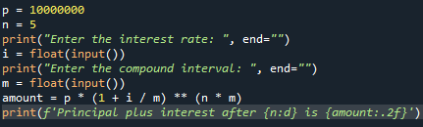
One Possible Solution
What happen if we want to repeat this code to calculate the principal plus interest for another bank? Or for 10, 100 banks?
Code should be Reusable
Code should be DRY
Don’t Repeat Yourself
Functions

Slide 6

Reusable Code
Programming == Problem Solving
You look at the problem to solve
Clarify the problem and constraints
Break it up into *smaller* parts (Divide)
Outline the steps needed
Solve each step (Conquer)
Reassemble the pieces (Glue)
Completed program
Divide
Conquer
Conquer
Conquer
Glue

Slide 7
Function
def
defines the start of a function
indents keep the ‘code’ with the function
spacing matters!
parameters
allows for variables to the functions
print(your value)
function name print
your value is a parameter!
What should be the parameters for our code? Why?
Which commands are part of the function? Why?

Slide 8

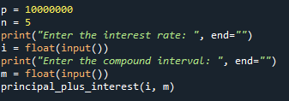
Function
How are we going to call the function we just created?
Could we improve this code a little bit more? How about p and n variables?

Slide 9
Return Values
Other programs can then use those answers
As they need / best for their problem
Always the best paradigm to follow
Notice return in get_real_code
returns the value, done with the function
Pure Functional - Most all functions should return something!
Better yet
Functions do some work
and then return the answer
def get_real_code(code): return (code * 3 / 2) - 2.1 def print_machine_info(computer, code): print("The code to the " + computer + " is ", end='') print(get_real_code(code)) def use_formula(code): solve_cipher(get_real_code(code) * 10)
Your turn – one person coding - type the code above, and then as a group figure out ways to modify it!
How do you test those changes?

Slide 10
Student Challenge
Team Coding
As group, write two functions
The first function takes in two parameters – first, last
It prints the ”welcome to the class (last), (first)”
The second function
Calls input to ask the client their first name
It calls input a second time to ask them their last name
it calls your first function to print out the result
Have one person on the table code using their laptop and zybooks IDE
The person who codes has to limit their input. They follow the instructions of others
We will alternate who codes each class, so you won’t always be typing.

Slide 11
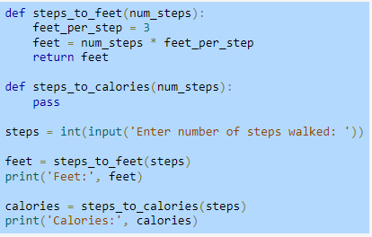
Recall Activity – From Your Readings
What is incremental development?
What is function stubs?
What does the pass keyword mean? When is it used?
Discuss your answer with your group
Notes:
Programs are typically written using incremental development, meaning a small amount of code is written and tested, then a small amount more (an incremental amount) is written and tested, and so on.
To assist with the incremental development process, programmers commonly introduce function stubs, which are function definitions whose statements haven't been written yet.
pass keyword, which performs no operation except to act as a placeholder for a required statement.

Slide 12
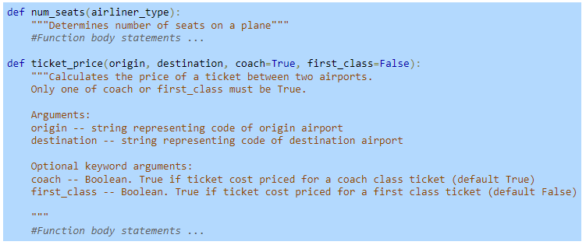
Recall Activity – From Your Readings
What is a docstring?
What is a help function? How would you use it in the example below?
Notes:
A docstring is a string literal placed in the first line of a function body.
The help() function can aid a programmer by providing them with all the documentation associated with an object. A statement such as help(ticket_price) would print out the docstring for the ticket_price() function, providing the programmer with information about how to call that function.

