Slide 1
CS 152: Files
CS 152: Python for STEM
Colorado State University
Computer Science Department
Slides Originally Created by Albert Lionelle and Updated by Marcia Moraes

Slide 2

Weekly Announcements!
TODO Reminders:
Reading 9 (zybooks) – you should have already done that ☺
Lab 06
Reading 10 (zybooks) – you should have already done that ☺
Lab 07
Reading 11 (zybooks)

Slide 3
Recall Activity
Write at least three concepts that you remember from your readings regarding Files in Python.
Have this written in a paper, you will turn in at the end of the class.

Slide 4
Reading entire .txt files
Understanding the readEntireTxtFile function
def readEntireTxtFile(name):
f = open(name);
contents = f.read();
f.close();
return contents

Slide 5
Reading entire .txt files with “with”
Understanding the readEntireTxtFileWith function
def readEntireTxtFileWith(name):
with open(name, 'r') as f:
contents = f.read()
return contents

Slide 6
Comparing Solutions for Reading entire .txt
def readEntireTxtFile(name):
f = open(name);
contents = f.read();
f.close();
return contents
def readEntireTxtFileWith(name):
with open(name, 'r') as f:
contents = f.read()
return contents

Slide 7
Reading each line in .txt files
Understanding the readEachLineTxtFile function
def readEachLineTxtFile(name):
f = open(name);
lines = f.readlines()
f.close()
return lines
Write the readEachLineTxtFileWith function

Slide 8
Writing in .txt files
def writeTextFile(name, anyString):
f = open(name, 'w')
f.write(anyString)
f.close()
def writeTextFileWith(name, anyString):
with open(name, 'w') as f:
f.write(anyString)

Slide 9
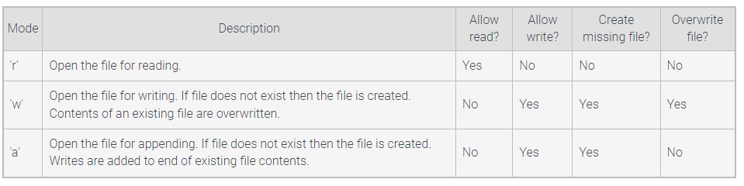
Modes for opening files

Slide 10
Reading csv files
import csv
def readCSVFile(name):
with open(name, 'r') as csvfile:
name_ages = csv.reader(csvfile, delimiter=',')
row_num = 1
for row in name_ages:
print(f'Row #{row_num}:', row)
row_num += 1

Slide 11
Writing csv files with append
Understanding the writeCSVFile function
Rows is a list of a list ☺ we will work more on that
rows = [["Julia", "18"], ["Anton", "19"]]
open function has 3 parameters: name of the file, mode for open the file – a – append, newline=‘’ does not add a blank line in the csv file, between rows that are being appended
def writeCSVFile(name, rows):
with open(name, 'a', newline='') as csvfile:
name_ages = csv.writer(csvfile)
for row in rows:
name_ages.writerow(row)

Slide 12
Coding Along
Write a Python function that receives the lines of a file as a parameter and calculates and prints the sum of each line.
To do this we will need to use the following additional functions:
split() – split a string into a list (https://www.w3schools.com/python/ref_string_split.asp)
replace(oldValue, newValue) – removes the oldValue and substitute for a newValue in a string (https://www.w3schools.com/python/ref_string_replace.asp)
Download the fileExamples.py file from Canvas, that file already has reading and writing functions to work with files

Slide 13
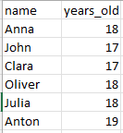
Coding Activity
With a Peer:
Write a Python function that receives the name of a csv file, reads the content of the file and calculate the sum and average of the years old data.
Consider that the csv file has the following format.
Tip: rewrite the readCSVFile function provided in Canvas.

