Slide 1
CS 152: More Operations
CS 152: Python for STEM
Colorado State University
Computer Science Department
Slides Originally Created by Albert Lionelle and Updated by Marcia Moraes

Slide 2

Weekly Announcements!
TODO Reminders:
Reading 6 (zybooks) – you should have already done that ☺
Lab 04
Reading 7 (zybooks)
Lab 05
Reading 8 (zybooks)

Slide 3
Arithmetic Expressions
Division: /
Returns a float pointing number
Floored division: //
round down the result of a floating-point division to the closest smaller whole number value
Module: %
evaluates the remainder of the division of two integer operands

Slide 4
Arithmetic Expressions - Activity
Write exactly what will be the output if we run the instructions below.
division = 24/10
module = 24%10
floor = 24//10
print("24/10 = ", division)
print("24%10 = ", module)
print("24//10 = ", floor)

Slide 5
Arithmetic Expressions – Coding Activity
Write a function that receives a number in seconds, converts that into hours, minutes and seconds, and return a string containing that information in the following format hours:minutes:seconds.
Do a call to that function
If you enter 3665 the function should return the following string “1:1:5”
What kind of operations are you going to use?

Slide 6
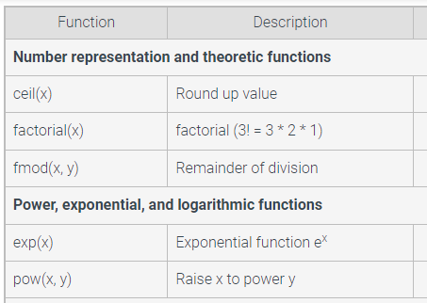
Math Module
import math

Slide 7
Math Module – Coding Activity
Given the number of people attending a pizza party, output the number of needed pizzas and total cost. For the calculation, assume that people eat 2 slices on average and each pizza has 12 slices and costs $14.95.
Output each floating-point value with two digits after the decimal point, which can be achieved as follows: print(f'Cost: ${cost:.2f}’)
Hint: Use the ceil() function from the math module to round up the number of pizzas so that enough pizzas are ordered.
Upgrade your program, so it will work for any number of slices that people eat, the number of slides that each pizza has and the cost of the pizza. Make it as a function.

Slide 8
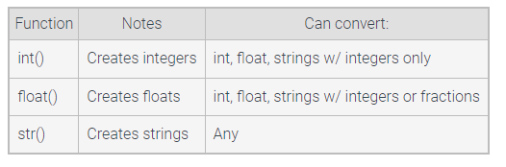
Type Conversion

Slide 9
Type Conversion – Understanding Activity
Write “correct” or “incorrect” for each one of the following instructions:
num = int(1.74)
num = int("1.74")
num = float("1.74")
num = float("1.74a")
num = str(1.74)

Slide 10
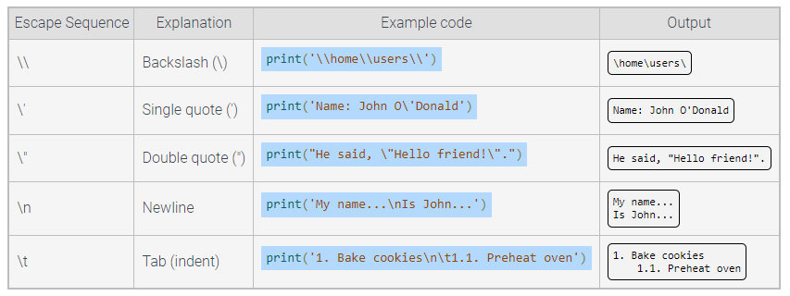
Common escape sequences

Slide 11
Coding Activity
Using Heron's formula, you can calculate the area of a triangle if you know the lengths of all three sides. Given the length of each side of a triangle as input, write a function that calculate the area of the triangle using Heron's formula as follows:
s = half of the triangle's perimeter
area = the square root of s(s-a)(s-b)(s-c) , where a, b, and c are each sides of the triangle.
Hint: Use the sqrt() function from the math module to calculate the square root.
Output the floating-point value of the area with three digits after the decimal point, which can be achieved as follows: print(f'The area of the triangle is: {your_value:.3f}')

Slide 12
Coding Activity
Write a function to calculate the cost for replacing carpet for a single room. Carpet is priced by square foot. Total cost includes carpet, labor and sales tax. Dollar values are output with two decimals.
For example, print(f'Cost: ${cost:.2f}’).
Write a program to ask the user if he wants to calculate the cost for replacing carpet for a single room. While the user answers “yes”, call the function to calculate and print the cost for replacing the carpet.

