Slide 1
CS 152: Operations, Input, Types
CS 152: Python for STEM
Colorado State University
Computer Science Department
Slides Originally Created by Albert Lionelle and Updated by Marcia Moraes

Slide 2

Weekly Announcements!
TODO Reminders:
Reading 2 (zyBooks)
Lab 01
Reading 3 (zyBooks)
Lab 02
Reading 4 (zyBooks)

Slide 3
Recall Activity
Individually
Grab a paper and write at least three concepts that you can remember from our last class
With your neighbor(s)
Discuss what each other could remember. Did you remember the same things? What did you learn from each other?
Turn you paper to the TAs or myself at the end of the class, this will count as your participation activity for this lecture

Slide 4
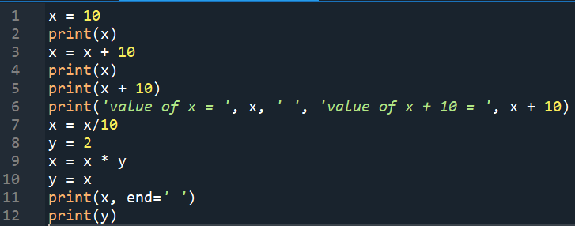
What is missing?
What do we need to do in order to make the following program generic,
meaning that it could work for any values of x and y?

Slide 5


Input: Reading
input() function
reads a string (sequence of characters) that the user typed
text = input()
OR

Slide 6
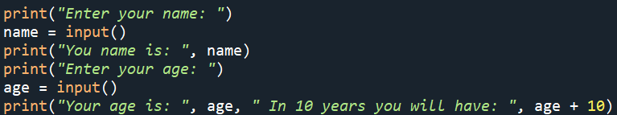
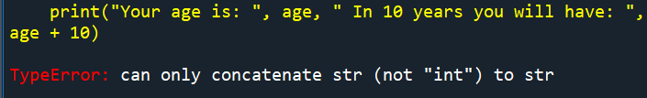
Input: Reading
Analyze the program below
Considering that input() reads strings, do you think we are going to have a problem when we run this program?

Slide 7
Types in Python
We already saw that Python uses ”implicit”/weak typing
figures out types for you!
Somethings you want to specify type
int - whole numbers only
float – floating point/decimal numbers
str – strings (sequence of characters)
Most useful on getting client input
answer = int(input(“get the answer”))

Slide 8
Input: Reading – Class Activity 1
Discuss with your peers and change the program below in order to read an int value for age.

Slide 9
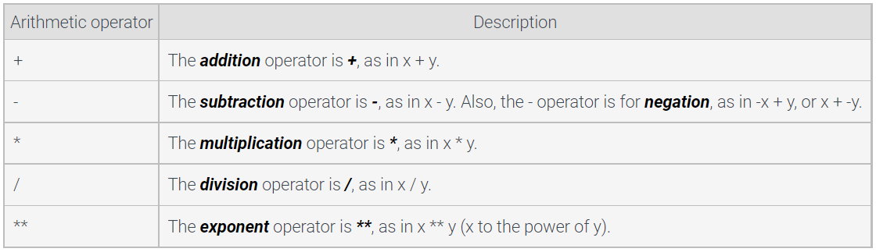
Arithmetic Expressions
combination of items, like variables, literals, operators, and parentheses, that evaluates to a value
// - returns an integer result (the floor)
% - (modulo) operator returns the remainder

Slide 10
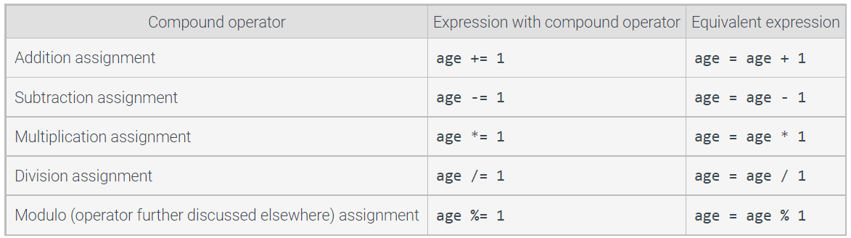
Compound Operators
provide a shorthand way to update a variable

Slide 11
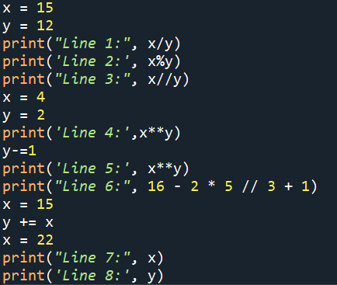
Arithmetic Expressions and Compound Operators – Class Activity 2
Write exactly what will be printed in the program below:

Slide 12


Objects
are used to represent everything in a Python program, including integers, strings, functions, lists, etc.
Each object has:
Value: A value such as "20", "abcdef", or 55.
Type: The type of the object, such as integer or string.
Identity: A unique identifier that describes the object (address in memory).
 | Memory
140706803187039
140706803187040 | 10 | x
140706803187041

Slide 13
Strings Basic
Immutable sequence of characters
name = “Marcia”
print(name[0]) → ‘M’
name[0] = ‘m’ → error – Strings are immutable, can’t be changed by indexes, update the variable by assigning an entirely new string
0 | M
1 | a
2 | r
3 | c
4 | i
5 | a

Slide 14
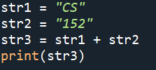

Strings Basic
Concatenation → +
Formatting → f-string, allows a programmer to create a string with placeholder expressions that are evaluated as the program executes

Slide 15

Formatting floating point numbers – Class Activity 3
Write exactly what will be printed in the program below:

Slide 16
Peer Coding – Class Activity 4
Average of the numbers
Result of num1 divided by num2
Result of num1 module num2
Result of num1 floor num2
Area of a rectangle of side num1
Area of a triangle of base num1 and heigh num2
Area of a sphere with radius as num3, use math.pi for pi number
Write a Phyton program that reads three numbers (num1, num2, num3) and calculates and prints the following:

Slide 17
Peer Coding – Class Activity 5
Dr. Green is looking for a bank that will give the most return on her money over the next 5 years. She has P100,000.00 into a savings account. The standard equation to calculate principal plus interest at the end of a period is:
amount = P * (1 + I/M) ^ (N * M)
Where:
P – principal (amount of money to invest)
I – interest (percentage rate the bank pays to the investor)
N – number of years (time for which the principal is invested)
M – compound interval (the number of times per year the interest is calculated and added to the principal)
Think about what problem do you need to solve, how you are doing to solve it (write in English the steps to do that), write a Python code to solve that.

