Slide 1
CS 152: Lists and Tuples
CS 152: Python for STEM
Colorado State University
Computer Science Department
Slides Originally Created by Albert Lionelle and Updated by Marcia Moraes

Slide 2
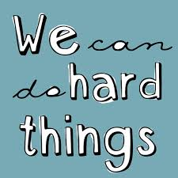
Weekly Announcements!
TODO Reminders:
Reading 6 (zybooks) – you should have already done that ☺
Lab 04
Reading 7 (zybooks) - you should have already done that ☺
Lab 05
Reading 8 (zybooks) - you should have already done that ☺

Slide 3
Recall Activity
What is the difference between a List and a Tuple? Explain using your own words.
Write your answer to our attendance activity for today’s class.

Slide 4
Lists
Fundamental to Python
List of items, any item.
mutable (can be modified)
machete = [4, 5, 2, 3, 6, 7, 8, 9] machete_names = ["A New Hope", "The Empire Strikes Back", "Attack of the Clones", "Revenge of the Sith", "Return of the Jedi", "The Force Awakens", "The Last Jedi", "The Rise of Skywalker"]
title = machete_names[2]
episode = machete[2]
print(f"Star Wars {episode}: {title}“, episode, title)
Prints - Star Wars 2: Attack of the Clones

Slide 5
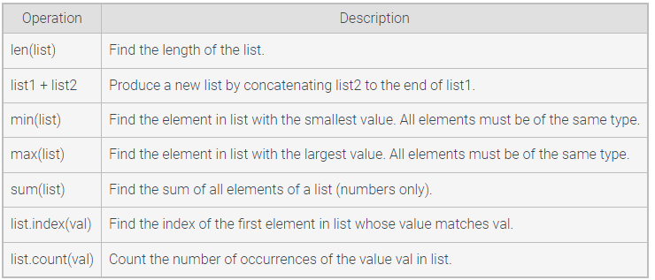
List Functions

Slide 6
List Functions
glacier_size = [0.53, 0.34, 0.59, 0.2, 0.28, 0.13, 0.25, 5.5, 3.25,0.84, 0.5, 0.75] missing_glaciers = [0.19, 0.04, 0.08, 0.29, 0.22, 0.07, 0.12]
print(min(glacier_size)) # 0.13 print(max(glacier_size)) # 5.5 print(glacier_size.index(5.5)) #7
glacier_size[7] = "Five.Five" print(glacier_size[7]) # Five.Five
combined = glacier_size[7:9] + missing_glaciers[0:3] print(combined) # ["Five.Five", 3.25, 0.19, 0.04, 0.08]

Slide 7
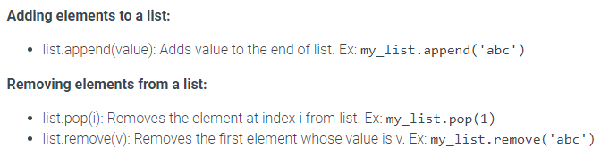
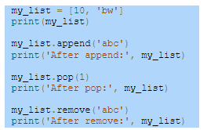
List Functions

Slide 8
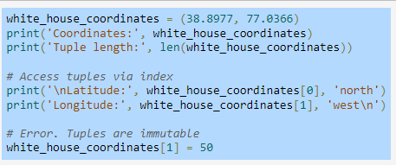
Tuples
Behaves similar to a list but is immutable – once created the tuple's elements cannot be changed

Slide 9
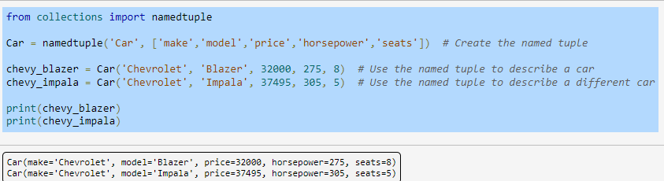
Named Tuples
Allows the programmer to define a new simple data type that consists of named attributes

Slide 10
List Activities
Write a Python function to multiply all the items in a list.
Write a Python function to calculate the average of the elements in a list.
Write a Python function to calculate the number of values that are greater than the average of the elements in a list.
Given a list, write a Python function to swap first and last element of the list.
Given a list, write a Python function to invert the list.
Write a Python function to find the max elements in a list and its position.
Write a Python function to print the numbers of a specified list after removing even numbers from it.

