Slide 1
CS 152: Dictionaries
CS 152: Python for STEM
Colorado State University
Computer Science Department
Slides Originally Created by Albert Lionelle and Updated by Marcia Moraes

Slide 2

Weekly Announcements!
TODO Reminders:
Reading 14 (zybooks) – you should have already done that ☺
Lab 09
Reading 15 (zybooks)
Lab 10
Reading 16 (zybooks)

Slide 3
Recall Activity
def main():
twoDList = [
[1,2],
[3,4]
]
iteratingMultiDimensionalList(twoDList)
def iteratingMultiDimensionalList(multiList):
sumTotal = 0
for row_index, row in enumerate(multiList):
sumRow = 0
for column_index, item in enumerate(row):
sumRow += item
print(f'Sum of the row {row_index}:',sumRow)
sumTotal += sumRow
print(f'Total sum: {sumTotal}’)
What is going to be printed?

Slide 4
Dictionaries
What is a dictionary?
Container used to describe associative relationships
Has a key and a value
Keys are immutable and unique
Created using curly braces { } to surround the key:value pairs
countriesPhoneCode = {} #empty dictionary
countriesPhoneCode = {‘USA’: 1, ‘BR’: 55, ‘CA’: 1}

Slide 5
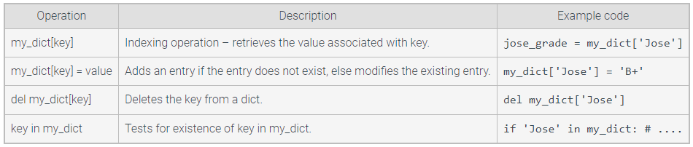
Dictionaries
As of Python 3.7, dictionary elements maintain their insertion order

Slide 6

In Class Activity
What is printed?
countriesPhoneCode = {'USA': 1, 'BR': 55, 'CA': 1}
dicNamesPhones = dict(Bobby='805-555-2232', Johnny='951-555-0055')
myDict = dict(name = 'Bob', grade = 'A+')
print(countriesPhoneCode)
print(dicNamesPhones)
print(myDict)

Slide 7

In Class Activities
What is printed?
countriesPhoneCode = {'USA': 1, 'BR': 55, 'CA': 1}
code = countriesPhoneCode['USA']
print(code)
code = countriesPhoneCode['AU']
How to solve that?

Slide 8



In Class Activities
What is printed?
countriesPhoneCode = {'USA': 1, 'BR': 55, 'CA': 1}
code = countriesPhoneCode['USA']
print(code)
countriesPhoneCode['AU'] = 10
countriesPhoneCode['AU'] = 61
print(countriesPhoneCode)
countriesPhoneCode['No country'] = 0
print(countriesPhoneCode)
if 'No country' in countriesPhoneCode:
del countriesPhoneCode['No country']
print(countriesPhoneCode)

Slide 9
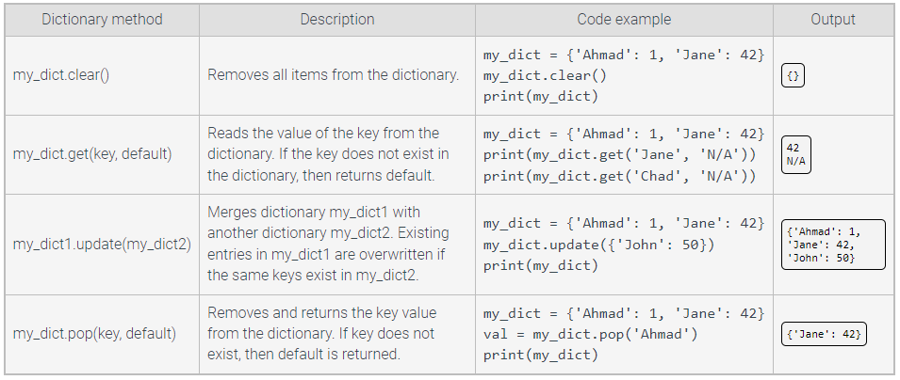
Dictionaries

Slide 10
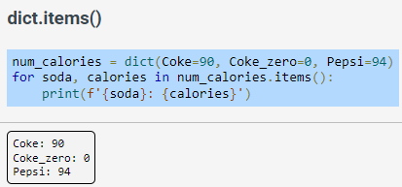
Dictionaries
dict.items() – returns a view object that yields (key, value) tuples.

Slide 11
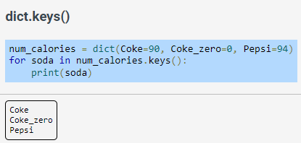
Dictionaries
dict.keys() – returns a view object that yields dictionary keys.

Slide 12
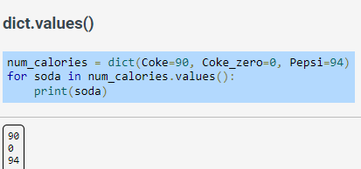
Dictionaries
dict.values() – returns a view object that yields dictionary values.

Slide 13

In Class Activities
What is printed?
countriesPhoneCode = {'USA': 1, 'BR': 55, 'CA': 1}
keys = countriesPhoneCode.keys()
print(keys)
for k in keys:
print(k)

Slide 14


In Class Activities
What is printed?
countriesPhoneCode = {'USA': 1, 'BR': 55, 'CA': 1}
values = countriesPhoneCode.values()
print(values)
for v in values:
print(v)

Slide 15


In Class Activities
What is printed?
countriesPhoneCode = {'USA': 1, 'BR': 55, 'CA': 1}
items = countriesPhoneCode.items()
print(items)
for index, elem in enumerate(items):
print(elem)

Slide 16
Understanding Nested Dictionaries
contact = {
'Ann':
{
'Phone': ['900-000-001','900-000-002'],
'Address': '200 W Street'
},
'John':
{
'Phone': ['800-025-631'],
'Address': '3 S Ave'
},
}
What are the keys?
What are the values?

Slide 17
Understanding Nested Dictionaries
contact = {
'Ann':
{
'Phone': ['900-000-001','900-000-002'],
'Address': '200 W Street'
},
'John':
{
'Phone': ['800-025-631'],
'Address': '3 S Ave'
},
}
user_input = input('Enter name: ')
while user_input != 'exit’:
if user_input in contact:
# Get values from nested dict
phones = contact[user_input]['Phone']
address = contact[user_input]['Address’]
#phone is a list
for i, p in enumerate(phones):
print(f'{i}: {p}’)
print(address)
user_input = input('Enter name: ')

Slide 18
Another Option: Nested Dictionaries
informationAnn = {
'Phone': ['900-000-001','900-000-002'],
'Address': '200 W Street'
}
informationJohn ={
'Phone': ['800-025-631'],
'Address': '3 S Ave'
}
contact = {
'Ann': informationAnn,
'John': informationJohn
}
user_input = input('Enter name: ')
while user_input != 'exit’:
if user_input in contact:
# Get values from nested dict
phones = contact[user_input]['Phone']
address = contact[user_input]['Address’]
#phone is a list
for i, p in enumerate(phones):
print(f'{i}: {p}’)
print(address)
user_input = input('Enter name: ')

Slide 19
Coding Along
Considering the two lists below, create a dictionary where each element in the key list is a key into the dictionary and each element in values is a value to the respective key.
The result dictionary should be: {'Ten': 10, 'Twenty': 20, 'Thirty': 30}
keys = ['Ten', 'Twenty', 'Thirty']
values = [10, 20, 30]

Slide 20
Pair Coding Activity
Write a function that receives a dictionary and print its keys.
Write a function that receives a dictionary and print its values.
Test both functions.

