Slide 1
CS 152: Recursion
CS 152: Python for STEM
Colorado State University
Computer Science Department
Slides Originally Created by Albert Lionelle and Updated by Marcia Moraes

Slide 2
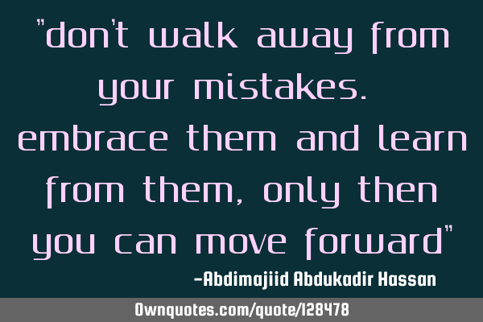
Weekly Announcements!
TODO Reminders:
Reading 14 (zybooks) – you should have already done that ☺
Lab 09
Reading 15 (zybooks) – you should have already done that ☺
Lab 10
Reading 16 (zybooks)

Slide 3

Recall Activity
Write a Python dictionary to represent products and prices.
Use your creativity to build that dictionary ☺.
Turn in your writing to the TAs or myself at the end of the class.

Slide 4
Factorial Function
def factorial(num):
if(num == 0 or num == 1):
return 1
fact = num
for i in range(num-1, 1, -1):
fact = fact * i
return fact
print(factorial(4))
print(factorial(0))
What is the original formula?
0! = 1
1! = 1
num! = num * num-1!
Recursion!
Function calling itself until reach a base case

Slide 5
Recursion
0! = 1
1! = 1
num! = num * num-1!
Always have a base case
No recursive call
Recursive call
Need to change the parameter so it will reach the base case and stop calling the function recursively
def factorial(num):
if(num == 0 or num == 1):
return 1
fact = num
for i in range(num-1, 1, -1):
fact = fact * i
return fact
print(factorial(4))
print(factorial(0))
What is the base case?
if(num == 0 or num == 1):
return 1
What is the recursive call?
return num * factorialRecursive(num-1)

Slide 6
Factorial – Two Versions
def factorial(num):
if(num == 0 or num == 1):
return 1
fact = num
for i in range(num-1, 1, -1):
fact = fact * i
return fact
print(factorial(4))
print(factorial(0))
def factorialRecursive(num):
if(num == 0 or num == 1):
return 1
return num * factorialRecursive(num-1)
print(factorialRecursive(4))
print(factorialRecursive(0))

Slide 7
Factorial – Recursive Version
def factorialRecursive(num):
if(num == 0 or num == 1):
return 1
return num * factorialRecursive(num-1)
print(factorialRecursive(3))
factorialRecursive(3)
return 3 * 2
factorialRecursive(2)
return 2 * 1
factorialRecursive(1)
return 1

Slide 8
Coding Along
Write a Python recursive function that reverse a string.
Thinking process
Get the last element in the string, use index -1
Call the method again, now passing a string that does not have the last element
Stop calling the function recursively when the string is empty
How do you know if a string is empty?

Slide 9
Pair Coding
Write a Python recursive function that sum the elements in a list.
Tip:
You need to go through the entire list.
How do you know when you reach the end of a list?
Base case: when you reach the end of the list – what should you return?
How many parameters your method should receive?
Recursive case: remember that you need to change the parameter so it will reach the base case

