Slide 1
CS 152: Function Parameters
CS 152: Python for STEM
Colorado State University
Computer Science Department
Slides Originally Created by Albert Lionelle and Updated by Marcia Moraes

Slide 2

Weekly Announcements!
TODO Reminders:
Reading 14 (zybooks) – you should have already done that ☺
Lab 09
Reading 15 (zybooks) – you should have already done that ☺
Lab 10
Reading 16 (zybooks) – you should have already done that ☺

Slide 3

Recall Activity
Write the function calls for the following code:
def reverseStr(str):
if(len(str) == 0):
return ''
return str[-1] + reverseStr(str[:-1])
str = “abc”
print(reverseStr(str))
Turn in your recall activity
at the end of the class ☺

Slide 4

Keyword Arguments
Functions that have many arguments could be difficult to read
Keyword arguments allow arguments to map to parameters by name, instead of implicitly by position in the argument list.
When using keyword arguments, the argument list does not need to follow a specific ordering.
Keyword arguments can be mixed with positional arguments, provided that the keyword arguments come last.

Slide 5
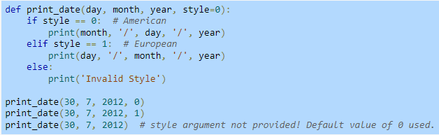
Default Parameters Value
Function can have a default parameter value for one or more parameters
meaning that a function call can optionally omit an argument, and the default parameter value will be substituted for the corresponding omitted argument.

Slide 6
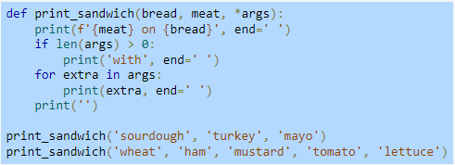
Arbitrary Arguments
A function definition can include a *args parameter that collects optional positional parameters into an arbitrary argument list tuple.

Slide 7
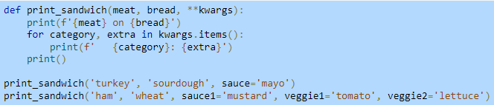
Arbitrary Arguments
Adding a final function parameter of **kwargs creates a dictionary containing "extra" arguments not defined in the function definition
kwargs is short for keyword arguments.

Slide 8
Coding Along
Download the file.csv
Download the file_list_list.py
We will go through the code so you can understand what is happening and think about the output before you run the program.

