Slide 1
CS 152: For
CS 152: Python for STEM
Colorado State University
Computer Science Department
Slides Originally Created by Albert Lionelle and Updated by Marcia Moraes

Slide 2

Weekly Announcements!
TODO Reminders:
Reading 9 (zybooks) – you should have already done that ☺
Lab 06
Reading 10 (zybooks)
Lab 07
Reading 11 (zybooks)

Slide 3
Recall Activity - Attendance
What is the difference between a for loop and a while loop? Explain using your own words.
Turn you paper to the TAs or myself at the end of the class

Slide 4
For
Interacting through all elements in a list
list = [2,7,12,9,22,44,33]
count = 0
for elem in list:
if elem%2 == 0:
count += 1
print(list)
print("Total of even numbers:", count)

Slide 5
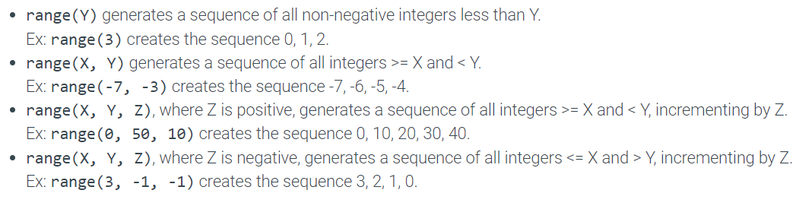
For – range function

Slide 6
For – range function
list = [2,7,12,9,22,44,33]
count = 0
for elem in list:
if elem%2 == 0:
count += 1
print(list)
print("Total of even numbers:", count)
list = [2,7,12,9,22,44,33]
count = 0
for i in range(len(list)):
if list[i]%2 == 0:
count += 1
print(list)
print("Total of even numbers:", count)

Slide 7
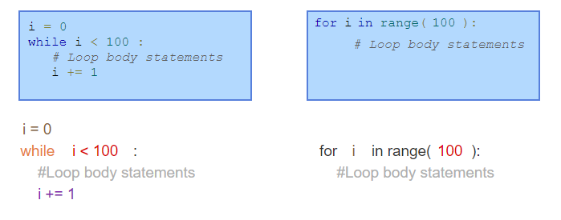
While and For

Slide 8

Nested Loop
for i in range(4):
for j in range(i):
print('*', end='')
print('')

Slide 9
Break and Continue
for i in range(10):
if(i % 2 == 0):
continue
if(i == 5):
break
print(i)

Slide 10
Coding Along
Write a Python function that receives a list and a value as a parameter and returns the number of times that the value is in the list.
Write a Python function that receives a list as a parameter and returns a new list containing only the elements that are not repeated in the parameter. For example, if list is [1, 2, 1, 10, 3, 4, 3] the function will return the following list [2, 10, 4].

Slide 11
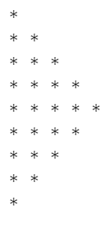
Coding Activity
Write a Python function that receives a list and returns a list containing only the even numbers.
Write a Python function to find those numbers which are divisible by 7 and multiple of 5, between 1500 and 1700(both included) and return a list containing those numbers.
Write a Python function to write the following pattern:

