Slide 1
CS 152: Functions
CS 152: Python for STEM
Colorado State University
Computer Science Department
Slides Originally Created by Albert Lionelle and Updated by Marcia Moraes

Slide 2

Weekly Announcements!
TODO Reminders:
Reading 3 (zyBooks) – you already should have done that for today’s class ☺
Lab 01 – Warm Up
Reading 4 (zyBooks)
Lab 02 - Application
Reading 5 (zyBooks)

Slide 3
Remembering - Coding from Last Class
Dr. Green is looking for a bank that will give the most return on her money over the next 5 years. She has P100,000.00 into a savings account. The standard equation to calculate principal plus interest at the end of a period is:
amount = P * (1 + I/M) ^ (N * M)
Where:
P – principal (amount of money to invest)
I – interest (percentage rate the bank pays to the investor)
N – number of years (time for which the principal is invested)
M – compound interval (the number of times per year the interest is calculated and added to the principal)
Think about what problem do you need to solve, how you are doing to solve it (write in English the steps to do that), write a Python code to solve that.
Notes:
Last lecture we ended by having you to code the following problem. Dr. Green is looking for a bank that will give the most return on her money over the next 5 years. She has a hundred thousand into a savings account. The standard equation to calculate principal plus interest at the end of a period is as shown in the slide. Where P is the principal amount of money to invest. I is the interest, percentage rate the bank pays to the investor. N is the number of years for which the principal is invested. And M is the compound interval, meaning the number of times per year the interest is calculated and added to the principal.
First let’s think about our input variables, these would be P, I, N and M. Our output variable will be amount and the output variable is calculated by the equation provided. One way to solve this problem is the following: we know the amount of money that Dr. Green has to invest, so we know P. We also know the number of years that she would like to invest her money, that is N. So the first thing we could do into our program is to assign the values to the these variables. After that we need to read the values of the remainder input variables, calculate the output, and print the output.

Slide 4
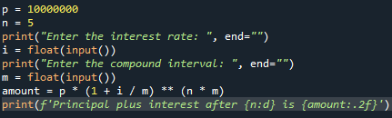
One Possible Solution
What happen if we want to repeat this code to calculate the principal plus interest for another bank? Or for 10, 100 banks?
Code should be Reusable
Code should be DRY
Don’t Repeat Yourself
Functions
Notes:
One possible solution for what we just discuss in the previous slide is this one.
Our first and second print function have two parameters. The first parameter is the message and we know that because we have a sequence of strings between quotes. The second parameter is telling us that instead of going to the next line after printing the message, the end of the print statement will be a space, meaning that the cursor will stay in the same line as the message we just printed.
As we learned from last lecture, the input function reads a string and we need to cast or transform that string to another data type sometimes. That is what we are doing when we read the I and M variables, we are reading the input and transforming it to a float number. We need to do that in order to use these variables in the equation that calculates the amount.
After that we are calculating the amount and using the f-print, the first placeholder will print the n value which is a int, that is why we have the d. The second placeholder will print amount value and we are only printing 2 numbers after the decimal point that is what .2f mean.
Now that we understand this solution, what do we need to do in order to be able to run this program to calculate the principal and inters for another bank? Or other several banks?
We should be able to reuse the code, meaning that we are not copying and pasting the same code several times, our code should be DRY, meaning D’ont Repeat Yourself. The way to do that is by building functions.

Slide 5

Reusable Code
Programming == Problem Solving
You look at the problem to solve
Clarify the problem and constraints
Break it up into *smaller* parts (Divide)
Outline the steps needed
Solve each step (Conquer)
Reassemble the pieces (Glue)
Completed program
Divide
Conquer
Conquer
Conquer
Glue
Notes:
In order to build a program we need to be able to solve the problem by clarifying the problem and its constraints, break it into smaller parts. Solve each one of these smaller parts and after that make these parts work together. That is what we call divide, conquer and glue concept.

Slide 6
Function – Part 1
def
defines the start of a function
indents keep the ‘code’ with the function
spacing matters!
parameters
allows for variables to the functions
print(value)
function name print
value is a parameter!
What should be the parameters for our code? Why?
Which commands are part of the function? Why?
Notes:
To create a function we need to use the def reserved keyword.
So we start our function with the def keyword followed by the name of the function, open and close parenthesis and : at the end. We hit enter and we need to ident to tell Python that the code is part of the function. Spacing matters!
Between the parenthesis we could have a list of parameters separated by a comma. A parameter is a value that is needed by the function so the function could work properly.
We have being using functions already. The print is a function that has parameters. In print(value), the function name is print and it has only one parameter which is value. In our program example, we are using the function print with two parameters, the first parameter is a string and the second parameter is changing the end of the print statement.
Lets go back to our example, what should be the parameters for our code? Why?
Which commands are part of the function? Why?

Slide 7

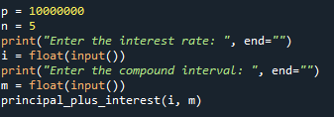
Function – Part 2
How are we going to call the function we just created?
Could we improve this code a little bit more? How about p and n variables?
Notes:
One possible solution will consider two parameters for our function, i and m. And the function will contain the calculation of the output variable and the print of that variable. As we mentioned before, the code that is part of the function needs to be indented.
So we have the function, how are we going to call the function we just created?
We call the function by its name and send the necessary parameters, with in our case are two, i and m. It is important to notice that this function does not have a return because the amount is being printed inside of the function.
Could we improve this function a little bit more? How about p and n variables? Let’s think that we would like the program to work for any kind of principal and number of years.

Slide 8
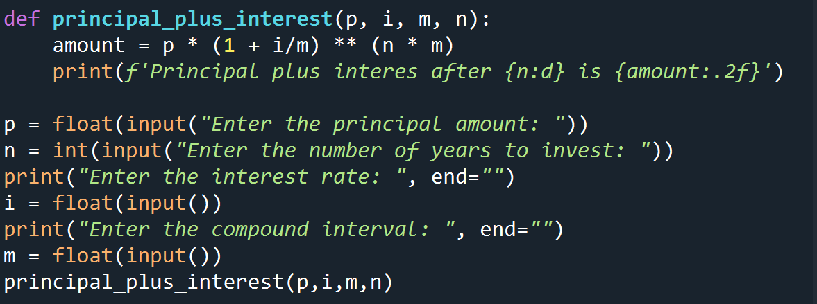
Function – Part 3
Notes:
This is one possible solution, not that our function now has 4 parameters, so when we call the function we need to send these 4 parameters in the correct order.
The function still prints the output variable.
What should we do if instead of printing the output variable inside of the function we would like to print it outside?
We need to be able to return the variable that was just calculated.
And that is what we will see in the next slide.

Slide 9
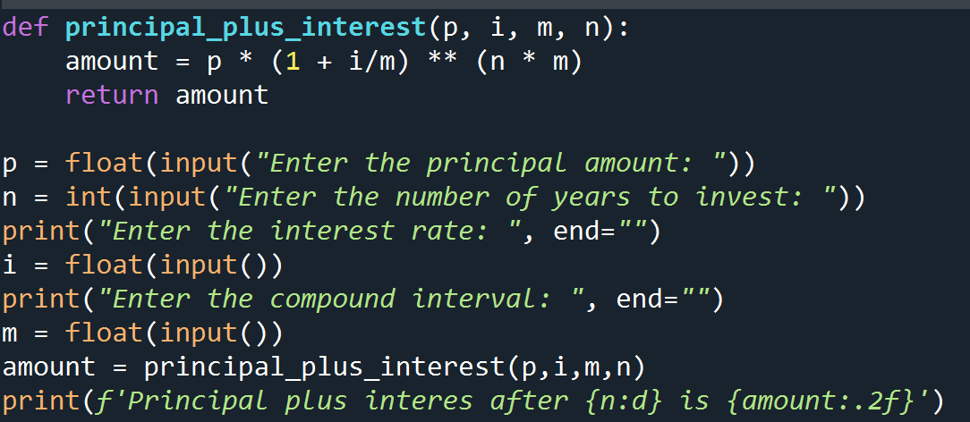
Return Values
Functions do some work
and then return the answer of that work
Other programs can then use those answers
Always the best paradigm to follow
Function principal_plus_interest is returning the value that was calculated
We need to store the variable that is returned when we call the function, in order to be able to use it
Notes:
The best paradigm to follow is the one that the functions do some specific work and then return the answer of that work. So other programs can use those answers.
In our example, instead of printing the amount inside of the function the function is returning the amount calculated.
Since the function now returns a value, when we call the function we need to be able to store that value to use it later.

Slide 10
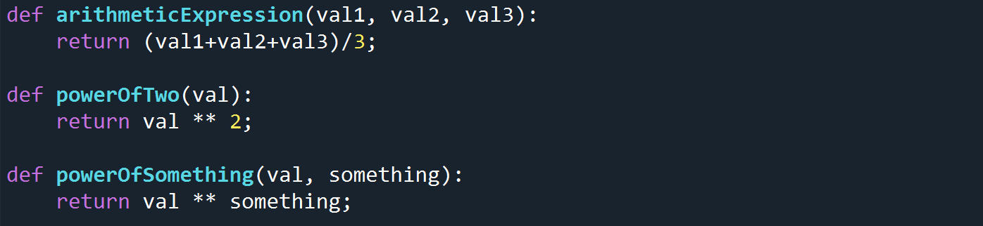
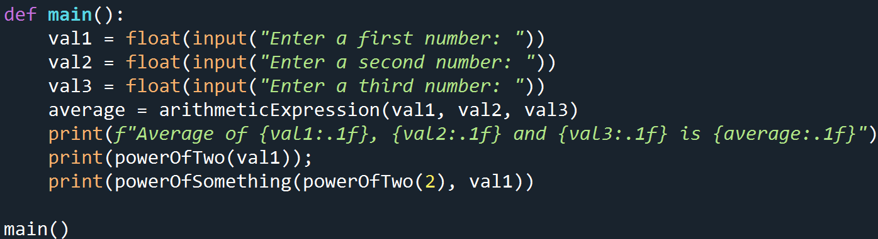
Return Values – More Examples
Lets analyze the program below:
Notes:
We have four functions in this program, arithmeticExpression, powerOfTwo, powerOfSomething and main. Outside of all functions we have a call to the main function, which is the one responsible for reading the input variables and calling the other functions.
The arithmeticExpression, powerOfTwo, and powerOfSomething return values. So in order to call them inside of the main function, we need to either have a variable that stores the returned value or we need to call the function inside of the print function, so the returned value is going to be printed.
Python interpreter will start reading the file top to bottom. He will identify each function by its name and parameters, when it reaches the last line of the program it will call the main function. The first three instructions in main are input from the terminal. After the inputs are done, the arithmeticExpression function is being called by passing three parameters (which is the number of parameters that the function is expecting to receive) and the returned valued is being stored in the average variable.
After that an output message is printed, it is printed only one decimal number after the point.
Then the print function is being used again, and its parameter is a call to powerOfTwo function which has a parameter itself. The returned value of the powerOfTwo function will be used as the parameter to be printed.
The last print is calling the powerOfSomething function. That function has two parameters. In our example, the first one is the powerOfTwo function with number 2 as its parameter, the second parameter of powerOfSometing is val1. The order of the execution is, first powerOfTwo is called, its result is then used as the first parameter for powerOfSomething, then powerOfSomething is called and its result is going to be printed.
Watch the video that shows a step-by-step execution of this program in the Python tutor webpage.

Slide 11
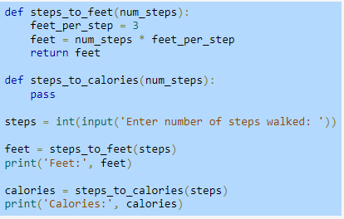
Incremental Development and Function Stubs
What is incremental development?
What is function stubs?
What does the pass keyword mean? When is it used?
Notes:
Programs are typically written using incremental development, meaning a small amount of code is written and tested, then a small amount more (an incremental amount) is written and tested, and so on.
To assist with the incremental development process, programmers commonly introduce function stubs, which are function definitions whose statements haven't been written yet.
pass keyword, which performs no operation except to act as a placeholder for a required statement.

Slide 12
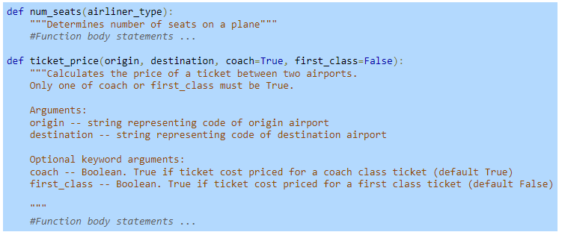
Docstring and help function
What is a docstring?
What is a help function? How would you use it in the example below?
Notes:
A docstring is a string literal placed in the first line of a function body.
The help() function can aid a programmer by providing them with all the documentation associated with an object. A statement such as help(ticket_price) would print out the docstring for the ticket_price() function, providing the programmer with information about how to call that function.

Slide 13
Student Challenge
Write two functions
The first function takes in two parameters – first, last
It prints the ”welcome to the class (last), (first)”
The second function
Calls input to ask the client their first name
It calls input a second time to ask them their last name
it calls your first function to print out the result
Use the Python Tutor editor (https://pythontutor.com/visualize.html#mode=edit) to see a step-by-step execution of your program.

