Slide 1
CS 152: More Lists
CS 152: Python for STEM
Colorado State University
Computer Science Department
Slides Originally Created by Albert Lionelle and Updated by Marcia Moraes

Slide 2

Weekly Announcements!
TODO Reminders:
Reading 12 (zybooks) – you should have already done that ☺
Lab 08
Reading 13 (zybooks) ) – you should have already done that ☺
Lab 08
Coding Exam 2
Exam2

Slide 3
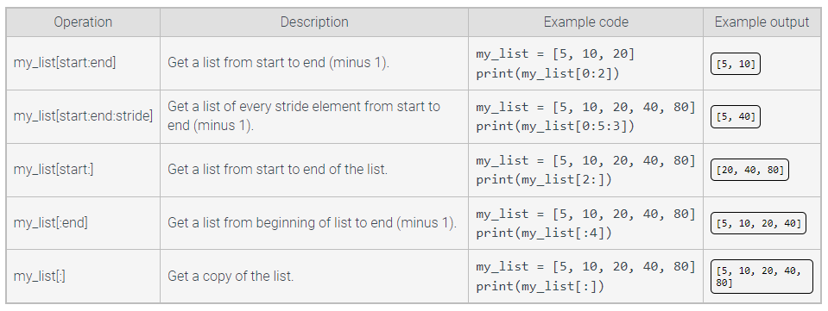
List Slicing

Slide 4
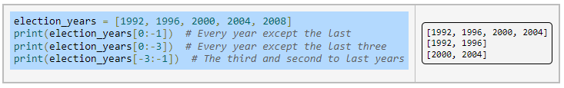
List Slicing
A position of -1 refers to the last element of the list

Slide 5


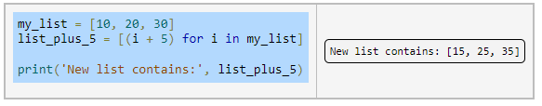
Modifying List During Interaction
List comprehension

Slide 6

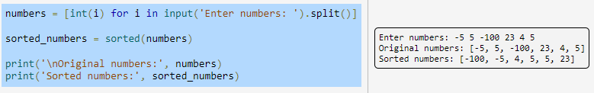
Sorting List
Function sort() – sort the own list
Function sorted() – creates a new sorted list

Slide 7
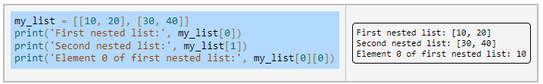
Multidimensional Lists
List nesting

Slide 8
Reading Values for a Two-Dimensional List
def readingTwoDimensionalList():
matrix = [[0,0],[0,0]]
for i in range(2):
for j in range(2):
print(f'Enter a number for [{i}][{j}]:')
matrix[i][j] = int(input())
return matrix

Slide 9
Writing Values for a Two-Dimensional List
def printTwoDimensionalList(matrix):
for i in range(2):
for j in range(2):
print(f'{matrix[i][j]} ', end='')
print()

Slide 10
Printing a Multidimensional List
def printTableFormat(multiList):
for row_index, row in enumerate(multiList):
for column_index, item in enumerate(row):
print(f'{item:<8.2f} ', end='')
print()
multiList = [[10.5, 4.1, 3.3], [2.6, 4], [10, 20, 30]]
printTableFormat(multiList)

Slide 11
Coding Activity
With a Peer:
Write a Python function that receives a multidimensional list and prints the sum of each row and the total sum of the multidimensional list.
Write a Python function that returns the principal diagonal of a square matrix.
Write a Python function that returns the max element of the principal diagonal of a square matrix.
Write a Python function that receives a multidimensional list as a parameter and returns a list containing only the even number.

