Slide 1
CS 152: More Functions
CS 152: Python for STEM
Colorado State University
Computer Science Department
Slides Originally Created by Albert Lionelle and Updated by Marcia Moraes

Slide 2
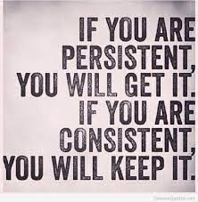
Weekly Announcements!
TODO Reminders:
Reading 12 (zybooks) – you should have already done that ☺
Lab 08
Reading 13 (zybooks)
Coding Exam 2
Exam2

Slide 3
Recall Activity
What is the difference between local variables and global variables? Explain with your own words.
Have this written in a paper, you will turn in at the end of the class.

Slide 4
Scope of Variables
def numberGenerator(start, end, step):
lst = []
while start < end:
lst.append(start)
start += step
return lst
start = int(input("Enter start value:"))
end = int(input("Enter end value:"))
step = int(input("Enter step value:"))
print(numberGenerator(start, end, step))
Local variables – declared inside of a function – exist while the function is being executed
Global variables – declared outside of a function

Slide 5
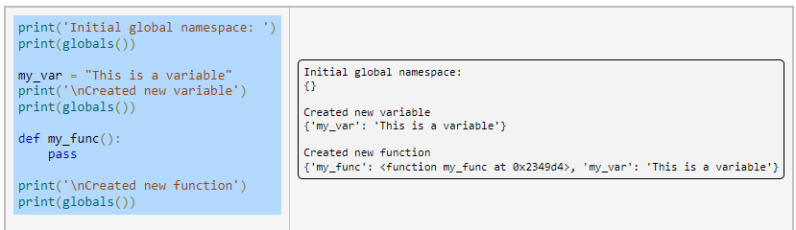
Namespaces
A namespace maps names to objects

Slide 6
Scope Resolution
There are at least three nested scopes that are active at any point in a program's execution:
Built-in scope: contains all of the built-in names of Python, such as int(), str(), list(), range(), etc.
Global scope: contains all globally defined names outside of any functions.
Local scope: Usually refers to scope within the currently executing function, but is the same as global scope if no function is executing.
When a name is referenced in code, the local scope's namespace is the first checked, followed by the global scope, and finally the built-in scope.

Slide 7
Multiple Function Outputs
Occasionally a function should produce multiple output values.
However, function return statements are limited to returning only one value.
A workaround is to package the multiple outputs into a single container, commonly a tuple, and to then return that container.

Slide 8
Multiple Function Outputs
def numberGeneratorAndSum(start, end, step):
lst = []
sumLst = 0
while start < end:
lst.append(start)
start += step
sumLst += start
return lst,sumLst
start = int(input("Enter start value:"))
end = int(input("Enter end value:"))
step = int(input("Enter step value:"))
lst, sumLst = numberGeneratorAndSum(start, end, step)
print(lst)
print(sumLst)
Returning a tuple, could be
also represented as (lst,sumLst)

Slide 9
Coding Activity
With a Peer:
Write a Python function that receives two lists as a parameter and generates and returns other two lists. Remember that you need to return a tuple containing the lists.
One of the lists to be returned contains the sum of the elements in the same index for the lists that were passed as a parameter
The other list to be returned contains the multiplication of the elements in the same index for the lists that were passed as a parameter
You need to check the size of both lists passed as a parameter and you will consider the size of the shorter list to build the two new lists
Think about why do you need to do that…

Slide 10
Coding Activity
With a Peer:
Write a Python function that receives a list as a parameter and calculates and returns the number of positive, negative, and zeros in that list. Remember that in order to return more that one value, you need to return a tuple.
Write a Python function that receives a list as a parameter and generates and return two lists, one containing the even values and the other containing the odd values from the original list. Remember that in order to return more that one value, you need to return a tuple.

