Slide 1
Loops

Slide 2
Announcements
Opening Question
Can you think of a repetitive task? Is there a way to use tech to make that task easier?
Practical 1 - work on it right away!
Only three files have errors (rest are read only)
Debugging is hard!
Especially if you wait until all the code is written…
Next week:
Monday Lecture – help on debugging / coding follow along
Coding exam – Tuesday in Lab
Wednesday Lecture - review session
Canvas exam – Thursday in Lab
Friday Lecture – Cancelled (take time to catch up)
ACM-W Diversity in Computing Dinner
When: Thursday September 16th at 5:30pm
Where: LSC room 382
RSVP: https://forms.gle/LdDiVAPaui5Ctgw38

Slide 3
What are computers good at?
Computers are good at three things
Calculations
Formal logic
Repeating what you just asked it to do (iteration) - Loops
Coincidently
Three things humans tend to struggle with
If you understand
Calculations
Formal Logic
And Loops
You will be able to accomplish impressive programs

Slide 4
Loop Types in Java (and most langs)
While Loops
For Loops
For:each loops (we will cover this later)
Do While loops (we will cover this later)
All loops have
An iterator - a way to cycle through the values you want to look at
A condition to exit (else, your computer blows up - it happens to everyone)

Slide 5
Reading Check In
public static void complexFor(int lines) { String count_up = ""; String count_down = ""; for(int i=0,j = lines; i < lines; i++, j--) { count_up = count_up + i; count_down = count_down + j; } System.out.println(count_down); } public static void main(String[] args) { complexFor(7); }
7654321

Slide 6
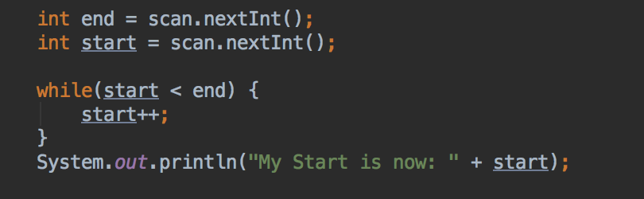
While Loop
Good when:
Your “iteration” variable is created outside the loop
You need your iterator variable outside of the loop
while(TRUE-CONDITION) {/*block of code to execute*/}

Slide 7
While Loop
Lets assume:
end = 3;
start = 1;
end
start
3
1
while(1 < 3){
start++;
}
2
while(2 < 3){
start++;
}
3
while(3 < 3) – out of while
System.out.println(“My Start is now: ”+ start);

Slide 8
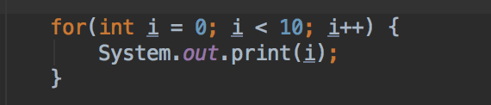
For Loop
Good when:
Your loop has a set start and end
You don’t need to keep your iterator outside the loop
for(variables; condition; iterator) { /* block of code to execute*/ }

Slide 9
For Loop
How the for works:
control variable is initialized
test condition
2.1. if test if true:
execute what is in {}
increment control variable and
go to step 2 again
2.2. if test if false, exit for
What is the program output?
0123456789
What do we need to change to have each number in a different line?
System.out.println(i);
What do we need to change to print the numbers in the reverse order?
for(int i = 9; i >=0; i--)

Slide 10
Activity
Write the following as a for loop
public static void simpleLoop(int total) { int i = 1; while(i <= total) { System.out.print(i + ","); i = i + 1; } }

Slide 11
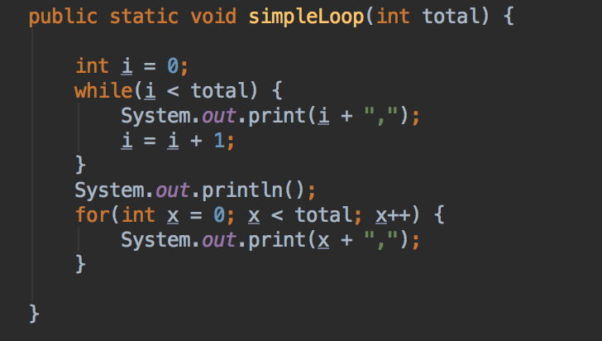
While/For Mostly Interchangeable
Let total = 10
0,1,2,3,4,5,6,7,8,9,

Slide 12

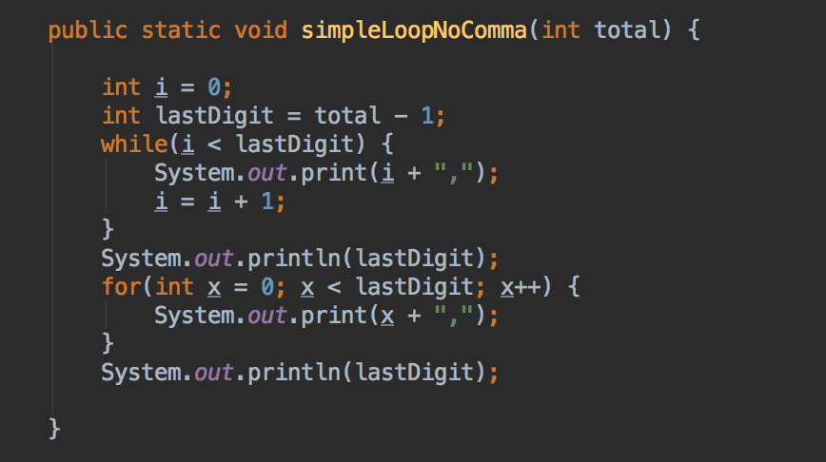
Trailing Comma?
What if I wanted to write same simple loop, but
NO trailing comma?
Let’s face it, that looks bad and probably isn’t what we want

Slide 13
Code Along: loopChallenge
Write a program that reads 5 pairs (value1, value2) of int values. For each pair print the smaller value. If the values are equal, print "equals" and the number.
What do we need to change in our code if instead of 5 we want 100 pairs?
What do we need to change in our code if instead of a predefined number we would like to ask for the total number of pairs to read?
public class InclassExample { Scanner scanner = new Scanner(System.in); // instance! public void loopChallenge(){ // TODO } public int getInput() { System.out.println("I need a number? "); return scanner.nextInt(); } public static void main(String[] args) { InclassExample example = new InclassExample(); example.loopChallenge(); // because I need scanner! } }
You can assume getInput
Only focus on the TODO

