Slide 1
Abstract Classes and Interfaces

Slide 2

Announcements
TODO Reminders:
Readings are due before lecture
Reading 23 (zybooks) – you should have already done that ☺
Lab 15
Reading 24 (zyBooks) – you should have already done that ☺
Practical Project Lecture
RPA 11
Keep practicing your RPAs in a spaced and mixed manner ☺
Help Desk
Day | Time : Room
Monday | 12 PM - 2 PM : CSB 120
Tuesday | 6 PM - 8 PM : Teams
Wednesday | 3 PM - 5 PM : CSB 120
Thursday | 6 PM - 8 PM : Teams
Friday | 3 PM - 5 PM : CSB 120
Saturday | 12 PM - 4 PM : Teams
Sunday | 12 PM - 4 PM : Teams
NEXT WEEK – Exam 3 Week
Catch up, if you need!

Slide 3
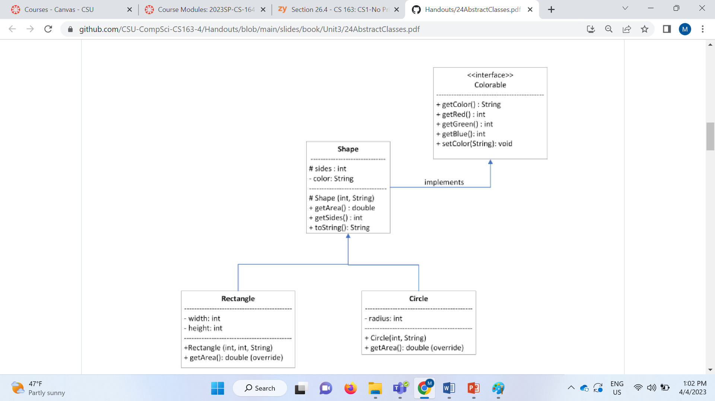
Recall Activity
Define the following elements:
Interface
Methods that are overwritten
Superclasses and Subclasses
Does getArea() really make sense for Shape?

Slide 4

Inheritance
Creates an is-a relationship between classes
Allows fully implemented 'more generalized' classes as the super classes
specialized subclasses as the subclasses inherits instance variables and methods from the super class
Uses the key word extends
can only extend / inherited from one immediate parent (but can have 'chain' of parents)

Slide 5
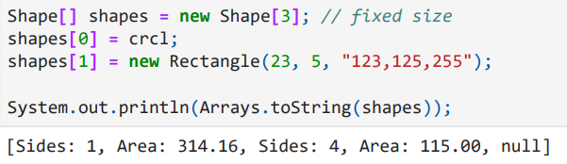
Polymorphism
Allows the subclass to be declared as the super
actually a subclass can 'substitute' in for the super
Extremely useful for things like Arrays and ArrayLists

Slide 6
Abstract Class
What if a method you write, needs specific information?
Unique to subtypes / children
BUT – the rest of the method is general
Enter Abstract classes
Classes that are not *complete* by themselves
Contain partial implementations of a class
With other methods that are *required* to be completed by children.
Class is abstract, some methods are abstract
Can’t be instantiated
but can have constructors the children can inherit

Slide 7
Abstract Example
public abstract class AbstractJob { protected String name; protected ArrayList<String> inventory; private int armor; private int attack; public abstract double getJobModifier();
// unique to sub classes
public double getArmor() { return armor * getJobModifier(); }
public AbstractJob(String name) { this.name = name;
this.armor = 1;
this.attack = 1;
inventory = new ArrayList<>(); } }
public class Paladin extends AbstractJob { private double modifier = 1.6; @Override public double getJobModifier() { return modifier; }
public Paladin(String name) { super(name); } }
Child
public static void main(String[] args) { Paladin cecil = new Paladin("Cecil"); System.out.println(cecil.getArmor()); }
Parent

Slide 8
Abstract Class Practice
<<abstract>> Teacher
- id:int
-subject:String
-totalHoursWeek: int
+Teacher()
+Teacher(subject:String, hours:int)
+getSubject(): String
+setSubject(subject: String)
+getId(): int
+getTotalHoursWeek():int
+getSalary(): double
+toString():String
Considering that we can only have FullTimeTeachers and PartTimeTeachers
Teacher as an abstract class.
Is there any abstract methods in Teacher?
FullTimeTeacher
PartTimeTeacher
-salary: double
+FullTimeTeacher()
+FullTimeTeacher(subject:String, hours: int, salary:double)
+getSalary(): double
+setSalary(salary: double)
+toString():String
-hourSalary: double
+PartTimeTeacher()
+PartTimeTeacher(subject:String, hours: int, hourSalary:double)
+getHourSalary(): double
+setHourSalary(salary: double)
+getSalary(): double
+toString():String

Slide 9
Interfaces
Inheritance Limitation: Can only inherit one class directly
meaning, there can be a chain of classes
What if we wanted to ‘inherited’ from more than one class?
Enter interfaces
contracts that define what methods will be implemented
contains no implementation – just definitions
uses implements in the class to say class is following the contract
Common Interface
Comparable (specification)
implementing it – allows objects to be sorted in ArrayList!
compareTo is the method

Slide 10
Interface example
public class Paladin extends AbstractJob implements MeleeType, HealerType { private double modifier = 1.6; @Override double getJobModifier() { return modifier; } @Override public double getCureModifier() { return 1.5; } @Override public double getMP() { return 10.5; } @Override public boolean hasSwordAttack() { return true; } @Override public int calcSwordDamage() { return (int)(100*getJobModifier()); } }
public interface HealerType { double getCureModifier(); double getMP(); }
public interface MeleeType { boolean hasSwordAttack(); int calcSwordDamage(); }

Slide 11
Interface Example in Java
Comparable
requires you implement .compareTo(T obj)
T is your object
Allows you to sort based on your own ideas!
public static void main(String[] args) { ArrayList<Paladin> list = new ArrayList<>();
list.add(new Paladin("Cecil"));
list.add(new Paladin("Caliban"));
Collections.sort(list); // puts Caliban before Cecil System.out.println(list); // Caliban, Cecil }
public class Paladin extends AbstractJob implements Comparable<Paladin> { private double modifier = 1.6; @Override public double getJobModifier() { return modifier; }
@Override public int compareTo(Paladin obj2) { return name.compareTo(obj2.name); }
public Paladin(String name) { super(name); } }
-1 if less than
0 if equal
1 if greater

Slide 12
Interface Practice
Implement a list of Countries that can be ordered by their area.
Need to implement interface Comparable and the method compareTo the areas.
<<interface>> Comparable<T>
Country
+compareTo(O : T): int
-name: String
-area: double
+Country(name:String, area:double)
+getName():String
+getArea():double
+equals(other: Country): boolean
+compareTo(other: Country): int
Download Abstract class and Interface – classes for this lecture

