Slide 1
Identifiers, Variables, Operators
Colorado State University
Computer Science Department
Slides Originally Created by Albert Lionelle (Albert.Lionelle@colostate.edu), updated by Marcia Moraes (marcia.moraes@colostate.edu)

Slide 2

Announcements
Reminder – readings are due before lecture
You don’t have to do all of it - challenge problems can be challenging…
You can return to them.
We start off lecture with a quiz from your reading!
Todo:
Busy Week! (readings + labs)
Lab projects start!
Remember: build a habit of doing a little every night!
Notes:
Do you have your iClicker Cloud setup?
Now is good time!

Slide 3
iClicker Cloud
Do you have it setup?
Let’s get going…

Slide 4
Recall Activity
Individually
Grab a paper and write at least three concepts that you can remember from your readings
With your neighbor(s)
Discuss what each other could remember. Did you remember the same things? What did you learn from each other?
Turn you paper to the TAs or myself at the end of the class, this will count as your participation activity for this lecture
Don’t forget to write your name as it is in our Canvas course!

Slide 5
Reading Check-in
Which of the following are considered primitives in Java?
int
double
String
char
System

Slide 6
Types
TYPE tells the computer how much room to save!
int
Whole numbers only
1, 2, 3, 1000
double
Floating point numbers
1.0, 2.5, 3.33333, 1000 (which is 1000.0)
char
Every character on a keyboard - stored as int
boolean
true or false
String
collection of ordered characters
It is more unique (Object)

Slide 7
Variables
Identifiers are WORDs
You use the to *hold* information
Cannot be a reserved word
Cannot start with numbers or special characters outside of underscore
Use real words! int x doesn’t mean much, but int puppyCounter - has meaning and readable!
Declaring Variables:
<TYPE> <IDENTIFIER>;
Can be declared in the same line
Declaring reserves or allocates memory! But doesn’t store!
int myInt;
double myDouble;
int x, y, z;
double dbl, dbl2, longerDoubleName;
String firstProgrammer;

Slide 8
Assigning / Storing Values
Single equals sign (=) assigns values
The value must match the type
Strongly typed language
You can change the value as much as you want
But it must still be the same type
Assigning the first time is called
Initialization
Often done in the same line as declaring
Objects have the null value if not assigned
String firstProgrammer;
firstProgrammer = "Countess Lovelace";
firstProgrammer = "Ada Lovelace"; // new value
int puppyCounter = 100; // initialization
int a = 5, b, c; // allowed, but not clear
double my_value = a; // allowed! makes it 5.0
int _int = 10.5; // won't compile!

Slide 9
Practice 1 – Group Reflection
In zyBooks has a in-class if you want to try it.
int A = 5;
int B = 2;
int C = 10;
A = B;
B = C;
----------------------------------------------------------------------------------------------
int A = 10;
int B = 20;
A = B;
B = A;
----------------------------------------------------------------------------------------------
????
What are the final values for A, B, and C?
What are the final values for A and B?
If we wanted to swap the values A and B, how would we modify the code above? Would we need to use a third variable?

Slide 10
Operators
Operators are MATH
= (assignment)
+ (add)
- (subtract or negative)
/ (divide)
* (multiply)
% (modulo) - remainder!
Numeric Types
int - always whole number
int myVal = 1 / 2; // evaluates to 0!
double - has decimals
double doubleVal = 1.0 / 2; // evaluates to 0.5!

Slide 11
Practice 2 – Group Reflection
int A, B, C;
A = 10;
A = A + 1;
B = A/2;
A = 6;
C = B + 1;
C = C + 2;
A = B/2;
What are the final values for A, B, and C?
What happens if A is double instead of int?
What happens if A and B are double instead of int?

Slide 12

Integer Division
int val = 5 / 6; // sets val to 0
int val2 = 10 / 3; // sets val2 to 3
You lose the decimal point
Truncates, does not round!
This is a very, very common thing
both to our advantage
and often to our error
This Photo by Unknown Author is licensed under CC BY-NC-ND

Slide 13
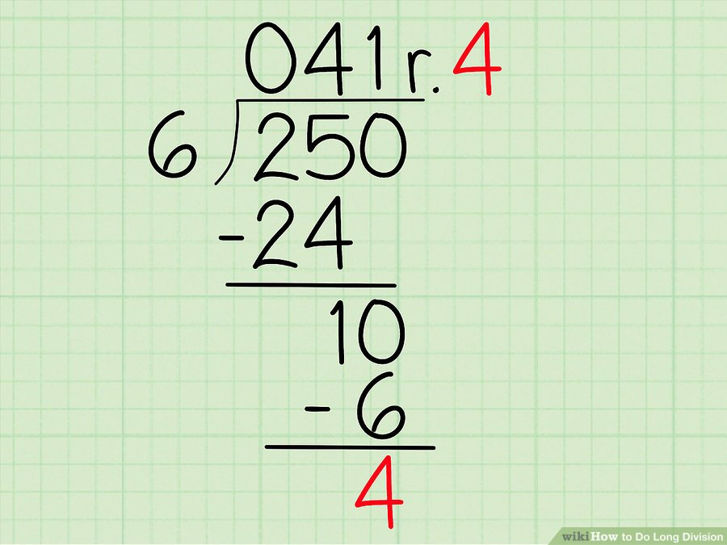
Modulo - Extremely useful operation
modulo (%) gives you the remainder
4th grade math!
This example: int x = 250 % 6; // would be 4 So combining them
int whole = 250 / 6; // 41
int remainder = 250 % 6; // 4

Slide 14
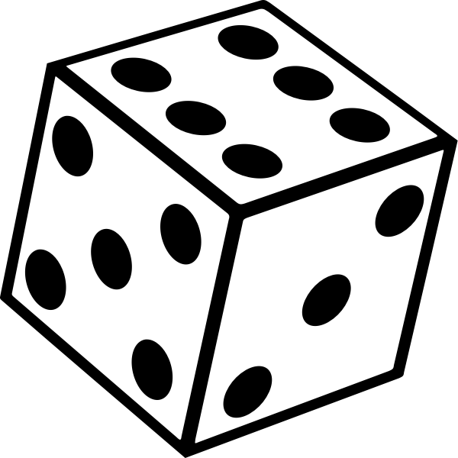
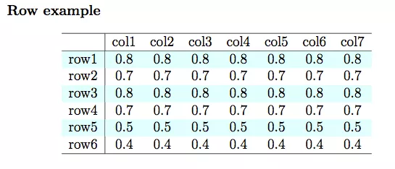
What are some cases to use it?
Forming groups
The remainder is always between 0 and n-1
Value % 6 has a range of 0-5
Value % 4 has a range of 0-3
Think about rolling dice
Math.random() % 6; - random number between 0 and 5
Determining Even and Odd - Math.random() %2 - if 0, even, if 1, odd
Pro Tip
Adding a remainder operator, allows us to handle complex math like GCD, and others.

Slide 15
Scanner
Read something from the console/terminal
First needs to create an object of the class Scanner
Scanner in = new Scanner(System.in);
Second needs to know the type of variable that wants to read – that will define the method you will use
int val = in.nextInt();
double valD = in.nextDouble();
String str = in.nextLine();

Slide 16
Activity : Seat Finder
Assigned Programmer (only one needed per table)
Go to zyBooks
Click In Class Activity: Seat Finder
Everyone else: Help that person code it
Make sure you all explain and know what is going on!
Before start programming think about:
What is the problem that you need to solve?
How you are going to solve it?
Write a possible solution in English
After that translate your solution to a sequence of instructions in Java

Slide 17
Convenience Operators
We often find ourselves doing things like
int value = 100;
value = value + 10;
Introducing operator plus assignment
value += 10; // same as value = value + 10;
+=
-=
/=
*=
%=
We also like to add and subtract by 1
--value and ++value
value++ and value—
Happens after using the value
int value = 100;
value++; // value is now 101
value += 10; // value is now 111
value /= 10; // value is now 11
value *= 2; // value is now 22
--value; // value is now 21
value %= 20; // value is now 1

Slide 18
Examples
int puppyCounter = 100; // so many puppies!
String puppyName = “Spot”;
String puppyLongName = “Cerberus”;
double amountOfFoodPerDayLbs = 20.56;
amountOfFoodPerDayLbs = amountOfFoodPerDayLbs + 10.0; // assigns 30.56 to the variable
boolean isPettable = true; // only options for boolean is true or false
char singleLetter = ‘c’; //characters are single letters, notice single quote
Advanced Concept: puppyCounter (and others) follow “camel case” a naming convention that capitalizes every word after the first - very common for java programs.

Slide 19
Practice 3 - Group Coding
Come up with other examples (write them down, white board, etc)
A single person goes to the zybooks IDE (note, we will alternate this person throughout the semester)
Write out examples
Do they compile? if not, what is wrong? fix it
Can you print out each of the variables?
Try to include a math operation that uses ints and doubles combined
What happens?

