Slide 1
Operating Systems and File Output

Slide 2
Announcements
Opening Question:
How are you coming on practical 3?
Make sure to review knowledge checks and spread out their use!
More on exams soon, but highest grades :
Students who attended classes had higher grades
Students who did readings before attending had even higher grades
Will be adding additional help sessions and times, watch announcements.
Tuesday/Thursday help desk – students who are asking for help on that day’s lab – have priority!
Correlation – don’t wait until Tuesday to ask questions on P3, those who are starting P4 will have priority!
Todo:
Practical 3 – finish it this week

Slide 3



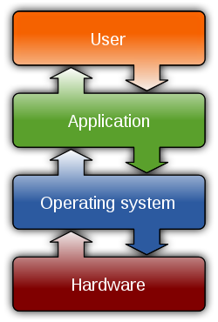




Operating Systems
You use them daily
Most common OS in the world?
Android
Written in Java w/ Kotlin
The control
Resources
Hardware Interaction
Devices
Running applications, memory, etc
Files!

Slide 4
File Systems
Root - c:/ or /
Program that helps manage files and other programs
Directory Structure
Relative
Based on current location
Absolute
Based on Root
Key “shortcuts”
. (yes dot) - current directory
.. (directory above)
Let’s look at an example
Directory - A
File
Directory - B
File
Directory - C
File
File
File
File

Slide 5
Try For Yourself
Open Terminal
Mac OS - type ⌘ + spacebar. Then type ‘terminal’
Windows OS - go to search bar, type wt (or cmd)
First, let’s see where you are at:
Mac OS - type pwd
Windows - type echo %cd%
This is your present working directory -> pwd should have given absolute path
List your files
Mac OS - type ls
Windows - type dir
Change directors
cd _directory you want to change to_ (For example) cd Desktop
cd Downloads
Try to list your files from within this directory, and see your present working directory.

Slide 6
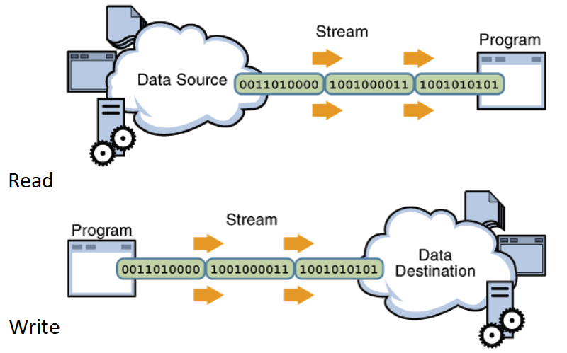
Files and Streams
To read we used:
Scanner in = new Scanner(new File("input.txt"));
To write we will use:
PrintWriter writer =
new PrintWriter(new File(“notes.txt”);

Slide 7
File Object in Java
Has a number of useful methods when dealing with Files
File myFile = new File(“filename”);
Creates or reads a file based on the path+filename given
Connects to the location which is a ‘stream of bytes’
For example
File myFile = new File(“output.txt”);
Creates a file in the same directory as that you are executing the java file from - so relative to your program
File myfile = new File(“/Users/lionelle/output.txt”);
Creates a file based on the absolute path that is Root -> Users -> lionelle (folder) -> output.txt
File myfile = new File(“../output.txt”);
What does this do?
To write, you need objects like BufferedWriter or PrintWriter
To read, you need objects like BufferedStreamReader or Scanner

Slide 8
Print Writer
PrintWriter is an object designed to write text to a File Stream
What Are Streams?
System.out - stream to the console
System.in - stream from the console
System.err - stream to the error log (often console)
File is also a Stream
PrintWriter uses the same interface as System.out but directs the stream
PrintWriter writer = new PrintWriter(new File(“notes.txt”));
writer.println(“#These are my notes”);
writer.print(“This is a note without the extra line”);
writer.print(“ this would append right after the one above”);
writer.close(); //we need to close the stream after writing in the file!

Slide 9
Group Coding
Write a method that receives a file name and generates 100 integer numbers from 0-100 and write each number into a text file. Each number should be in a different line.
What do you need to know?
Random Class
Random rand = new Random();
int numberInt = rand.nextInt(upperbound); //generates a random int number 0-upperbound
double numberDouble = rand.nextDouble(); //generates a random double number 0.0 – 1.0
PrintWriter and File Class
Printwriter = new PrintWriter(new File(“notes.txt”));
writer.println(“#These are my notes”);
writer.close(); //we need to close the stream after writing in the file!

