Slide 1
Loops

Slide 2
Announcements
February 2nd : ACM – Presentation: Tech Interviews
February 3rd : ACM-W – Career Fair Prep
NEXT WEEK
Monday: Lecture on github and IDEs
Tuesday: Setup IDE in lab and review
bring your laptop if you want help
Wednesday: Review Lecture
Send me questions to review by EOD Monday
Thursday: EXAM in lab
(most) Accommodations on Friday at help desk
Friday: No Class
Throughout the week
coding exam / one submission attempt assignment
Reminder – readings are due before lecture
You don’t have to do all of it - challenge problems can be challenging…
You can return to them.
We start off each lecture with a quiz from your reading!
Help Sessions
Go to them! They make a difference
Lab teams should be setup
If you are not on a private channel with your other lab mates, let us know
Tuesday lab – meant to be done by Thursday
Opening Question
Can you think of a repetitive task? Is there a way to use tech to make that task easier?

Slide 3
What are computers good at?
Computers are good at three things
Calculations
Formal logic
Repeating what you just asked it to do (iteration) - Loops
Coincidently
Three things humans tend to struggle with
If you understand
Calculations
Formal Logic
And Loops
You will be able to accomplish impressive programs

Slide 4
Loop Types in Java (and most langs)
While Loops
For Loops
For:each loops (we will cover this later)
Do While loops (we will cover this later)
All loops have
An iterator - a way to cycle through the values you want to look at
A condition to exit (else, your computer blows up - it happens to everyone)

Slide 5
Reading Check In
public static void loop(int max, int inc) { for(int i = 0; i < max; i+= inc) { System.out.println(i); } }
How many lines are printed, given the following call
loop(5, 1)
5
loop(9, 4)
3
loop(0, 3)
0

Slide 6
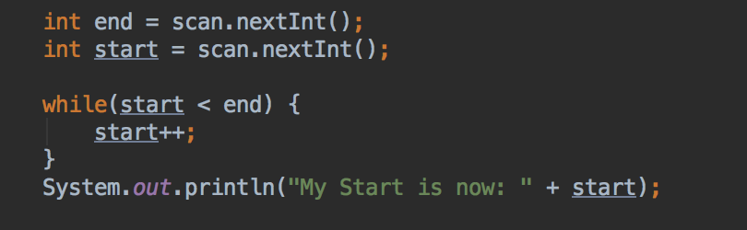
While Loop
Good when:
Your “iteration” variable is created outside the loop
You need your iterator variable outside of the loop
while(TRUE-CONDITION) {/*block of code to execute*/}

Slide 7
While Loop
Lets assume:
end = 3;
start = 1;
end
start
3
1
while(1 < 3){
start++;
}
2
while(2 < 3){
start++;
}
3
while(3 < 3) – out of while
System.out.println(“My Start is now: ”+ start);

Slide 8
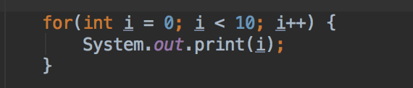
For Loop
Good when:
Your loop has a set start and end
You don’t need to keep your iterator outside the loop
for(variables; condition; iterator) { /* block of code to execute*/ }

Slide 9
For Loop
How the for works:
control variable is initialized
test condition
2.1. if test if true:
execute what is in {}
increment control variable and
go to step 2 again
2.2. if test if false, exit for
What is the program output?
0123456789
What do we need to change to have each number in a different line?
System.out.println(i);
What do we need to change to print the numbers in the reverse order?
for(int i = 9; i >=0; i--)

Slide 10
In Class Activity – Loop Practice
Write the following as a for loop
public static void simpleLoop(int total) { int i = 1; while(i <= total) { System.out.print(i + ","); i = i + 1; } }

Slide 11
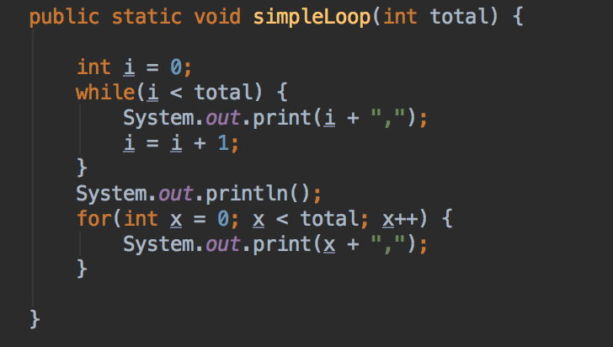
While/For Mostly Interchangeable
Let total = 10
0,1,2,3,4,5,6,7,8,9,

Slide 12
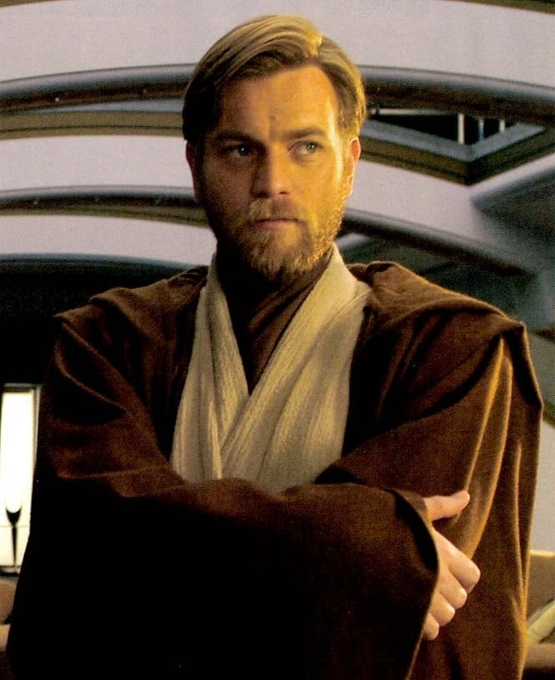
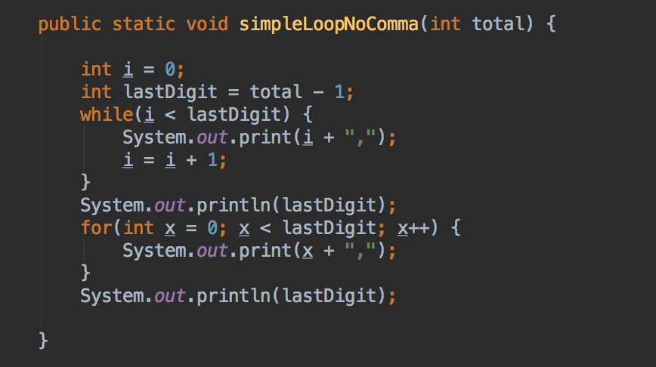
Trailing Comma?
What if I wanted to write same simple loop, but
NO trailing comma?
Let’s face it, that looks bad and probably isn’t what we want

Slide 13
Code Along: loop Practice
Back to Canvas / Zybooks – work on Activity 2 the number game.
One person codes, the rests assists in the coding
Really, everyone trying it, isn’t as beneficial as everyone working together on these!
You can always try it on our own later

